Slide 1




man Research Protections and Quality Assurance
New Staff:
Institutional Review Board Orientation
Kevin Nellis, MS
Executive Director, Human Research Protections and Quality Assurance

Slide 2
Institutional Review Board (IRB) & Privacy Board
Protects the rights and welfare of Research Participants (Human Subjects).
Empowered to approve, require modifications, or disapprove Human Research.
Ensures Human (Subjects) Research is scientifically/scholastically valid, ethical, and in compliance with all requirements.
Ensures compliance through oversight functions.
Serves as a Privacy Board to ensure HIPAA compliance.

Slide 3
Q1: Is it Research? (Under the Common Rule)
A Research Activity is BOTH:
  A systematic investigation (including research development, testing, and evaluation) (i.e., activity that is planned, orderly, methodical, and uses data collection to answer a question)
-AND-
  Designed to develop or contribute to generalizable knowledge (i.e., knowledge gained from a study may be applied to populations outside of the specific study population).

Slide 4
Q2: Does it Involve Research Participants (Human Subjects)? (Under the Common Rule)
In order for research to be considered human research (and thus requiring IRB approval before the study begins), the research must involve living individuals about whom an investigator (whether professional or student) conducting research either
  obtains information or biospecimens through intervention or interaction with the individual, and uses, studies, or analyzes the information or biospecimens; or
  obtains, uses, studies, analyzes, or generates identifiable private information or identifiable biospecimens.

Slide 5

Is IRB Approval Required?
Q1: Is it research?
Q2: Does it involve Research Participants (human subjects)?
If “YES” to
Q1 and Q2:
Submit an IRB application
YES
YES
If “NO” to
Q1 or Q2:
Consult with “IRB Decision Aid”, IRB@downstate.edu or call X8480.
NO

Slide 6
Is IRB Approval Required for
Performance Improvement Activities?
It depends! Does the activity to improve internal operations meet the definition of human research?
Is there an intent to develop or contribute to *generalizable knowledge?
  YES: IRB approval is required
  NO: IRB approval is NOT required
Example:
A clinic surveys patients to improve the quality of service
Without changing intent, clinic staff could
  Share the results at a conference
  Publish the results
  * Publication in

Slide 7
Is IRB Approval Required for
Case Reports or Case Series?
Case Reports/Series of up to three (3) individuals do not need IRB approval
  Such limited activities are generally not considered to be both systematic and generalizable
Examples:
  Review records of 3 patients
  Review records of one patient and ask questions of 2 family members
May request an IRB Determination letter (may be required by journal or conference)
Some journals require informed consent/HIPAA Authorization

Slide 8
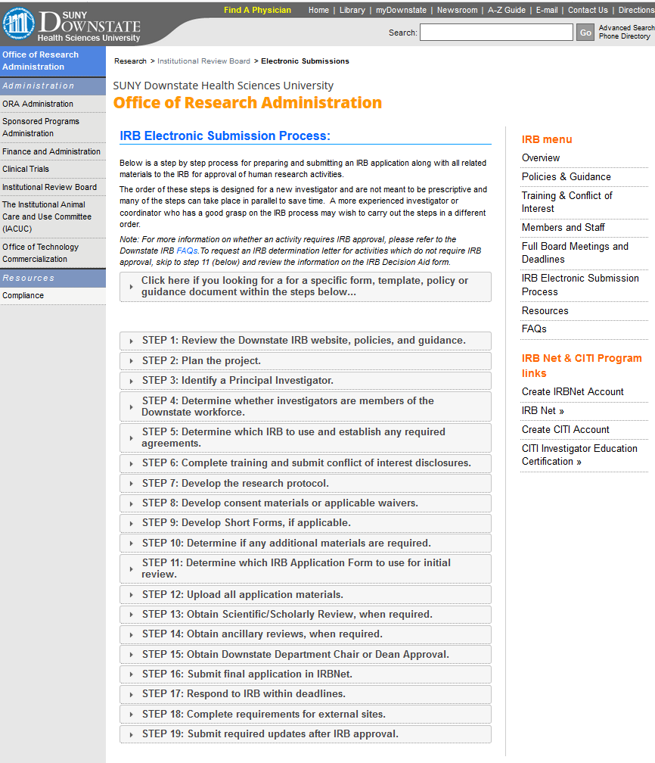

Slide 9
Summary
Submit online applications to obtain initial IRB approvals and submitting required updates
Follow instructions and guidance
Call or visit the IRB Office for help

Slide 10

IRB Contacts
Clinton Brown, MD, IRB Chair | (718) 270-1729
Stanley Friedman, MD, Vice Chair | (718) 270-1335
Jeannette Jakus, MD, Vice Chair | (718) 270-1229
Kevin L. Nellis, MS, CIP, Executive Director, Human Research Protection & Quality Assurance | (718) 613-8461
Diann Johnson, MPH, Associate IRB Administrator | (718) 270-4341
Nikol Celestine, BA, CIP, IRB Management Analyst | (718) 270-4411
Nakih Gonzales, IRB Assistant | (718) 270-4372
IRB Office (BSB 3-26) IRB@downstate.edu Appointments recommended; walk-ins welcome | (718) 613-8480

Slide 11
Additional Contacts
Office of Compliance and Audit Services (Privacy Officer, HIPAA, Compliance Training, Audits, Internal Controls, Clinical Reimbursements, Financial Conflict of Interest Committee) | (718) 270-4033
Igor Gorelik, Information Security Officer | (718) 613-8593 (929) 359-0401
Sponsored Programs Administration (Contracts, Grant Review, Submission, and Management) | (718) 270-2680
Finance and Administration (Financial Analysis, HR, Payroll, Purchasing) | (718) 270-3027
Technology Commercialization (Commercialization and IP) | (718) 613-8514
Michele Follen, MD, PhD, MBA, Director of Research and Chair, Facility Research Review Committee (KC) | (718) 613-8401
Bryce Petty, CCRC, Facility Research Coordinator (KC)/STAR contact | (718) 613-8185

