Slide 1




man Research Protections and Quality Assurance
Institutional Review Board Orientation
& IRB Submission Process
Kevin Nellis, MS
Executive Director, Human Research Protections and Quality Assurance

Slide 2
Institutional Review Board (IRB) & Privacy Board
Protects the rights and welfare of Research Participants (Human Subjects).
Empowered to approve, require modifications, or disapprove Human Research.
Ensures Human (Subjects) Research is scientifically/scholastically valid, ethical, and in compliance with all requirements.
Ensures compliance through oversight functions.
Serves as a Privacy Board to ensure HIPAA compliance.

Slide 3
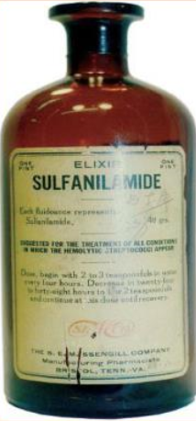
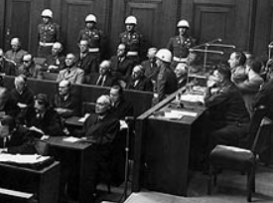

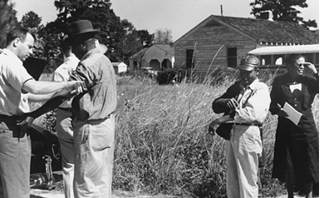
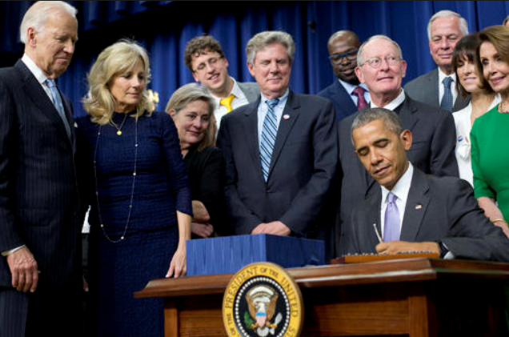
Key Events Change the IRB Landscape
1937
1946 - 47
1950 - 60’s
1972 - 91
2010’s - 20’s
Sulfanilamide Elixir Incident
Nuremberg Trials
Thalidomide Tragedy
Tuskegee Syphilis Study Exposé
Government aims to accelerate research and reduce regulatory burden
Food, Drug, and Cosmetic Act (‘38)
Nuremburg Code (‘47)
Drug Amendments added to F,D&C Act (‘62)
FDA Informed consent regulations (‘63)
National Research Act (‘74)
The Belmont Report (‘79)
Common Rule (‘81)
Revised CR (‘91)
21st Century Cure’s Act (‘16)
NIH Single IRB Rule (Effective ‘18)
Revised Common Rule (Effective ’19)
Single IRB oversight of multi-site studies (Effective ‘20)

Slide 4
Q1: Is it Research? (Under the Common Rule)
A Research Activity is BOTH:
  A systematic investigation (including research development, testing, and evaluation) (i.e., activity that is planned, orderly, methodical, and uses data collection to answer a question)
-AND-
  Designed to develop or contribute to generalizable knowledge (i.e., knowledge gained from a study may be applied to populations outside of the specific study population).

Slide 5
Q2: Does it Involve Research Participants (Human Subjects)? (Under the Common Rule)
In order for research to be considered human research (and thus requiring IRB approval before the study begins), the research must involve living individuals about whom an investigator (whether professional or student) conducting research either
  obtains information or biospecimens through intervention or interaction with the individual, and uses, studies, or analyzes the information or biospecimens; or
  obtains, uses, studies, analyzes, or generates identifiable private information or identifiable biospecimens.

Slide 6

Is IRB Approval Required?
Q1: Is it research?
Q2: Does it involve Research Participants (human subjects)?
If “YES” to
Q1 and Q2:
Submit an IRB application.
YES
YES
If “NO” to
Q1 or Q2:
Consult with “IRB Decision Aid”, IRB@downstate.edu or call X8480.
NO

Slide 7
Is IRB Approval Required for
Performance Improvement Activities?
Does the activity meet the definition of research, including the invent to develop or contribute to generalizable knowledge*?
  If YES, IRB approval is required, if there is an intervention/interaction or it involves identifiable private information or identifiable biospecimens.
  If NO, IRB approval is NOT required
  * Intent to publish is an insufficient criterion for determining whether a quality improvement activity involves research. Planning to publish an account of a quality improvement project does not necessarily mean that the project fits the definition of research; people seek to publish descriptions of nonresearch activities for a variety of reasons, if they believe others may be interested in learning about those activities. Conversely, a quality improvement project may involve research even if there is no intent to publish the results.

Slide 8
Is IRB Approval Required for
Performance Improvement Activities?
Example:
A Downstate clinic develops a patient satisfaction survey for the intent of improving the quality of their service
Identifiable patient information is collected
Without changing intent, clinic staff could
  Share the results at a conference
  Publish the results
Recommend obtaining IRB determination letter stating IRB approval is not required.

Slide 9
Is IRB Approval Required for
Case Reports or Case Series?
Case Reports/Series of up to three (3) individuals do not need IRB approval
  Such limited activities are generally not considered to be both systematic and generalizable
Examples:
  Review records of 3 patients
  Review records of one patient and ask questions of 2 family members
May request an IRB Determination letter (may be required by journal or conference)
Some journals require informed consent/HIPAA Authorization

Slide 10
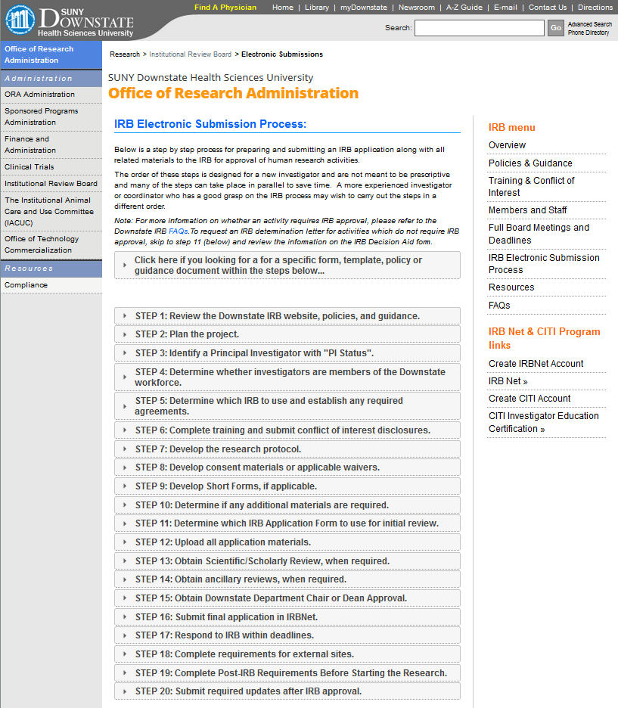

Slide 11
STEP 1: Review the Downstate IRB website, policies, and guidance.
Review the Downstate IRB website for instructions and details on how to submit an IRB application.
  https://research.downstate.edu/irb/electronic-submission.html
Refer to the Policy and Guidance webpage to understand Downstate Policy IRB-01 and other applicable policies and IRB guidance.
  https://research.downstate.edu/irb/policies.html

Slide 12
STEP 2: Plan the project.
Start early!
Conduct a literature search and keep a bibliography of references to include with the protocol.
Consult with a mentor and other experts in the field, as needed.
Consult with a biostatistician, as needed.
More tips available on IRB website.

Slide 13
STEP 3: Identify a Principal Investigator with “PI Status”.
Seasoned investigator with a field-specific terminal degree who is a Faculty Member at Downstate
Clinician with clinical privileges at NYC H + H, Kings County
Faculty member under recruitment to Downstate with written approval by a Dean
Individual approved to be a PI by written memo or e-mail from the Downstate Institutional Official
Individual who qualifies to be a PI at an external site, when the research makes Downstate engaged. Downstate becomes engaged when:
  Federal funding or support is provided to Downstate
  Co-investigators or key personnel on the study are members of the Downstate workforce

Slide 14
STEP 4: Determine whether investigators are members of the Downstate workforce
Understanding whether an Investigator (or Key Personnel) is a member of the "Downstate workforce" will help determine:
  IRB Training Requirements of Investigators and Key Personnel & Conflict of Interest (COI) Requirements for “Investigators for the Purposes of COI,
  Whether IRB Reliance Agreement(s) or Individual Investigator Agreement(s) are required, and
  Which IRB to use.

Slide 15
The Downstate IRB has Oversight of the Downstate Workforce:
Faculty members, employees, and staff who are paid by Downstate,
Employees, staff, or contractors paid by the Research Foundation for SUNY, working on behalf of Downstate,
Individuals with a Downstate Voluntary Faculty appointment with medical privileges (credentialed by University Hospital SUNY Downstate),
Retired Downstate faculty member with emeritus status (approved by IO & Dean/Department Chair),
Residents, Fellows, or Medical Students who are sponsored by Downstate
Students in a Downstate academic program,
Temporary Employees or SUNY contractors working on behalf of Downstate, or
Downstate Volunteers (officially approved by the Downstate Volunteer Office).

Slide 16
Individuals who are not members of the Downstate Workforce
External consultants (e.g., those paid by sponsors or other entities outside of Downstate),
Individuals with Voluntary Faculty appointments at Downstate without medical privileges, and
Employees or agents of institutions that are not listed as components of the Downstate’s FWA including:
  University Physicians of Brooklyn (UPB),
  NYC Health + Hospital, Kings County Hospital,
  Companies within the Downstate Biotech Park,
  Other institutions, or
  Private practices.

Slide 17
STEP 5: Determine which IRB to use …
Downstate IRB
External IRBs:
  Single IRB (sIRB): Federally Funded multi-site research
  Commercial IRB: Sponsored research
  NCI Central IRB: Oncology group trials
  Main site IRB: Institutional IRB
  Tribal IRB: When required by (tribal) law, typically for research with a focus on American Indians, Alaskan Natives tribes, or indigenous people.

Slide 18
STEP 5: …and establish required agreements, as applicable to the research
External IRB Reliance Agreement (IRA) -request their form
SUNY Downstate IRA if external site relies on Downstate IRB
  This is already in place for UHP, NYC H+H, NYC and some Downstate Incubator Tenants
Individual Investigator Agreement (IIA) for each external investigator who is not covered by:
  SUNY Downstate IRA
  PHS COI management process or training program
Data Use Agreement (DUA) for limited data sets, when applicable
Business Use Agreement (BAA) for activities with business associates
Confidentiality Agreements
Clinical Trial Agreement or Facilities Use Agreement

Slide 19
STEP 6: Complete training …
Summary of training requirements:
  CITI training (Group 1 or Group 2)
  HIPAA compliance training
  If applicable:
    COI & research misconduct training (if PI or other investigator for COI purposes)
    Dangerous Goods Shipping certification (if involved with shipping specimens, infectious substances, biological or hazardous substances
    GCP training (if conducting NIH clinical trial or when required by sponsor)
    Department of Defense training is required (if receiving DoD funding)

Slide 20
STEP 6: … and submit conflict of interest disclosures.
Investigators who are determined by the PI to be if investigator for COI purposes, must submit Annual COI disclosures and Transactional Questionnaires for each study.
Update their Annual COI disclosure within 30 days of any new significant financial interest (SFI).
Management Plans must be established for any SFI.
Investigators who are not members of the Downstate workforce must follow their COI disclosure process at their institution and submit their COI adjudication (determination) with the IRB submission or establish IIA.

Slide 21
STEP 7: Develop the research protocol.
Options:
  Use the protocol provided by the sponsor.
  Use template available on Downstate IRB website.
  Develop your own.
Caution:
  Must meet Downstate Data Security requirements.
  Must be consistent with the funding documents.

Slide 22
STEP 8: Develop consent materials or applicable waivers.
Review guidance for Obtaining Legally Effective Informed Consent and HIPAA Research Authorization.
Develop the informed consent templates and related materials or request a waiver, when applicable.
HIPAA authorizations (or waivers ) apply to exempt research involving PHI.
Include SUNY RF Payment Consent, if:
  Compensation is >$600 / calendar year
  Compensation is over $100 per study visit (unless waived for indirect payments, such as cash, gift/pre-paid cards)

Slide 23
STEP 9: Develop Short Forms, if applicable.
Review guidance for Obtaining Legally Effective Informed Consent and HIPAA Research Authorization to determine if Short Forms should be used for the study.
Short Forms and certificates of translations are available on IRB website
Written translation of the long form is expected when the research anticipates the enrollment of five or more research participants with limited English proficiency of the same language (e.g., 6 Spanish speaking participants), for: research:
  Phase 0, 1,1/2, 2, 2a, 2b, or 2/3 Clinical trials which are determined to be greater than minimal risk without any anticipated therapeutic benefit for the research participants
  Studies which are determined to be a minor increase over minimal risk, when there is no direct benefit to the research participant;
  Complex clinical trials; or
  When required by the sponsor.
Interpreter and Witness signs long & short forms

Slide 24
STEP 10: Determine if any additional materials are required.
Recruitment Materials, Questionnaires, Surveys, Data Collection Tools
IND study: Investigator Brochure, FDA Form 1572, IND letter
IDE study: Package Insert, IDE Letter, SR/NSR determination
For trials following GCP, or when requested: CV/Biosketch
When requested, credentials of study staff performing clinical interventions
When requested: Contract with Sponsor
  IRB may need to confirm consistency of informed consent language regarding compensation for injuries, additional costs, GDPR disclosures, data security requirements, or other information.
HIPAA Preparatory to Research Certification Form.

Slide 25
STEP 11: Determine which IRB Application Form to use for initial review.
IRB Application Forms are posted in IRB Website
Website includes guidance on which form to use
IRB is in the process of converting to PDF fillable forms
  Download Adobe Reader DC, if needed
  Update your software, if needed

Slide 26
Types of IRB Applications
Most Common:
  Exempt
  Expedited or Full Board
  External IRB Oversight
  IRB Decision Aid
Other Types:
  Clinical Use of a Humanitarian Use Device (HUD)
  Expanded Access (Investigational Drug/Biologic for Treatment Use)
  Honest Broker Agreement (used with other applications)

Slide 27
Exemption Categories
(Revision effective January 2019)
1) Normal educational practices in established educational settings
2) Educational tests, surveys, interviews, or observation of public behavior
3) Benign behavioral interventions with adults with prospective agreement
4) Secondary research for which consent is not required (includes retrospective chart reviews with HIPAA waiver)
5) Federal research and demonstration projects
6) Taste and food quality evaluation and consumer acceptance studies

Slide 28
Expedited Review of Some Studies That Are No Greater Than Minimal Risk
Clinical studies of drugs and medical devices only under specific conditions (no IND or IDE)
Chart reviews (Consider Exemption #4, if PHI involved)
Survey research (Consider Exemption #2)
Collection of blood samples
Biological specimens obtained by non-invasive means
Collection of data through non-invasive means
Materials collected solely for non-research purposes (Consider Exemption #4)
Collection of data from voice, video, etc. (Consider Exemption #2 and/or #3)
Research employing surveys, focus groups, etc. (Consider Exemption #2)

Slide 29
Examples of Full Board Review
Studies involving greater than minimal risk
Clinical Trials involving IND, IDE, or HUD
Humanitarian Use Device (HUD) for clinical purpose
Expanded Access (Drug/Biologic for Treatment Use)
Initial review of research that meets the criteria for “expedited review” category #1 or #2:
  If it involves biomedical interventions with children, pregnant women, neonates, prisoners, or cognitively impaired adults, or
  If referred by the expedited reviewer

Slide 30
General External IRB Oversight Process
STEP 1: Initiate Reliance Request:
  On file: BRANY IRB, NCI CIRB, & SMART IRB Network (711 sites)
  Others with approval of Downstate IO
  Downstate IRB clarifies local research requirements for the external IRB
STEP 2 (Optional): Pre-Activation/Pre-Review of materials by Downstate IRB
STEP 3: Obtain External IRB approval of Downstate workforce
STEP 4: Activation by Downstate IRB:
  Confirms all local research requirements are met
  Acknowledges External IRB approval
  Downstate reserves the right to request amendments or make recommendations
STEP 5: Follow all applicable policies

Slide 31
IRB Decision Aid – Application for a Determination that IRB Approval is Not required
Use FORM A when Downstate is not engaged in human research.
Use FORM A when there is no intention of developing or creating generalizable knowledge, and the proposed activity is limited to one of the following:
  Health care operations activity (e.g., performance improvement),
  Case report or case series (up to three individuals)
  Operational activity,
  Pilot activity, feasibility activity, or evidence-based practice activity,
  Training or educational activity, or

Slide 32
IRB Decision Aid – Application for a Determination that IRB Approval is Not required
Use FORMB B for any request, such as:
  Any activity described for Form 4A above, particularly if the activity also includes other activities like those listed below,
  Secondary data or materials (data collected for another purpose) which has been de-identified,
  Use of data or specimens from deceased individuals
  Specimens or commercial cell lines that cannot be linked to an individual by the investigator,
  De-identified or coded materials,
  Use of a limited data set under a Data Use Agreement,
  Preparatory to research activities,
  Referring others from Downstate to a new study,
  Pilot activity, feasibility activity, or evidence-based practice that does not involve human research as defined in Policy IRB-01, or
  Training or educational activity that does not involve human research as defined in Policy IRB-01.

Slide 33
STEP 12: Upload all application materials.
Create Username and Password to use IRBNet
Refer to IRB guidance on how to create a new project in IRBNet
Add all documents to the package
Complete the IRBNet registration form (Start Wizard)
OPTIONAL: If desired, share with IRB Administrator to request Pre-Review for any additional feedback

Slide 34
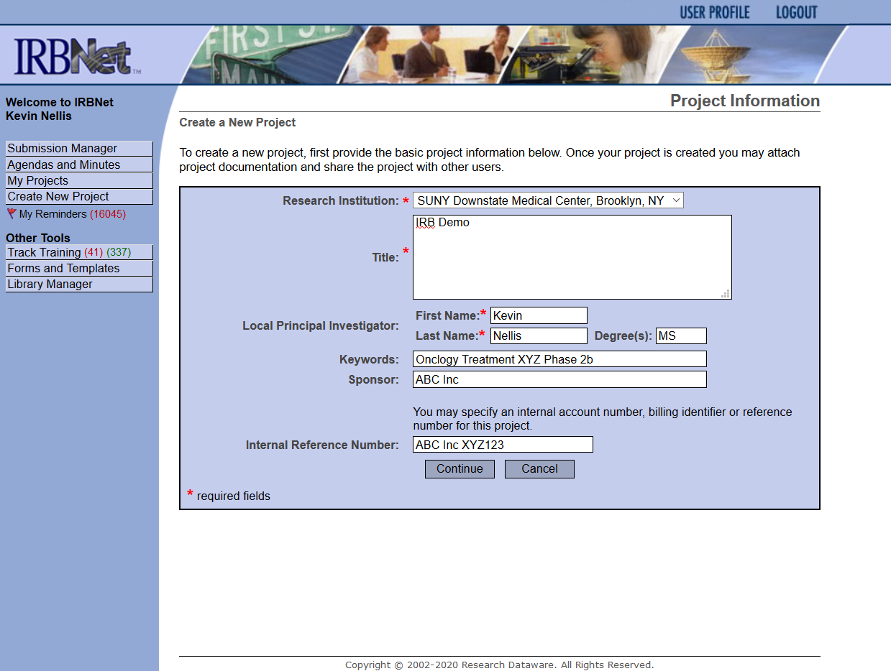

Slide 35
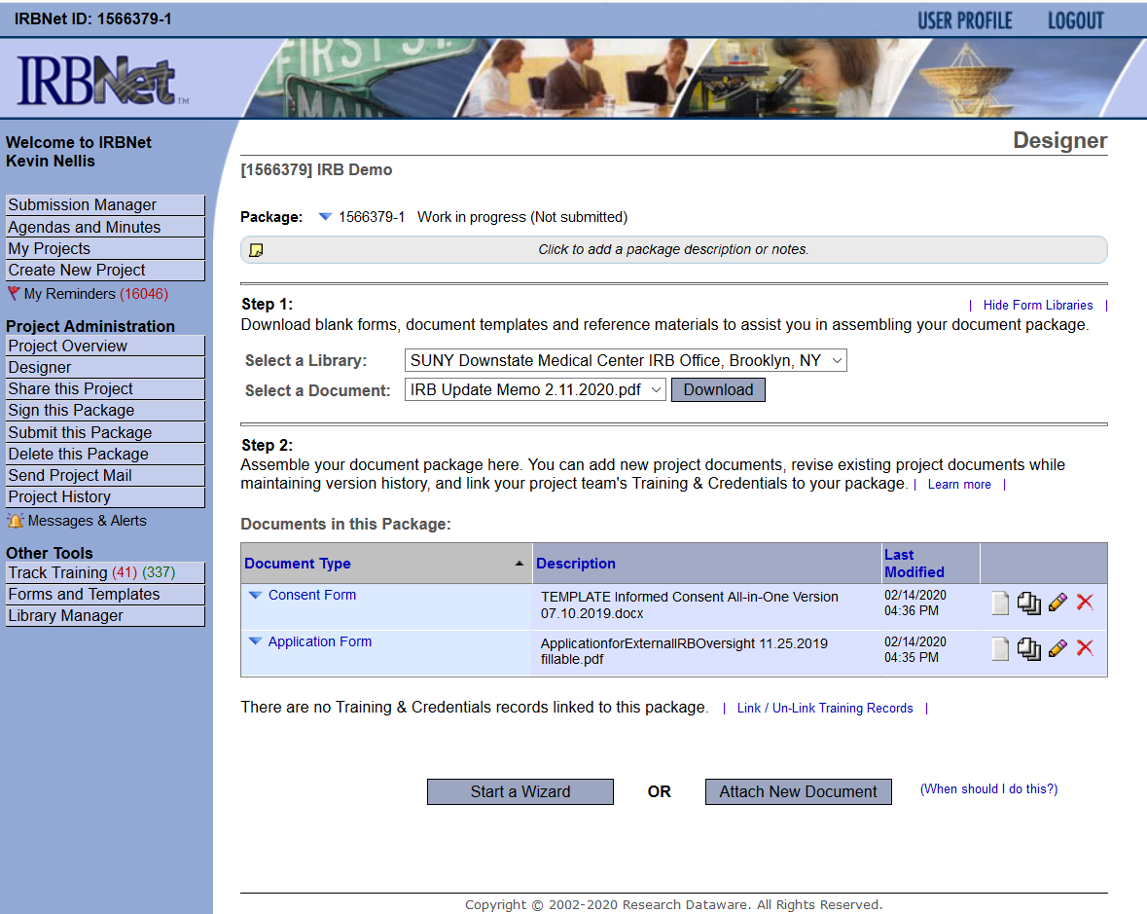

Slide 36
STEP 13: Obtain Scientific/Scholarly Review when required.
Scientific/Scholarly Review (SR) is required prior to IRB approval of the following types of research projects:
  Downstate Full Board Applications, and
  Downstate Expedited Review Applications that qualify for research reviewed under categories (1A) or (1B) (e.g., studies involving a drug, biologic, or medical device).
Share the submission and request electronic signature in IRBNet

Slide 37
STEP 14: Obtain ancillary reviews, when required.
UHB Pathology Laboratories Services
Institutional Biosafety Committee (IBC)
NIH Novel and Exceptional Technology and Research Advisory Committee (NExTRAC)
Downstate Research Pharmacy
Others, if requested by IRB

Slide 38
STEP 15: Obtain Downstate Department Chair or Dean Approval.
Department Chair of Dean must approve application
  Each area needs to approve the study
  Share the submission and request electronic signature in IRBNet
Chair/Dean may delegate to another person via “Delegation of e-Signature Form”

Slide 39
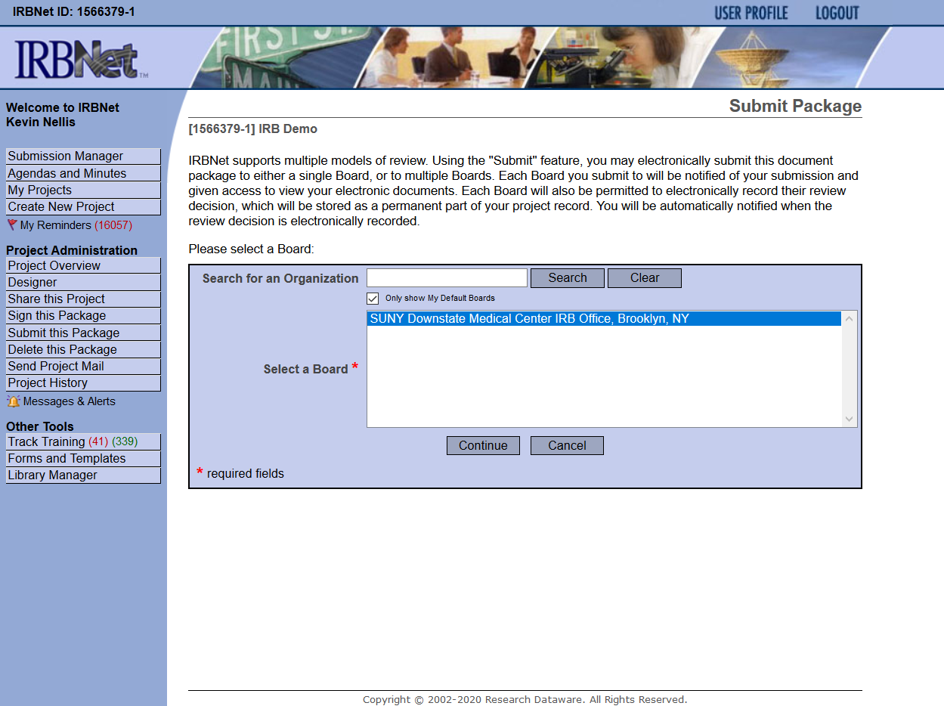
STEP 16: Submit final application in IRBNet.

Slide 40
STEP 17: Respond to IRB Within Deadlines.
“Unlocked” package in IRBNet by IRB:
  Revise materials when requested
  Lock package and mark revisions complete
“Modifications Letter” published by IRB:
  Submit follow-up package in IRBNet
  Include point by point response cover letter
CAUTION: Automatically withdrawn by IRB if response is not timely; however, PI may request more time if needed.

Slide 41
STEP 18: Complete requirements for external sites.
NYC H+H, Kings County:
  Follow policies of NYC H+H and Downstate
  Submit IRB approval in System to Track and Approve Research (STAR).
  Site Principal Investigator must be a full-time, part-time or voluntary physician who is a member of the Medical Staff at Kings County and who has appropriate clinical privileges
Other external sites:
  Follow policies of both the external site and Downstate
  Follow requirements of IRA and/or IIA

Slide 42
STEP 19: Complete Post-IRB Requirements Before Starting the Research
Upon approval by the IRB, the study team should do the following:
  Review the IRB approval letter for accuracy and appropriate determinations.
  Check the approval date and expiration date in letter and approved documents (consent, recruitment materials, etc.). An expiration date is NOT needed for recruitment materials
  Contact the IRB if there are any discrepancies, errors, or questions.
  Share applicable documents with sponsor.
  File documents in study binder.
  Ensure the study meets Applicable Clinical Trial Requirements of the FDA, within the required deadlines.
  Understand and ensure the requirements of sponsor.
  Understand reporting requirements to the IRB, sponsor, and FDA.
  Do not use laboratory reports from research laboratories for diagnosis, treatment and prevention of disease, unless the research laboratory is properly certified or accredited.
Finalize clinical trail agreements, facilities use agreements, with Sponsored Programs Administration, as applicable for the study
Complete any required ancillary reviews that are still pending approval.

Slide 43
STEP 20: Submit required updates after IRB approval.
Acknowledgement
Reportable Events
Amendment (2 TYPES)
  Staff Changes Only
  All other changes
Continuing Review (3 OPTIONS)
  Abbreviated forms for External IRB or HUD for Clinical Use
Check-In Report (for studies with 3 year approval periods)
Final Report (Study Closure)

Slide 44
Reportable Events
Government Inspections (or audit)
Privacy or Information (Data) Security Violation (Breach)
Incarceration of a research participant
Any FDA Action or Changes to HUD
Unanticipated Serious Adverse Event
Research related Injury involving provision of healthcare
Apparent non-compliance (including serious or continuing non-compliance)
New information that indicates a change to the risks or potential benefits of the project
Significant new finding
Changes to eliminate an apparent immediate hazard
Termination or suspension
Administrative or enrollment hold
Local unanticipated problem involving risks to participants or others
Unexpected Adverse Event
Audit or Monitor activities
Unanticipated adverse device effect
Interim Analysis report or DSMB report
Adverse Event, external event, or other sponsored required reporting

Slide 45
Summary
Submit IRB applications online using IRBNet
  Initial IRB approvals
  Required updates
Follow instructions, policies, and guidance on IRB website
Call or visit the IRB Office for help

Slide 46

IRB Contacts
Clinton Brown, MD, IRB Chair | (718) 270-1729
Stanley Friedman, MD, Vice Chair | (718) 270-1335
Jeannette Jakus, MD, Vice Chair | (718) 270-1229
Kevin L. Nellis, MS, CIP, Executive Director, Human Research Protection & Quality Assurance | (718) 613-8461
Diann Johnson, MPH, Associate IRB Administrator | (718) 270-4341
Nikol Celestine, BA, CIP, IRB Management Analyst | (718) 270-4411
Nakih Gonzales, IRB Assistant | (718) 270-4372
IRB Office (BSB 3-26) IRB@downstate.edu Appointments recommended; walk-ins welcome | (718) 613-8480

Slide 47
Additional Contacts
Office of Compliance and Audit Services (Privacy Officer, HIPAA, Compliance Training, Audits, Internal Controls, Clinical Reimbursements, Financial Conflict of Interest Committee) | (718) 270-4033
Igor Gorelik, Information Security Officer | (718) 613-8593 (929) 359-0401
Sponsored Programs Administration (Contracts, Grant Review, Submission, and Management) | (718) 270-2680
Finance and Administration (Financial Analysis, HR, Payroll, Purchasing) | (718) 270-3027
Technology Commercialization (Commercialization and IP) | (718) 613-8514
Michele Follen, MD, PhD, MBA, Director of Research and Chair, Facility Research Review Committee (KC) | (718) 613-8401
Bryce Petty, CCRC, Facility Research Coordinator (KC)/STAR contact | (718) 613-8185

