Slide 1



IRB Member Orientation
Session I
Presented by:
Nikol Celestine
Kevin Nellis
March 2022

Slide 2
Agenda (Session I)
IRB Member Roles & Goals
Applicability of Regulations
General Information
Types of IRB applications

Slide 3
Agenda (Session II)
Informed Consent Requirements
HIPAA Research Authorization Requirements
Waivers and Alterations

Slide 4
Agenda (Session III)
Risk Assessment
Criteria and considerations for IRB approval
IRB Actions

Slide 5
IRB Member Roles & Review Goals

Slide 6
IRB Member Roles
Scientist/Nonscientist
Affiliation
Community member
Prisoner representative

Slide 7
IRB Member Goals
Terms: ( 1 year; renewable to 3 years)
Maintain confidentiality
Training and education
Inform IRB Office of extended absences
Review goals
  For full board studies, enter comments no later than COB on Friday before scheduled meeting
  Other submissions, enter review ASAP, but no later than
    3 days for IRB determinations
    5 days for urgent requests
    10 days all others
Disclose conflicts or interest
Attendance goals -important to meet quorum and voting requirements
  Attend all meetings if possible
  Attend at least 5 of estimated 6 meetings per year.
Performance evaluations

Slide 8
Applicability of Regulations

Slide 9
Regulations:
2018 Common Rule (45 CFR 46)
  Federally funded or supported research
  Research not regulated by FDA or HIPAA regulations
  Applies to multisite research from institutions that voluntarily comply with the Common Rule
  Subparts B, C, D, and E apply when applicable, as indicated within the regulations.
  Expedited review categories
HIPAA Privacy Rule (45 CFR Parts 160, 162, and 164)
  Research involving Protected Health Information (PHI)
FDA (21 CFR 11, 50, 56, 312, 320, 812, 814, etc.)
  Investigational studies involving research participants (including specimens) and FDA regulated articles (e.g., drugs including biologics, food or color additives, and medical devices), including bioavailability and bioequivalence studies.
Applicable Clinical Trial (ACT) –As defined by the FDA/NIH
International Council for Harmonisation (ICH) Harmonized Guideline: Integrated Addendum to ICH E6 (R1): Guideline for Good Clinical Practice E6 (R2).
  Generally, applies to Clinical Trials, especially international trials
Single IRB (sIRB) Requirements (Federally funded/supported)
NIH Certificate of Confidentiality Requirements (NIH funded)
Federal Department or Agency requirements, for example:
  VA – VHA Handbook 1200.05
  Department of Defense
  Department of Justice (PRE-2018 Common Rule (45 CFR 46)
Family Educational Rights and Privacy Act (FERPA)
  Gives parents certain rights regarding children’s education records
Protection of Pupil Rights Amendment (PPRA)
  Gives parents certain rights regarding surveys with children when funded by ED
Children’s Online Privacy Protection Act (COPPA)
  Gives parents certain rights regarding online surveys with children
NYC DoE IRB – Must review certain research taking place at NYC Public schools
NY Privacy Shield – Applies to private data of NY residents
Foreign regulations, including EU General Data Protection Regulation (GDPR)

Slide 10
General Information

Slide 11
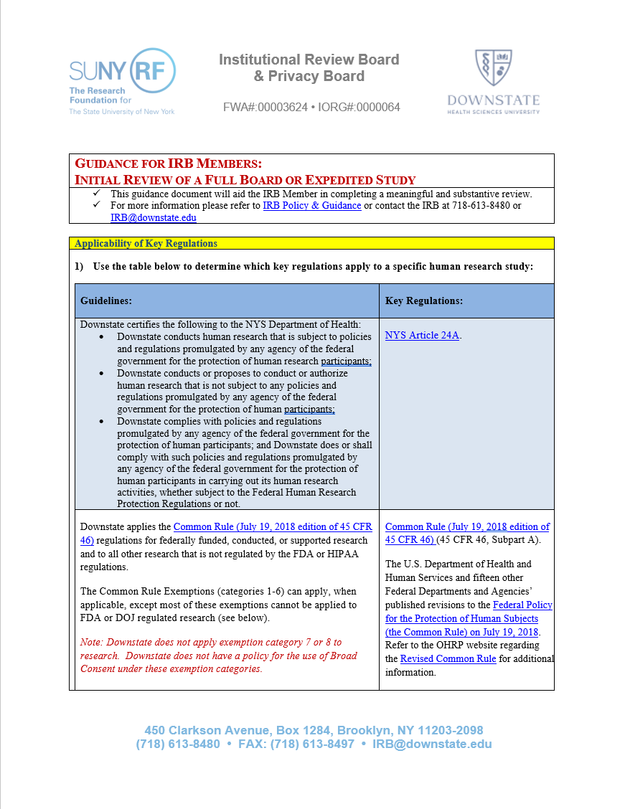
IRB Review Guidance
Available on IRB Website (Guidance for IRB Members)
Institutional Review Board Policies | SUNY Downstate Health Sciences University

Slide 12
Downstate IRB Guidance
Institutional Review Board Policies | SUNY Downstate Health Sciences University
Consolidated IRB guidance related to COVID-19
Applicable Clinical Trial (ACT) Checklist
Belmont Report
Data Security
FDA Guidance
Enrolling or Excluding Pregnant People, Contraception, Pregnancy Testing, and Partners of Participants Who Become Pregnant
Fee Schedule for Industry Sponsored Research
Genome-Wide Association Studies (GWAS- NIH)
GWAS FAQs (NIH)
ICH GCP (E6-R2) 2016
IRBNet (IRB Application and Reporting System)
Lay-Person Summary
Local Context for Reviewing (External) IRB
Material Transfer Agreements
Military Health System Research Regulatory Oversight Office
Obtaining Legally Effective Informed Consent and HIPAA Research Authorization
Office for Human Research Guidance (Alphabetical List)
Qualtrics Survey Software
Recruitment, Referral, Screening, Advertising, and Incentives
REDCap: Research Data Capture and Analysis System
Students, Residents, Fellows, Volunteers, or Employees as Research Participants
Veterans Affairs Office of Research and Development

Slide 13
Belmont Principals
The Belmont Report | HHS.gov
Principal | Application
Respect for Persons -Protects autonomy -Protect those with diminished autonomy | -Informed Consent, Parent/Legal Guardian Permission, or Legally Authorized Representative Disclose all information Ensure comprehension Ensure voluntariness
Beneficence -Do no harm -Maximize benefits -Minimize risks | -Risk/benefit ratio must be justified
Justice -Equal distribution of benefits and risk | -Equitable selection -Consider recruitment of those with limited English proficiency when there is a therapeutic benefit

Slide 14
Types of IRB Applications

Slide 15
IRB Applications for Initial Review
STEP 11 @ IRB Submissions website:
Most frequently used forms:
Form 11-A1: Application for Exempt Review
Form 11-A2: Application for Expedited or Full Review
Form 11-A3: Application for External IRB Oversight
Form A4A: Application for a Determination Letter (IRB Decision Aid)
Less commonly used forms:
Form A1B: Application for Exempt Review - DOJ/DIJ Funded Research Only
Form A5: Application for IRB Approval of Expanded Access to Investigational Drug/Biologic for Treatment Use
Form A6: Application for HUD for Clinical Purposes
Form A7: Application for Independent Honest Broker Assurance Agreement
Forms related to Enrolling or Excluding Pregnant People, Contraception, Pregnancy Testing, and Partners of Participants Who Become Pregnant:
Form 11-8: Exclusion of Pregnant People and/or Plans to Study Outcomes of Unexpected Pregnancies
Form 11-9: Research involving Pregnant People and/or Fetuses

Slide 16
Post-IRB Approval Applications
STEP 20 @ IRB Submissions website:
Submit the applicable application forms to the IRB after the IRB has granted initial approval:
Form 20-B1: Application for Acknowledgment
Form 20-B2A: Application for Amendment
Form 20-B2B: Application for Amendment - STAFF CHANGES ONLY
Form 20-B3: Application Form for Reportable Event
Form 20-B4: Application for Continuing Review/Check-In/Study Closure/Re-Activation

Slide 17
Examples of Full Board Review
Studies involving greater than minimal risk.
Clinical Trials involving IND, IDE, or HUD.
Humanitarian Use Device (HUD) for clinical purpose.
Expanded Access (Drug/Biologic for Treatment Use).
Initial review of research that meets the criteria for “expedited review” category that involves a drug, device or blood collection, if the study includes a biomedical intervention with children, pregnant women, neonates, prisoners, or cognitively impaired adults.
IRB Member refer any study to full board.

Slide 18
Expedited Review
Some Studies That Are No Greater Than Minimal Risk
Clinical investigations of drugs and medical devices only under specific conditions (no IND or IDE)
Collection of blood samples
Biological specimens obtained by non-invasive means
Collection of data through non-invasive means
NOTE: Some of the other federal expedited review categories (1998) now qualify for exempt research under the revised Common Rule (2018).

Slide 19
Exemption Categories
1) Normal educational practices in established educational settings
2) Educational tests, surveys, interviews, or observation of public behavior
3) Benign behavioral interventions with adults with prospective agreement
4) Secondary research for which consent is not required (includes retrospective chart reviews with HIPAA waiver)
5) Federal research and demonstration projects
6) Taste and food quality evaluation and consumer acceptance studies

Slide 20
REMINDER
Please attend Session II & III
Contact the IRB Office with any questions or write to IRB@downstate.edu

Slide 21
Thank You!

