Slide 1
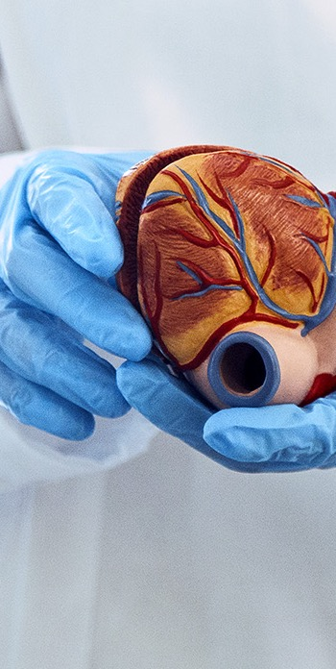


IRB Member Orientation
January 29, 2025
Presented by: Kevin Nellis
Slides by: Nikol Celestine & Kevin Nellis

Slide 2
SUNY Downstate IRB & Privacy Board:
The SUNY Downstate Health Sciences University Institutional Review Board & Privacy Board (Downstate IRB) is a committee established to review and approve human research.
The purpose of the Downstate IRB is to ensure that all human research is ethically conducted in accordance with all applicable regulations and policy, while protecting the rights and welfare of research participants.
Ensures clinical trials involving investigational or unlicensed test articles (drugs, biologics, and devices) have the appropriate regulatory approval or meet exemptions for such approval.
Ensures human research is within compliance of all requirements.
Approves each research protocol or plan according to criteria based on policy, applicable laws, regulations, codes, guidance, and best practices.
Performs Quality Assurance Program monitoring.
Serves as a Privacy Board.
Establishes policy.
Provides guidance, education, and technical support to investigators and their collaborators.

Slide 3
IRB Submissions 2024
Transaction Type
Transaction Type | Number Submitted 2024
INITIAL (NEW PROJECT) | 197
CONTINUING REVIEW | 73
AMENDMENTS | 61
CLOSURE | 48
RESPONSE / FOLLOW-UP | 1
REVISIONS | 1
REPORTABLE EVENTS | 1
FUNDING / GRANT | 1
OTHER | 42
TOTAL | 441

Slide 4
IRB Turnaround Time for NEW Studies (2024)
Turnaround time = Total calendar days from submission to first approval – Investigator response time [(Total calendar days between package while pending a response from investigator) + (Calendar days unlocked for investigators)]
Review Type | TAT Statistics
Full Board | N=1; Average = 158.9 days; Median = 158.9 days; Range =158.9 days
Expedited | N=10; Average = 21.6 days; Median = 3 days; Range = 0 to 109 days
Exempt | N=58; Average = 14.1 days; Median = 10.8 days; Range = 1.75 to 40.1 days

Slide 5
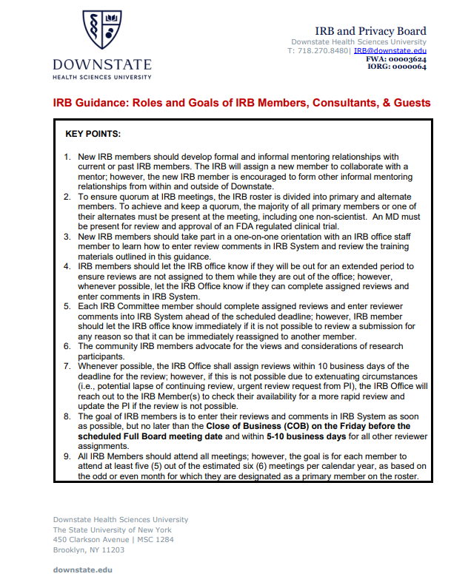
IRB Member Roles & Goals
Roles (Scientist or Nonscientist; Affiliated or Non-Affiliated/Community member, Prisoner representative)
Terms: ( 1 year; renewable to 3 years)
Maintain confidentiality
Maintain training and education
Inform IRB Office of extended absences
Review goals
  For full board studies, enter comments no later than COB on Friday before scheduled meeting
  Other submissions, enter review ASAP, but no later than
    3 days for IRB determinations
    5 days for urgent requests
    10 days all others
Disclose conflicts or interest
Attendance goals -important to meet quorum and voting requirements
  Attend all meetings if possible
  Attend at least 5 of estimated 6 meetings per year.

Slide 6
Regulations:
2018 Common Rule (45 CFR 46)
  Federally funded or supported research
  Research not regulated by FDA or HIPAA regulations
  Applies to multisite research from institutions that voluntarily comply with the Common Rule
  Subparts B, C, D, and E apply when applicable, as indicated within the regulations.
  Expedited review categories
HIPAA Privacy Rule (45 CFR Parts 160, 162, and 164)
  Research involving Protected Health Information (PHI)
FDA (21 CFR 11, 50, 56, 312, 320, 812, 814, etc.)
  Investigational studies involving research participants (including specimens) and FDA regulated articles (e.g., drugs including biologics, food or color additives, and medical devices), including bioavailability and bioequivalence studies.
Applicable Clinical Trial (ACT) –As defined by the FDA/NIH
International Council for Harmonisation (ICH) Harmonized Guideline: Integrated Addendum to ICH E6 (R1): Guideline for Good Clinical Practice E6 (R2).
  Generally, applies to Clinical Trials, especially international trials
Single IRB (sIRB) Requirements (Federally funded/supported)
NIH Certificate of Confidentiality Requirements (NIH funded)
Federal Department or Agency requirements, for example:
  VA – VHA Handbook 1200.05
  Department of Defense
  Department of Justice (PRE-2018 Common Rule (45 CFR 46)
Family Educational Rights and Privacy Act (FERPA)
  Gives parents certain rights regarding children’s education records
Protection of Pupil Rights Amendment (PPRA)
  Gives parents certain rights regarding surveys with children when funded by ED
Children’s Online Privacy Protection Act (COPPA)
  Gives parents certain rights regarding online surveys with children
NYC DoE IRB – Must review certain research taking place at NYC Public schools
NY Privacy Shield – Applies to private data of NY residents
Foreign regulations, including EU General Data Protection Regulation (GDPR)

Slide 7
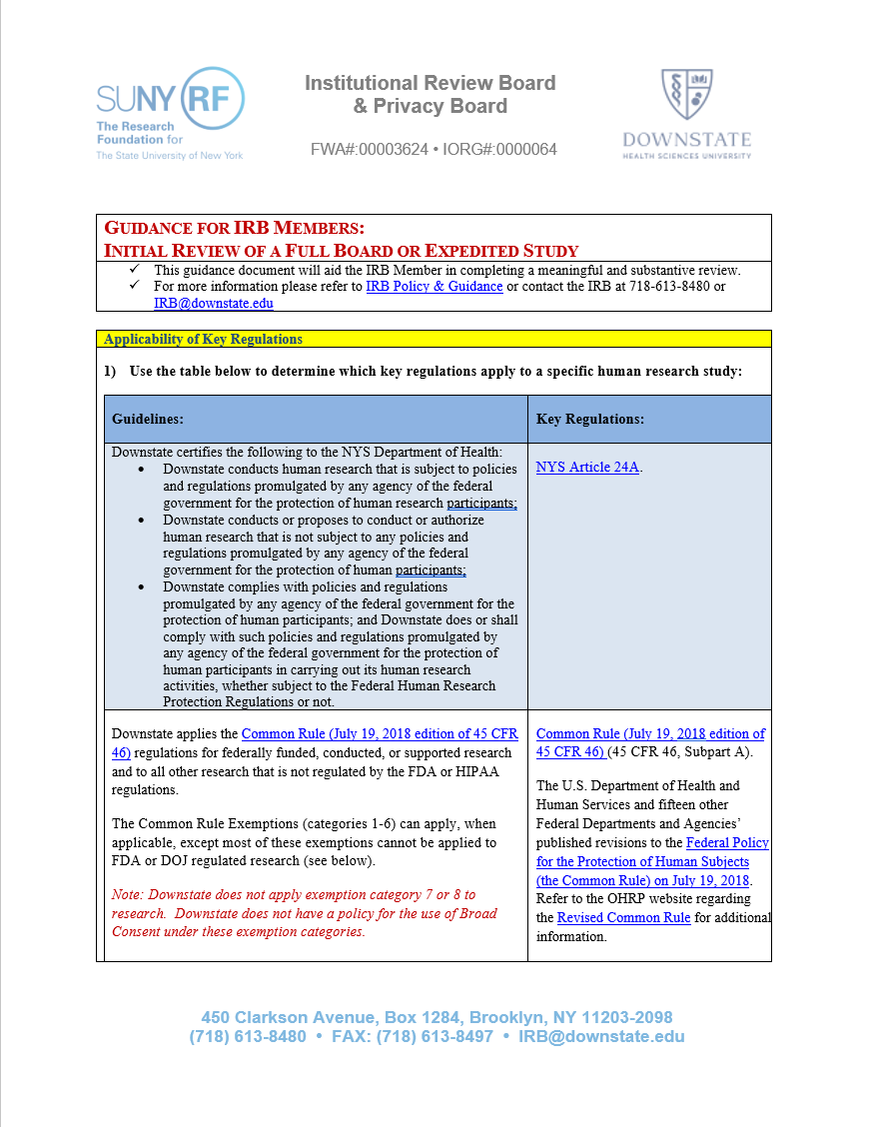
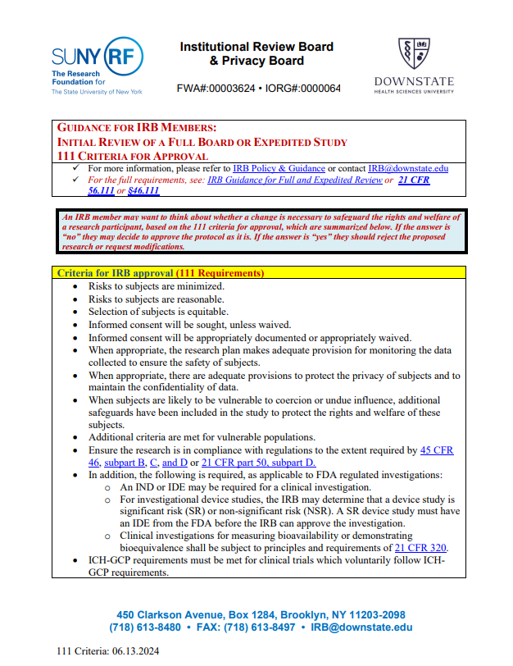
IRB Review Guidance
Available on IRB Website (Guidance for IRB Members)
Institutional Review Board Policies | SUNY Downstate Health Sciences University

Slide 8
Downstate IRB Guidance for Investigators (1)
Institutional Review Board Policies | SUNY Downstate Health Sciences University
Applicable Clinical Trial (ACT) Checklist
Belmont Report
COI Requirements
CITI Program
Definitions for Clinical Research and Clinical Trials
Determining which IRB to Use, which Agreements are required, and which IRB fees to budget
Enrolling or Excluding Pregnant People, Contraception, Pregnancy Testing, and Partners of Participants Who Become Pregnant
FDA Guidance
Fee Schedule
Form 11-A4 Guidance (How to successfully submit and get approval for Form 11-A4: Application for Determination Letter (IRB Decision Aid) for "Not Research, Not Human Research, or Institution Not Engaged in Human Research"
Genome-Wide Association Studies (GWAS- NIH)
GWAS FAQs (NIH)
ICH GCP (E6-R2) 2016
Information Security
IRB Member Nomination
Injury Language
IRBNet (IRB Application and Reporting System)
Lay-Person Summary
Levels of IRB review
Local Context for Reviewing (External) IRB
Military Health System Research Protections (DHA Office of Research Protections)

Slide 9
Downstate IRB Guidance for Investigators (2)
Institutional Review Board Policies | SUNY Downstate Health Sciences University
Obtaining Legally Effective Informed Consent and HIPAA Research Authorization
Office for Human Research Guidance (Alphabetical List)
Quality Assessment Program
Quality Assessment Program -Template Letters to PI
Qualtrics Survey Software
Recruitment, Referral, Screening, Advertising, and Incentives
Rescinding COVID-19 Risk Mitigation Strategies
REDCap: Research Data Capture and Analysis System
Students, Residents, Fellows, Volunteers, or Employees as Research Participants
Training Requirements
Veterans Affairs Office of Research and Development
Zoom to Teams/Doxy.Me IRB Amendment

Slide 10
Belmont Principals
The Belmont Report | HHS.gov
Principal | Application
Respect for Persons -Protects autonomy -Protect those with diminished autonomy | -Informed Consent, Parent/Legal Guardian Permission, or Legally Authorized Representative Disclose all information Ensure comprehension Ensure voluntariness
Beneficence -Do no harm -Maximize benefits -Minimize risks | -Risk/benefit ratio must be justified
Justice -Equal distribution of benefits and risk | -Equitable selection -Consider recruitment of those with limited English proficiency when there is a therapeutic benefit

Slide 11
IRB Applications for Initial Review
Most frequently reviewed by Scientific and Community IRB Members:
Form 11-A2: Application for Expedited or Full Review
Form 11-8: Exclusion of Pregnant People and/or Plans to Study Outcomes of Unexpected Pregnancies
Form 11-9: Research involving Pregnant People and/or Fetuses
Form A5: Application for IRB Approval of Expanded Access to Investigational Drug/Biologic for Treatment Use
Form A6: Application for HUD for Clinical Purposes
Form A7: Application for Independent Honest Broker Assurance Agreement
Most frequently reviewed by Non-Scientific IRB Members and/or IRB Office:
Form 11-A1: Application for Exempt Review
Form 11-A3: Application for External IRB Oversight
Form A4A: Application for a Determination Letter (IRB Decision Aid)
FORM 11-A4Q: Application for an IRB Determination of "NOT Research" or "NOT Human Research" for a Quality Improvement, Quality Assurance, Performance Improvement, or Evidence Based Practice Activity.
Form 11-10: Application For Downstate Workforce Activation of Exempt Research or IRB Determinations (Not Research, Not Human Research, or Downstate Not Engaged) Approved by an (External) Reviewing IRB
Form A1B: Application for Exempt Review - DOJ/DIJ Funded Research Only

Slide 12
Post-IRB Approval Applications
STEP 20 @ IRB Submissions website:
Typically reviewed by IRB Members that are IRB Administrators; however, may be referred to Scientific IRB Members or Chairs, when applicable:
Form 20-B1: Application for Acknowledgment
Form 20-B2A: Application for Amendment
Form 20-B2B: Application for Amendment - STAFF CHANGES ONLY
Form 20-B3: Application Form for Reportable Event (Clinical related events reviewed by MD IRB Member)
Form 20-B4: Application for Continuing Review/Check-In/Study Closure/Re-Activation
Used for the Quality Assessment Program (QAP):
Typically used by IRB Administrators. CAPA may be referred to Scientific Reviewers, Chairs, or Full Board when applicable:
Form 21-1: Quality Assessment Form
Form 21-2: Corrective & Preventative Action Plan (CAPA) Form
STEP 21 @ IRB Submissions website:

Slide 13
Examples of Full Board Review
Studies involving greater than minimal risk.
Clinical Trials involving IND, IDE, or HUD.
Humanitarian Use Device (HUD) for clinical purpose.
Expanded Access (Drug/Biologic for Treatment Use).
Initial review of research that meets the criteria for “expedited review” category that involves a drug, device or blood collection, if the study includes a biomedical intervention with children, pregnant women, neonates, prisoners, or cognitively impaired adults.
IRB Member refer any study to full board.

Slide 14
Expedited Review
Some Studies That Are No Greater Than Minimal Risk
Clinical investigations of drugs and medical devices only under specific conditions (no IND or IDE)
Collection of blood samples
Biological specimens obtained by non-invasive means
Collection of data through non-invasive means
NOTE: Some of the other federal expedited review categories (1998) now qualify for exempt research under the revised Common Rule (2018).

Slide 15
Exemption Categories
Exemption Determinations may be made by IRB Administrators; however, exempt research which requires “Limited IRB Review” is always done by an IRB Member. Typically, these reviews are conducted by an IRB Administrator who is also an IRB member; however, they may be referred to Scientific Members
1) Normal educational practices in established educational settings
2) Educational tests, surveys, interviews, or observation of public behavior
3) Benign behavioral interventions with adults with prospective agreement
4) Secondary research for which consent is not required (includes retrospective chart reviews with HIPAA waiver)
5) Federal research and demonstration projects
6) Taste and food quality evaluation and consumer acceptance studies

Slide 16
Criteria for IRB Approval of (non-exempt) Research (1)
45 CFR 46.111
(a) In order to approve research covered by this policy the IRB shall determine that all of the following requirements are satisfied:
  Risks to subjects are minimized:
    (i) By using procedures that are consistent with sound research design and that do not unnecessarily expose subjects to risk, and
    (ii) Whenever appropriate, by using procedures already being performed on the subjects for diagnostic or treatment purposes.
  (2) Risks to subjects are reasonable in relation to anticipated benefits, if any, to subjects, and the importance of the knowledge that may reasonably be expected to result. In evaluating risks and benefits, the IRB should consider only those risks and benefits that may result from the research (as distinguished from risks and benefits of therapies subjects would receive even if not participating in the research). The IRB should not consider possible long-range effects of applying knowledge gained in the research (e.g., the possible effects of the research on public policy) as among those research risks that fall within the purview of its responsibility.
  (3) Selection of subjects is equitable. In making this assessment the IRB should take into account the purposes of the research and the setting in which the research will be conducted. The IRB should be particularly cognizant of the special problems of research that involves a category of subjects who are vulnerable to coercion or undue influence, such as children, prisoners, individuals with impaired decision-making capacity, or economically or educationally disadvantaged persons.
  (4) Informed consent will be sought from each prospective subject or the subject’s legally authorized representative, in accordance with, and to the extent required by, §46.116.
  (5) Informed consent will be appropriately documented or appropriately waived in accordance with §46.117.

Slide 17
Criteria for IRB Approval of (non-exempt) Research (2)
45 CFR 46.111
    (6) When appropriate, the research plan makes adequate provision for monitoring the data collected to ensure the safety of subjects.
    (7) When appropriate, there are adequate provisions to protect the privacy of subjects and to maintain the confidentiality of data.
      The Secretary of HHS will, after consultation with the Office of Management and Budget’s privacy office and other Federal departments and agencies that have adopted this policy, issue guidance to assist IRBs in assessing what provisions are adequate to protect the privacy of subjects and to maintain the confidentiality of data.
    (8) For purposes of conducting the limited IRB review required by §46.104(d)(7)), the IRB need not make the determinations at paragraphs (a)(1) through (7) of this section, and shall make the following determinations:
      (i) *Broad consent for storage, maintenance, and secondary research use of identifiable private information or identifiable biospecimens is obtained in accordance with the requirements of §46.116(a)(1)-(4), (a)(6), and (d);
      (ii) *Broad consent is appropriately documented or waiver of documentation is appropriate, in accordance with §46.117; and
      (iii) If there is a change made for research purposes in the way the identifiable private information or identifiable biospecimens are stored or maintained, there are adequate provisions to protect the privacy of subjects and to maintain the confidentiality of data.
(b) When some or all of the subjects are likely to be vulnerable to coercion or undue influence, such as children, prisoners, individuals with impaired decision-making capacity, or economically or educationally disadvantaged persons, additional safeguards have been included in the study to protect the rights and welfare of these subjects.
*Note: Downstate has not implemented the Broad consent regulations.

Slide 18
CR Requirements of Informed Consent (1)
General requirements under the Common Rule (NON-EXEMPT REVIEWS):
  (1) Before involving a human subject in research covered by this policy, an investigator shall obtain the legally effective informed consent of the subject or the subject’s legally authorized representative.
  (2) An investigator shall seek informed consent only under circumstances that provide the prospective subject or the legally authorized representative sufficient opportunity to discuss and consider whether or not to participate and that minimize the possibility of coercion or undue influence.
  (3) The information that is given to the subject or the legally authorized representative shall be in language understandable to the subject or the legally authorized representative.
  (4) The prospective subject or the legally authorized representative must be provided with the information that a reasonable person would want to have in order to make an informed decision about whether to participate, and an opportunity to discuss that information.
(5) Obtained in accordance with:
  Informed consent must begin with a concise and focused presentation of the key information that is most likely to assist a prospective subject or legally authorized representative in understanding the reasons why one might or might not want to participate in the research. This part of the informed consent must be organized and presented in a way that facilitates comprehension.
  Informed consent must present information in sufficient detail relating to the research and must be organized and presented in a way that does not merely provide lists of isolated facts but rather facilitates the prospective subject’s or legally authorized representative’s understanding of the reasons why one might or might not want to participate.
(6) No informed consent may include any exculpatory language through which the subject or the legally authorized representative is made to waive or appear to waive any of the subject’s legal rights, or releases or appears to release the investigator, the sponsor, the institution, or its agents from liability for negligence.

Slide 19
CR Requirements of Informed Consent (2)
Basic Elements under the Common Rule (NON-EXEMPT REVIEWS):
  (1) A statement that the study involves research, an explanation of the purposes of the research and the expected duration of the subject’s participation, a description of the procedures to be followed, and identification of any procedures that are experimental;
  (2) A description of any reasonably foreseeable risks or discomforts to the subject;
  (3) A description of any benefits to the subject or to others that may reasonably be expected from the research;
  (4) A disclosure of appropriate alternative procedures or courses of treatment, if any, that might be advantageous to the subject;
  (5) A statement describing the extent, if any, to which confidentiality of records identifying the subject will be maintained;
  (6) For research involving more than minimal risk, an explanation as to whether any compensation and an explanation as to whether any medical treatments are available if injury occurs and, if so, what they consist of, or where further information may be obtained;
  (7) An explanation of whom to contact for answers to pertinent questions about the research and research subjects’ rights, and whom to contact in the event of a research-related injury to the subject;
(8) A statement that participation is voluntary, refusal to participate will involve no penalty or loss of benefits to which the subject is otherwise entitled, and the subject may discontinue participation at any time without penalty or loss of benefits to which the subject is otherwise entitled; and
(9) One of the following statements about any research that involves the collection of identifiable private information or identifiable biospecimens:
    (i) A statement that identifiers might be removed from the identifiable private information or identifiable biospecimens and that, after such removal, the information or biospecimens could be used for future research studies or distributed to another investigator for future research studies without additional informed consent from the subject or the legally authorized representative, if this might be a possibility; or
    (ii) A statement that the subject’s information or biospecimens collected as part of the research, even if identifiers are removed, will not be used or distributed for future research studies.

Slide 20
CR Requirements of Informed Consent (3)
Additional Elements Under the Common Rule
  (1) A statement that the particular treatment or procedure may involve risks to the subject (or to the embryo or fetus, if the subject is or may become pregnant) that are currently unforeseeable;
  (2) Anticipated circumstances under which the subject’s participation may be terminated by the investigator without regard to the subject’s or the legally authorized representative’s consent;
  (3) Any additional costs to the subject that may result from participation in the research;
  (4) The consequences of a subject’s decision to withdraw from the research and procedures for orderly termination of participation by the subject;
  (5) A statement that significant new findings developed during the course of the research that may relate to the subject’s willingness to continue participation will be provided to the subject;
  (6) The approximate number of subjects involved in the study;
  (7) A statement that the subject’s biospecimens (even if identifiers are removed) may be used for commercial profit and whether the subject will or will not share in this commercial profit;
(8) A statement regarding whether clinically relevant research results, including individual research results, will be disclosed to subjects, and if so, under what conditions; and
(9) For research involving biospecimens, whether the research will (if known) or might include whole genome sequencing (i.e., sequencing of a human germline or somatic specimen with the intent to generate the genome or exome sequence of that specimen).

Slide 21
FDA Requirements of Informed Consent (1)
Basic Elements for FDA Regulated Research:
(1) A statement that the study involves research, an explanation of the purposes of the research and the expected duration of the subject's participation, a description of the procedures to be followed, and identification of any procedures which are experimental.
(2) A description of any reasonably foreseeable risks or discomforts to the subject.
(3) A description of any benefits to the subject or to others which may reasonably be expected from the research.
(4) A disclosure of appropriate alternative procedures or courses of treatment, if any, that might be advantageous to the subject.
(5) A statement describing the extent, if any, to which confidentiality of records identifying the subject will be maintained and that notes the possibility that the Food and Drug Administration may inspect the records.
(6) For research involving more than minimal risk, an explanation as to whether any compensation and an explanation as to whether any medical treatments are available if injury occurs and, if so, what they consist of, or where further information may be obtained.

Slide 22
FDA Requirements of Informed Consent (2)
Basic Elements for FDA Regulated Research:
(7) An explanation of whom to contact for answers to pertinent questions about the research and research subjects' rights, and whom to contact in the event of a research-related injury to the subject.
(8) A statement that participation is voluntary, that refusal to participate will involve no penalty or loss of benefits to which the subject is otherwise entitled, and that the subject may discontinue participation at any time without penalty or loss of benefits to which the subject is otherwise entitled.

Slide 23
FDA Requirements of Informed Consent (3)
Additional Elements for FDA Regulated Research:
(1) A statement that the particular treatment or procedure may involve risks to the subject (or to the embryo or fetus, if the subject is or may become pregnant) which are currently unforeseeable.
(2) Anticipated circumstances under which the subject's participation may be terminated by the investigator without regard to the subject's consent.
(3) Any additional costs to the subject that may result from participation in the research.
(4) The consequences of a subject's decision to withdraw from the research and procedures for orderly termination of participation by the subject.
(6) The approximate number of subjects involved in the study.
(5) A statement that significant new findings developed during the course of the research which may relate to the subject's willingness to continue participation will be provided to the subject.
(6) The approximate number of subjects involved in the study.

Slide 24
FDA Requirements of Informed Consent (5)
Include the following for Applicable Clinical Trials
"A description of this clinical trial will be available on http://www.ClinicalTrials.gov, as required by U.S. Law. This Web site will not include information that can identify you. At most, the Web site will include a summary of the results. You can search this Web site at any time."

Slide 25
SUNY RF Informed Consent
SUNY RF Human Subject Payments Policy
Required for research payments (including travel reimbursement) of either
$600 or more in a calendar year, or
more than $100 per study visit

Slide 26
Other Considerations Related to Informed Consent
Other informed consent requirements (see Downstate IRB template for details)
Exception From Informed Consent (EFIC) for Planned Emergency Research or Clinical Trials
Stand-Alone HIPAA Authorizations
HIPAA Authorization for Psychotherapy Notes
Pregnancy Follow-up consent
SUNY RF Payment Consent
Assent (ages 7-12)
Assent (ages 13-17)
Recruitment Authorization Forms
NYS Medical Release Form
Translation of Long Forms, when applicable
Use of Short Forms, when applicable

Slide 27
Requirements of HIPAA Authorization (1)
HIPAA Privacy Rule (45 CFR Parts 160, 162, and 164)
The following core elements must be present in plain language for a research authorization to be valid:
(1) A specific and meaningful description of the PHI to be used or disclosed
Note: The minimum necessary rule does not apply to Authorizations; however, Downstate encourages the investigators to limit the PHI to the minimal necessary PHI that is reasonably necessary to accomplish the purpose of the research.
(2) The name or identification of the person(s) or class of person(s) authorized to make the use or disclosure of PHI. For example, who will disclose the PHI? (e.g., UHD, NYC H+H, Kings County, other hospitals, practice groups, etc.)
(3) The identification of the persons or class of persons to whom the covered entity is authorized to make the disclosure. For example, what internal or external persons or entities will be receiving PHI?
(4) Description of each purpose for which the specific PHI identified earlier is to be used or disclosed
(5) An expiration date or event (this must be a certain date or an event tied to the individual). For example, a statement providing that the authorization will expire on a specific date, after a specific amount of time, or upon occurrence of some event related to the research participant. (e.g., “at the completion of the research”)
(6) The individual’s signature and date, and if signed by a personal representative, a description of his or her authority to act for the individual (e.g., required when recruiting children or cognitively impaired adults).

Slide 28
Requirements of HIPAA Authorization (2)
HIPAA Privacy Rule (45 CFR Parts 160, 162, and 164)
The following statements must be included:
(1) A statement that the individual may revoke the authorization in writing at any time (except to the extent that a provider has taken action in reliance of the authorization), and instructions on how to exercise such right (who does the individual need to write, name and address)
(2) A statement that treatment, payment, enrollment, or eligibility for benefits may not be conditioned on obtaining the authorization if such conditioning is prohibited by the Privacy Rule or, if conditioning is permitted, a statement about the consequences of refusing to sign the authorization.
Note: The PI may condition healthcare on the provision of the authorization for research related treatment (e.g., clinical trial), in which case the provider may refuse to provide the research related healthcare if the research participant refuses to execute the authorization.
(3) A statement about the potential for the PHI to be re-disclosed by the research team (e.g., to another organization) and no longer protected by the Privacy Rule
There are additional requirements for authorizations for using PHI for marketing purposes, sale of PHI, or for the use or disclosure of psychotherapy notes. Contact the IRB or Privacy Officer for additional information or refer to SUNY Downstate HIPAA (Health Insurance Portability and Accountability Act) Policies and Forms.
For additional information see:
(1) DMC HIPAA-28 Policy: Uses and Disclosures for Research Purposes
(2) DMC HIPAA-32 policy: Uses and Disclosures Requiring Patient Authorization.

Slide 29
Waivers and Alterations
STEP 8: SUNY Downstate ORA IRB - Electronic Submissions
Types of HIPAA Waivers: (Investigator e-signs and submits Form 8-18; IRB Member or Privacy Officer must e-sign IRB approved form)
  Full HIPAA Waiver
  Partial HIPAA Waiver
  HIPAA Alteration
  Types of Waivers of Informed Consent Requirements: (Form 8-19)
  Waiver of the entire process
  Waiver of some of the required elements
  Waiver of documentation (signatures)
  IRB Approval:
  All criteria must be met (outlined on form)
  HIPAA Waiver MUST be signed by PI and IRB member

Slide 30
What is “Impracticable”?
SACHRP Recommendations related to waivers
IRB should consider the following points when determining whether the research could not be practicably be carried out without the waiver of consent.
  Common definitions of “Practicable”: Feasible; Capable of being effected, done or put into practice; and that may be practiced or performed; Capable of being done or accomplished with available means or resources.
    Emphasis: It should be noted that this criterion states that the research could not practicably be carried out without the waiver or alteration. Put another way, it would not be practicable to perform the research (as it has been defined in the protocol by its specific aims and objectives) if consent was required. The emphasis being that it is impracticable to perform the research, and not just impracticable to obtain consent. The following concepts may help an IRB determine whether the research could not be practicably carried out without the waiver of consent:
  Scientific validity would be compromised if consent was required. Examples of this might include: A) The sample size required is so large (e.g., population-based studies, epidemiology trials) that including only those samples/records/data for which consent can be obtained would prohibit conclusions to be drawn or bias the sample such that conclusions would be skewed. B) The subjects for whom records would be reviewed are no longer followed and may be lost to follow-up. For example, the proportion of individuals likely to have relocated or died may be a significant percentage of the subject population and the research results may not be meaningful and lose statistical power. iii. The disclosure of the study purpose as part of the consent process would bias the research subjects so that the results will not be meaningful.
  Ethical concerns would be raised if consent were required. For example: A) There is a risk of creating additional threats to privacy by having to link otherwise de-identified data with nominal identifiers in order to contact individuals to seek consent. B) There is a risk of inflicting psychological, social or other harm by contacting individuals or families.
  There is a scientifically and ethically justifiable rationale why the research could not be conducted with a population from whom consent can be obtained.
Practicability should not be determined solely by considerations of convenience, cost, or speed.

Slide 31
Risk Assessment
Minimal risk means that the probability and magnitude of harm or discomfort anticipated in the research are not greater in and of themselves than those ordinarily encountered in daily life or during the performance of routine physical or psychological examinations or tests.
Calibrated to the life of normal, healthy individuals and daily life to be those activities to which most individuals are exposed.
IRB may determine some risks constitute greater than minimal risk for populations that are vulnerable by virtue of their condition or circumstances.

Slide 32
Risk Assessment
Which studies are no greater than minimal risk? Why?
Survey for individuals with traumatic experiences.
A cardiologist enrolls obese diabetic patients into an exercise study using a weight supported treadmill. A crash cart is available to mitigate risk of cardiac arrest.
A study to evaluate vitamin D3 (prescription dose) in children scheduled to undergo standard of care hematopoietic stem cell transplants for AML. The outcome measures are incidence of GVHD, infection rates, and overall survival.
Research with adults that collects 2 mls of blood for genetic testing and takes a single chest x-ray.

Slide 33
Additional Criteria and Considerations for IRB Approval of (Non-Exempt) Research
Follow IRB Guidance and Policy IRB-01, for an extensive list of criteria and considerations.
Follow FDA regulations for clinical investigations.
When vulnerable populations are included, the IRB must also ensure the research is in compliance with regulations to the extent required by 45 CFR 46, subpart B (Pregnant Persons, Human Fetuses, and Neonates), C (Prisoners), and D (Children).
For FDA regulated clinical investigations involving children, ensure compliance with 21 CFR 50, subpart D.
Each Federal Agency has additional requirements.
For clinical trials which follow ICH-GCP requirements, the IRB must ensure additional requirements are met.

Slide 34
Categories of Permissible Research Involving Children (1)
Category | Evaluation | Requirements
Category 404 (45 CFR 46.404 and 21 CFR 50.51) | No greater than minimal risk | Permission of one parent/legal guardian Assent
Category 405 (45 CFR 46.405 and 21 CFR 50.52) | Greater than minimal risk Presents prospect of direct benefit to the individual research participants The risk is justified by the anticipated benefit to the participants; and The relation of the anticipated benefit to the risk is at least as favorable to the participants as that presented by available alternative approaches. | Permission of one parent/legal guardian Assent

Slide 35
Categories of Permissible Research Involving Children (2)
Category | Evaluation | Requirements
Category 406 (45 CFR 46.406 and 21 CFR 50.53) | Greater than minimal risk Minor increase over minimal risk No prospect of direct benefit to the individual research participants Likely to yield generalizable knowledge about the research participants’ disorder or condition Intervention/procedure presents experiences to participants that are reasonably commensurate with those inherent in their actual or expected medical, dental, psychological, social, or educational situations | Permission must be obtained by both parents (or legal guardians), unless one is deceased, unknown, incompetent or not reasonably available, or when only one parent has legal responsibility for the care and custody of the child Assent If children are wards of the state or any other agency, institution, or entity are included, additional requirements of 45 CFR 46.409 must also be met.
Category 407 (45 CFR 46.407 and 21 CFR 50.54) | Research is not otherwise in category 404, 405, or 406, which presents an opportunity to understand, prevent, or alleviate a serious problem affecting the health or welfare of children. | Includes 406 requirements OHRP (or by the FDA, if FDA regulated) must also approve the research

Slide 36
Which category of permissible research with children applies to each of the following studies?
Examples:
STUDY #1: Vaccine hesitancy survey of middle school students. (404)
STUDY #2: Pediatric clinical trial with an investigational agent that is compared to standard of care control arm. Pre-Clinical trials indicate a possible direct benefit of the agent. (405)
STUDY #3: Pediatric clinical trial that compares effectiveness of a new route for an anti-seizure medication. Study is a cross-over study comparing rectal gel to an investigational nasal spray. All subjects have refractory epilepsy. (406)
STUDY #4: Pediatric clinical trial to evaluate the safety and effectiveness of an investigational drug in response to the COVID-19 pandemic. (possibly 407?)

Slide 37
Clinical Trials with Investigational
Drug or Biologics
In general, an IND (Investigational New Drug Application with the FDA) is required for clinical trials with:
Investigational drugs or biologics
FDA approved drug/biologic, unless exempt from IND
Some studies using endogenous compounds, live organisms, cosmetics, dietary supplements, food, food-derived products, spices, herbs, or electronic cigarettes
IRB application requirements for studies with IND:
IND Letter from FDA or Sponsor
FDA Statement of Investigator (FDA Form 1572)
Investigator’s Brochure
References:
FDA Guidance on INDs – Determining Whether Human research Studies Can Be Conducted Without an IND
FAQs - Clinical Studies Involving Electronic Cigarettes and INDs

Slide 38
Criteria for IND Exemption
Full text for IND exemption criteria is available at 21 CFR 312.2(b)(2)(ii)
Not intended to be reported to FDA;
Not to support change advertising of FDA approved product;
Does not involve change in route, dosage, patient population, or other factor that significantly increases the risks of FDA approved drug; and,
IRB approves study and informed consent

Slide 39
Medical Device Studies
Reference: https://www.fda.gov/downloads/regulatoryinformation/guidances/ucm126418.pdf
Is an IDE needed?
If study evaluates safety OR effectiveness of a medical device, determine first if it meets criteria for IDE exemption at 21 CFR 812.2(c).
If not exempt, determine if study is Significant Risk (SR) or Non-Significant Risk (NSR) device study.
If SR, an IDE is needed from FDA
What is a SR Device Study?
Medical device is an implant;
Presents a potential for serious risk to the health, safety, or welfare of a research participant;
Supports or sustains life;
Substantially important in diagnosing, curing, mitigating, or treating disease, or otherwise preventing impairment of human health; or
Otherwise presents a potential for serious risk to the health, safety, or welfare of a research participant.
What is a NSR Device Study?
Medical device study that is not a SR study

Slide 40
IDE Exemption [21 CFR 812.2(c)]
Reference: Frequently Asked Questions About Medical Devices | FDA
In accordance with 21 CFR 812.2(b), sponsors and investigators of certain studies are exempt from the requirements of 21 CFR Part 812, with the exception of §812.119 (disqualification of a clinical investigator). Examples of exempt studies are consumer preference testing, testing of a device modification, or testing of two or more devices in commercial distribution if the testing does not collect safety or effectiveness data, or put subjects at risk.
Studies of an already cleared medical device in which the device is used or investigated in accordance with the indications in the cleared labeling are exempt from Part 812.5 Note: Studies of a cleared device for a new use must comply with the human subject protection (informed consent and additional safeguards for children in research), IRB, and IDE regulations. Similarly, studies of a PMA approved device are exempt from the IDE requirements if the device is being studied for the indications in the approved labeling.
In addition, diagnostic device studies (e.g., in vitro diagnostic studies) are exempt from the requirements of 21 CFR Part 812 under certain circumstances. The study is exempt as long as the sponsor complies with the requirements at 21 CFR 809.10(c) for labeling, and if the testing: (i) is noninvasive; (ii) does not require an invasive sampling procedure that presents significant risk; (iii) does not by design or intention introduce energy into a subject; and (iv) is not used as a diagnostic procedure without confirmation of the diagnosis by another, medically established diagnostic product or procedure. 21 CFR 812.2(c)(3).

Slide 41
Medical Device Quiz
Determine whether each is a medical device study. If so, determine if the study is exempt from IDE requirements, or whether it is NSR or SR:
STUDY #1: A clinical investigation that evaluates the safety and effectiveness of a new implantable cardiac defibrillator to prevent heart failure. (SR)
STUDY #2: A study that evaluates whether wooden tongue depressors are better than plastic tongue depressors. (Exempt)
STUDY #3: A study to evaluate whether an Endopap device can predict vascular problems in patients with sickle cell anemia. (Exempt)
STUDY #4: A clinical trial for FDA market approval of a new diagnostic test and there is no gold standard to confirm the test results. (NSR)

Slide 42
IRB Actions
Full and expedited review
Approve
Approve with conditions
    Response reviewed by expedited review
Require modifications to secure approval
    Response reviewed by Full Board, if initial review was required by Full Board
Disapprove
Note: An IRB member may also refer an exempt or expedited review to the full board.

Slide 43
Conditional Approval
Federal Guidance: OHRP Guidance & FDA Guidance
Specific changes are required (usually minor)
IRB notifies the PI in writing of the changes that are required.
The IRB may approve research with conditions if:
    Given the scope and nature of the required conditions, the IRB is able to make all of the 111 determinations required for approval
        -AND-
    IRB assumes the conditions will be satisfied

Slide 44
Examples of Conditional Approval
Confirmation of specific understandings on the part of the IRB regarding how the research will be conducted (e.g., confirmation that the research excludes children);
Submission of additional documentation (e.g., certificate of CITI training);
Precise language changes to protocol or informed consent documents; or
Substantive changes to protocol or informed consent documents along with clearly stated parameters that the changes must satisfy.

Slide 45
Circumstances that Preclude IRB from Approving Research
IRB cannot make one or more of the determinations required for approval (e.g., 111 findings or subpart findings)
Example:
  IRB is unable to make the required determinations about risks and benefits, adequacy of privacy and confidentiality protections, or adequacy of informed consent because insufficient information is provided
  -AND-
  the IRB is unable to specify changes that would allow the IRB to make these determinations.

Slide 46
Circumstances Which Preclude the IRB from Granting Conditional Approval
EXAMPLES:
Justification for using a placebo or withholding available treatment for a serious medical condition
Providing a justification for enrolling children and how regulatory requirements are met
Revising a study hypothesis
Providing a description of procedures that the control group will undergo
Clarifying information regarding risks
Clarifying timing or circumstances for seeking informed consent
Providing additional monitoring plans

Slide 47
Thank You!

