Slide 1




man Research Protections and Quality Assurance
Institutional Review Board Orientation & IRB Submission Process
Kevin Nellis, MS, CIP
Executive Director, Human Research Protections and Quality Assurance

Slide 2
Institutional Review Board (IRB) & Privacy Board
Protects the rights and welfare of Research Participants (Human Subjects).
Empowered to approve, require modifications, or disapprove Human Research.
Ensures Human (Subjects) Research is scientifically/scholastically valid, ethical, and in compliance with all requirements.
Ensures compliance through oversight functions.
Serves as a Privacy Board to ensure HIPAA compliance.

Slide 3
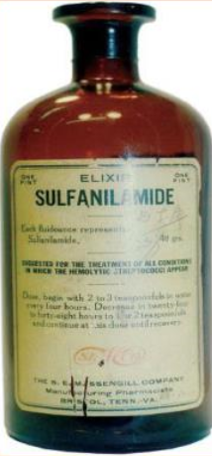
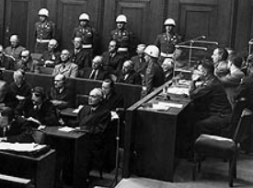

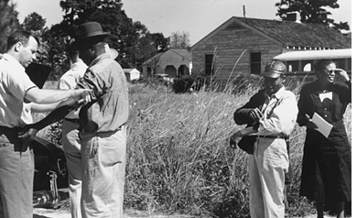
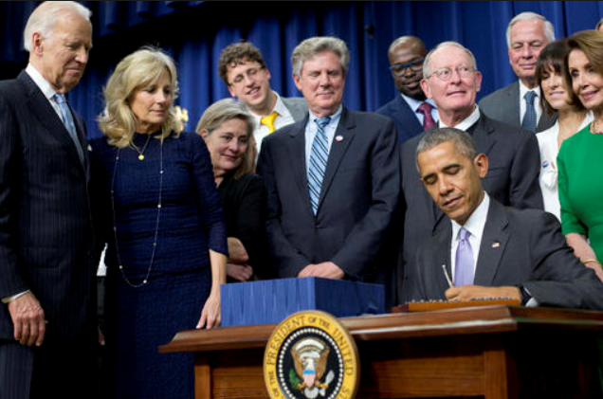
Key Historical Events
1937
1946-47
1960’s
1972-91
2010’s-2020’s
Sulfanilamide Elixir Incident
Nuremberg Trials
Thalidomide Tragedy
Tuskegee Syphilis Study Exposé
Government Aims to Accelerate, Discover, & Develop Biomedical Products; Reduce Regulatory Burden
Food, Drug, and Cosmetic Act (‘38)
Nuremburg Code (‘47)
Drug Amendments added to F,D&C Act (‘62)
FDA Informed consent regulations (‘63)
National Research Act (‘74)
The Belmont Report (‘79)
Common Rule (‘81)
Revised CR (‘91)
21st Century Cure’s Act (‘16)
Revised Common Rule (Effective ’19)
Single IRB oversight of multi-site studies. (Effective ’19 & ‘20)

Slide 4
Q1: Is it Research? (Under the Common Rule)
A Research Activity is BOTH:
  A systematic investigation (including research development, testing, and evaluation)
-AND-
  Designed to develop or contribute to generalizable knowledge.

Slide 5
Q2: Does it Involve Research Participants (Human Subjects)? (Under the Common Rule)
In order for research to be considered human research (and thus requiring IRB approval before the study begins), the research must involve living individuals about whom an investigator (whether professional or student) conducting research either
  obtains information or biospecimens through intervention or interaction with the individual, and uses, studies, or analyzes the information or biospecimens; or
  obtains, uses, studies, analyzes, or generates identifiable private information or identifiable biospecimens.

Slide 6
What is Human Research?
Q1) Is it research?
If YES, go to “Q2”
Q2) Does it involve Research Participants (human subjects)?
If YES to Q1 & then YES to Q2:
Submit an IRB application to the Downstate Medical Center IRB
-------------------------
If “NO” to either, consult with “IRB Decision Aid”, e-mail IRB@downstate.edu or call X8480.

Slide 7
Is IRB Approval Required for
Performance Improvement Activities?
It depends! Does it meet the definition of human research?
Performance improvement activities do not need IRB approval if:
  Intent is to improve internal operations, &
  No intent to contribute to generalizable knowledge
Example:
A clinic surveys patients to improve the quality of service
Without changing intent, clinic staff could
  Share the results at a conference
  Publish the results

Slide 8
Is IRB Approval Required for
Case Reports or Case Series?
Case Reports/Series of up to three (3) individuals do not need IRB approval
  Such limited activities are generally not considered to be both systematic and generalizable
Examples:
  Review records of 3 patients
  Review records of one patient and ask questions of 2 family members
May request an IRB Determination letter (may be required by journal or conference)
Some journals require informed consent/HIPAA Authorization

Slide 9
Types of IRB Applications
Most Common:
  Exempt
  Expedited or Full Board
  External IRB Oversight
  IRB Decision Aid
Other Types:
  Clinical Use of a Humanitarian Use Device (HUD)
  Expanded Access (Investigational Drug/Biologic for Treatment Use)
  Honest Broker Agreement (used with other applications)

Slide 10
Exemption Categories
(Revision effective January 2019)
1) Normal educational practices in established educational settings
2) Educational tests, surveys, interviews, or observation of public behavior
3) Benign behavioral interventions with adults with prospective agreement
4) Secondary research for which consent is not required (includes retrospective chart reviews with HIPAA waiver)
5) Federal research and demonstration projects
6) Taste and food quality evaluation and consumer acceptance studies

Slide 11
Examples of Expedited Review
(May be revised in near future by HHS)
Clinical studies of drugs and medical devices only under specific conditions (no IND or IDE)
Chart reviews (Consider Exemption #4, if PHI involved)
Survey research (Consider Exemption #2)
Collection of blood samples
Biological specimens obtained by non-invasive means
Collection of data through non-invasive means
Materials collected solely for non-research purposes (Consider Exemption #4)
Collection of data from voice, video, etc. (Consider Exemption #2 and/or #3)
Research employing surveys, focus groups, etc. (Consider Exemption #2)

Slide 12
Examples of Full Board Review
Studies involving greater than minimal risk
Clinical Trials involving IND, IDE, or HUD
Humanitarian Use Device (HUD) for clinical purpose
Expanded Access (Drug/Biologic for Treatment Use)
Initial review of research that meets the criteria for “expedited review” category #1 or #2:
  If it involves biomedical interventions with children, pregnant women, neonates, prisoners, or cognitively impaired adults
  If referred by the expedited reviewer

Slide 13
External IRB Oversight
Can request the use of an external IRB for multi-site studies and for research approved by a Tribal IRB
Requires IRB Reliance Agreement (IRA) with the External IRB
  IRA on file: BRANY IRB, NCI CIRB, & those in the SMART IRB Network (over 667 participating sites)
  Other IRAs determined on a case by case basis with approval of Downstate Institutional Official (IO)
Downstate IRB must acknowledge external IRB approval and confirm all local research requirements are met
Cannot be used for the following:
  Downstate as a single site, unless a Tribal IRB is required
  Research previously disapproved by the Downstate IRB
When completing a “Request for External IRB Oversight” application, include only Downstate Workforce to confirm local context

Slide 14
*General External IRB Process
(Not easier but different)
Reliance Request
  Reliance Agreement initiated
  Local research context clarified to external IRB
Pre-Activation (Pre-Review of materials by Downstate IRB)
  Model templates
  Local research context
Obtain approval from External IRB
Activation by Downstate after confirming it meets:
  Downstate institutional requirements
  Local research context
*Actual steps may be different for each External IRB

Slide 15
IRB Decision Aid – Application for a Determination that IRB Approval is Not required
Use FORM A when there is no intention of developing or creating generalizable knowledge, and the proposed activity is limited to one of the following:
  Health care operations activity (e.g., performance improvement),
  Case report or case series (up to three individuals)
  Operational activity,
  Pilot activity, feasibility activity, or evidence-based practice activity,
  Training or educational activity, or
Use FORM A when Downstate is not engaged in human research.
Use FORMB B for any request

Slide 16
Downstate IRB has Oversight of the Downstate Workforce
Faculty members, employees, and staff paid by Downstate
Employees, staff, or contractors paid by the Research Foundation for SUNY, working on behalf of Downstate
Individuals with a Downstate Voluntary Faculty appointment with medical privileges (credentialed by University Hospital SUNY Downstate)
Retired Downstate faculty member with emeritus status (approved by IO & Dean/Department Chair)
Residents, Fellows, or Medical Students who are sponsored by Downstate
Students in a Downstate academic program
Temporary Employees or SUNY contractors working on behalf of Downstate
Downstate Volunteers (officially approved by the Downstate Volunteer Office)

Slide 17
External Investigators’ Reliance with Downstate Serving as the IRB of Record
External Investigators include:
  External consultants (paid by sponsors or other entities outside of Downstate)
  External employees
  Individuals with Voluntary Faculty appointments without medical privileges
Request IRB Reliance Agreement (IRA), except for NYC H+H, Kings County (KC) investigators (IRA already in place)
Request Individual Investigator Agreement (IIA) for:
  Independent investigators not affiliated with an institution, who therefore are not under an IRA, or
  External investigator from an institution without a Public Health Services regulated COI policy and adjudication process

Slide 18
Who can be a Principal Investigator?
Seasoned investigator with a field-specific terminal degree who is a Faculty Member at SUNY Downstate
Meet the criteria for PI status by the NYC H + H, Kings County (e.g., Clinician with clinical privileges at NYC H + H, Kings County).
Faculty member under recruitment to SUNY Downstate with written approval by a Dean
Be approved to be a PI by written memo or e-mail from the Downstate Institutional Official

Slide 19
Who can be a Principal Investigator?
Qualify to be a PI at an external site, when the research makes SUNY Downstate engaged:
  Federal funding or support is provided to Downstate, or
  Co-investigators or key personnel who are members of the Downstate workforce
  Notes: An external PI cannot be acknowledged by the Downstate IRB on an IRB application for External IRB Oversight.

Slide 20
Suggested Timeline (Start Early!)
Review Downstate IRB website for instructions and details:
  https://research.downstate.edu//irb/irb.html
Complete training and submit COI disclosures
  http://research.downstate.edu/irb/irb-training.html
Plan your project
Identify Investigator with PI Status
Develop Protocol (Templates on IRB website)
    Hypothesis, Aims, & Objectives
    Methods, Procedures, Data Collection
    Consult Biostatistician for power analysis and statistical tests

Slide 21
Suggested Timeline (Continued)
Complete IRBNet Registration form in IRBNet
Upload all applicable materials in IRBNet
  Application
  Consent form(s), including short forms
  IND/IDE documentation
  Data Collection tools
  Waivers
  Recruitment materials
  Other materials as outlined on IRB website
Request IRB Office Pre-Review (OPTIONAL –share in IRBNet)
Obtain e-signatures (PI, Chair/Dean, Ancillary Reviewers)
Submit to IRB in IRBNet

Slide 22
Downstate IRB Approval/Disapproval
When reviewed by Downstate IRB:
  Approve
  Approve with conditions
    Response reviewed by expedited review
  Modifications required to secure approval
    Response reviewed by Full Board, if initial review was required by Full Board
  Disapprove/ Not Approved / Deferred / Tabled
When reviewed by an External IRB:
  (Pre-Review) Acknowledgement Pending External IRB Approval
  (Final) Acknowledgement (of external IRB approval)/Activation

Slide 23
Respond to the IRB in a Timely Manner
“Unlocked” package in IRBNet by IRB:
  Revise as requested
  Lock package and mark revisions complete
“Modifications Letter” published by IRB:
  Submit follow-up package in IRBNet
  Include point by point response cover letter
CAUTION: Withdrawn by IRB if response is not timely

Slide 24
Post IRB Approval Requirements
Check IRB approved materials for accuracy
For NYC H+H, Kings County studies, obtain STAR approval
Obtain Sponsored Programs approval, when applicable
Obtain Institutional Biosafety Committee Approval, when required, before starting study
Obtain legally effective informed consent, using IRB approved “stamped” document(s) (when applicable)

Slide 25
Post IRB Approval Applications
Acknowledgement
Reportable Events
Amendment (2 TYPES)
  Staff Changes Only
  All other changes
Continuing Review (3 OPTIONS)
  Abbreviated forms for External IRB or HUD for Clinical Use
Check-In Report (for studies with 3 year approval periods)
Final Report (Study Closure)

Slide 26
Reportable Events
Government Inspections (or audit)
Privacy or Information (Data) Security Violation (Breach)
Incarceration of a research participant
Any FDA Action or Changes to HUD
Unanticipated Serious Adverse Event
Research related Injury involving provision of healthcare
Apparent non-compliance (including serious or continuing non-compliance)
New information that indicates a change to the risks or potential benefits of the project
Significant new finding
Changes to eliminate an apparent immediate hazard
Termination or suspension
Administrative or enrollment hold
Local unanticipated problem involving risks to participants or others
Unexpected Adverse Event
Audit or Monitor activities
Unanticipated adverse device effect
Interim Analysis report or DSMB report
Adverse Event, external event, or other sponsored required reporting

Slide 27
Contact IRB for HELP
Call: (718) 613-8480
E-mail: IRB@downstate.edu
IRB Office: Basic Science Building Room 3-26
  Appointments recommended
  Walk-ins welcome (9AM – 5 PM)

Slide 28

Downstate IRB Contacts
Clinton Brown, MD, IRB Chair | (718) 270-1729
Stanley Friedman, MD, Vice Chair | (718) 270-1335
Jeannette Jakus, MD, Vice Chair | (718) 270-1229
Kevin L. Nellis, MS, CIP, Executive Director, Human Research Protection & Quality Assurance | (718) 613-8461
Diann Johnson, MPH, Associate IRB Administrator | (718) 270-4341
Nikol Celestine, BA, CIP, IRB Management Analyst | (718) 270-4411
Nakih Gonzales, IRB Assistant | (718) 270-4372
IRB Office (BSB 3-26) IRB@downstate.edu | (718) 613-8480

Slide 29
Additional Downstate Contacts
Privacy Officer: (718) 270-4033
Information Security: (718) 270-4621
Sponsored Programs Administration: (718) 270-2680
Office of Technology Commercialization: (718) 613-8515
Office of Compliance and Audit Services: (718)270-4033
Compliance Training Program: (718) 270-4033

Slide 30
NYC H+H, Kings County
All research conducted at NYC H+H, Kings County must also be in compliance with H+H policy and approved in System to Track and Approve Research (STAR). IRB Approval is required before information can be entered in STAR. For more information refer to the NYC H+H, Kings County policies at: https://research.downstate.edu//irb/irb-policies.html
For any questions about NYC H+H, Kings County policy, please contact:
  Michele Follen, MD, PhD, MBA; Director of Research and Chair, Facility Research Review Committee, NYC Health + Hospitals/Kings County (718) 613-8401 or follenm@nychhc.org
  Bryce Petty, CCRC, Facility Research Coordinator: (718) 613-8185 or Bryce.Petty@nychhc.org (Bryce Petty is the best contact for STAR)
Note: The Site Principal Investigator for a study conducted at NYC H+H, Kings County must be a full-time, part-time or voluntary physician who is a member of the Medical Staff at Kings County and who has appropriate clinical privileges as defined in the Facility's Medical Staff Bylaws. This individual must also be approved by the reviewing IRB as personnel on the study.

Slide 31
Summary
Submit online applications to obtain IRB approvals
Follow instructions and guidance
Call or visit the IRB Office for help

