Slide 1
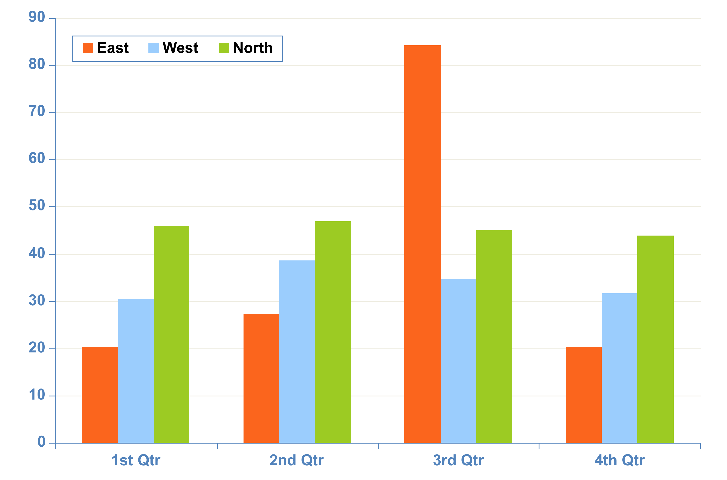
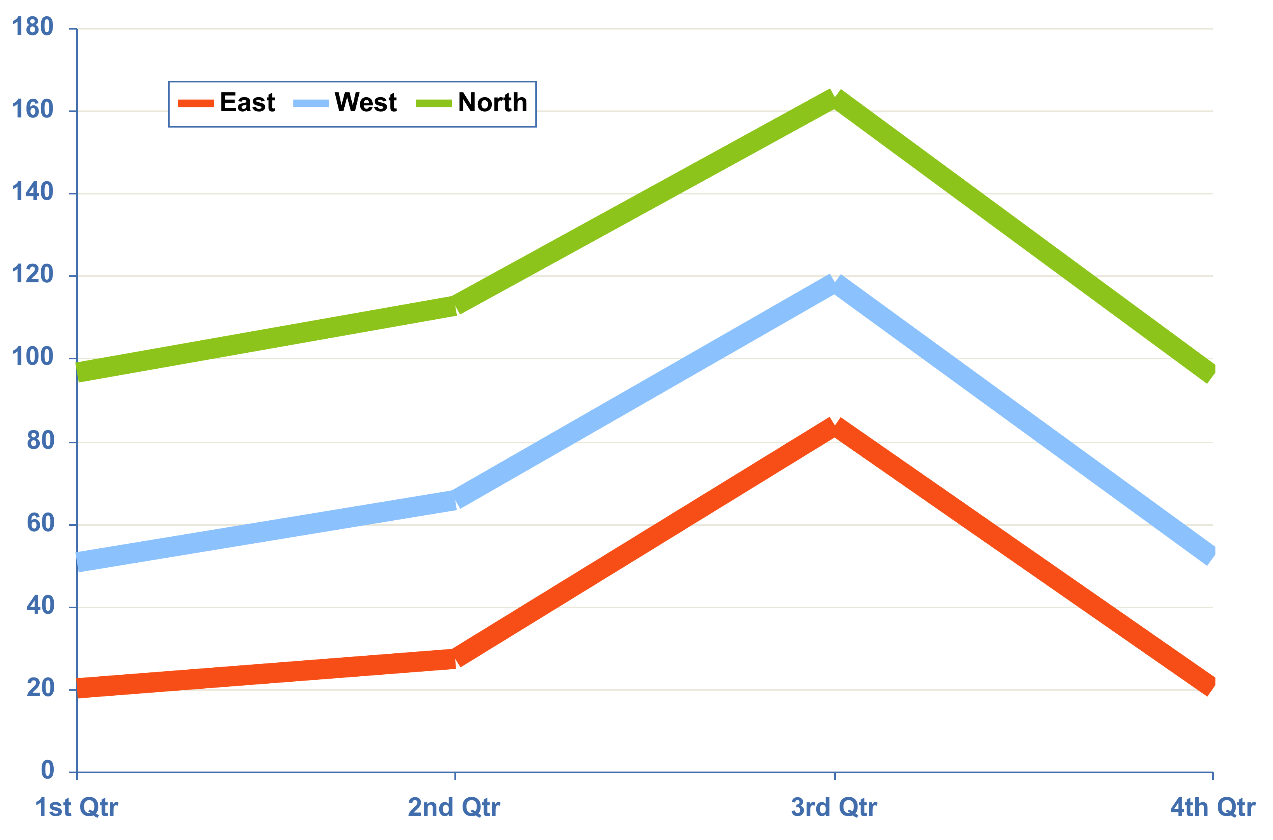
Chart 1. Line CHART input title
Table 2. input title
xx | xx | xx | xx | xx | xx | xx
x | x | x | x | x | x | x
x | x | x | x | x | x | x
x | x | x | x | x | x | x
x | x | x | x | x | x | x
For best results importing text from another program such as Word, please save out the file as a “Plain text” .txt. This will erase all existing formatting.
Copy and paste function can then be applied
Table 2. Pleff lorem monaq morel plaff lerom
Chart 1. Pleff lorem monaq morel plaff lerom
Chart 2. BAR CHART input title
Figure 1. Place your image inside box below
Chart 2. Pleff lorem monaq morel plaff lerom
Figure1. Pleff lorem monaq morel plaff lerom
Table 1. input title
xx | xx | xx | xx | xx | xx | xx
x | x | x | x | x | x | x
x | x | x | x | x | x | x
x | x | x | x | x | x | x
Figure 2. Insert your image inside box below
Commonly used symbols
° Δ Θ Ξ Φ Ψ Ω Σ α β γ δ ε ζ η θ λ ξ ν π ρ σ ς υ φ ψ ω ϑ ϒ ϕ ϖ œ ů § ¶ ¼ ½ ¾ ± α β μ ζ ≤ ≥ © ® √ ∞ ∨∧ ≈ ≅ < > ≤ ≥ = ≠ ⁄ ± ÷ × −+ ™
Table 1. Pleff lorem monaq morel plaff lerom
Figure 2. Pleff lorem monaq morel plaff lerom

