Slide 1
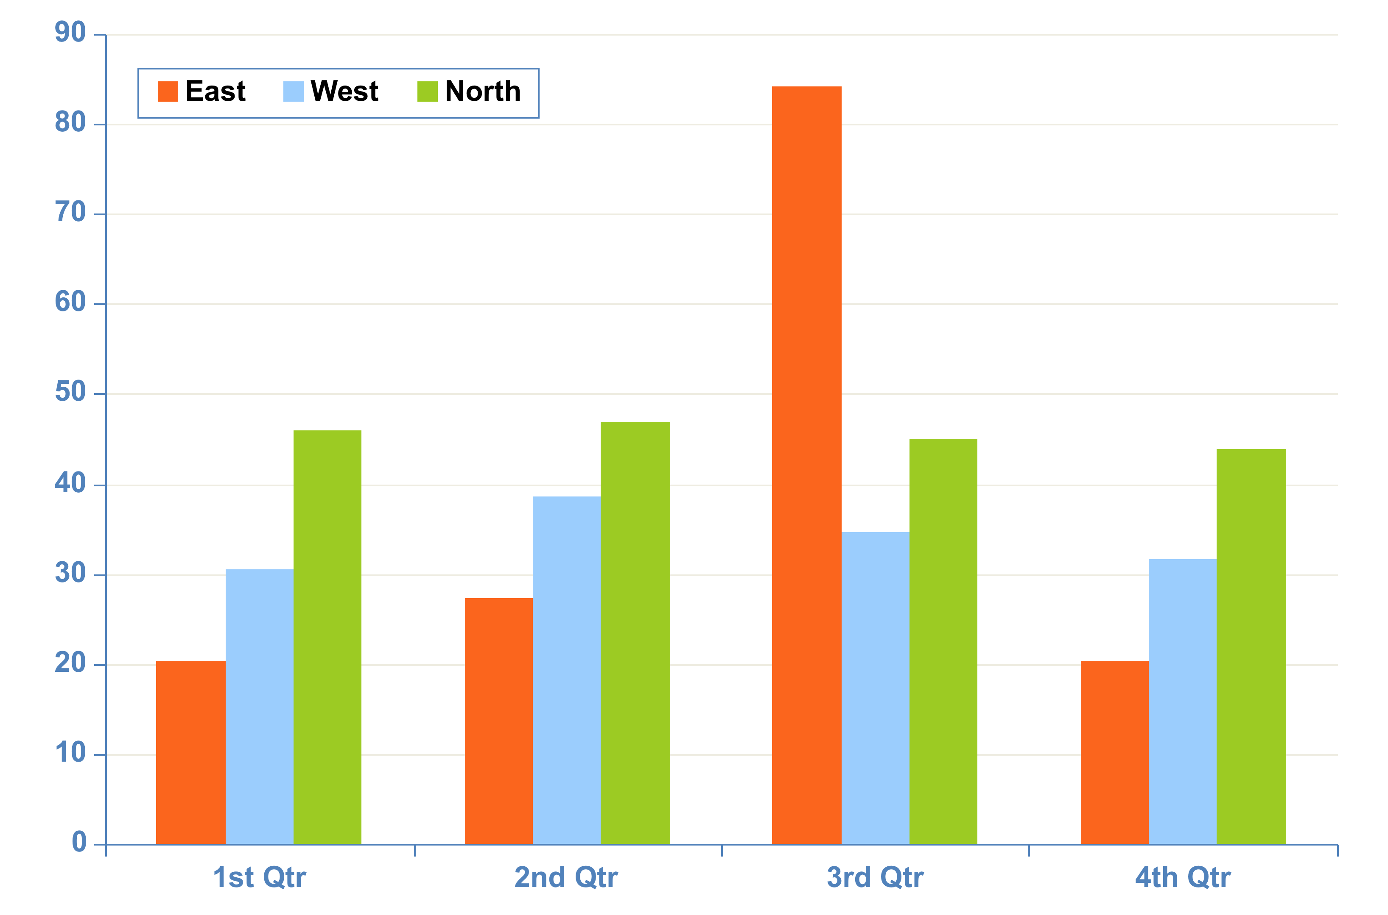
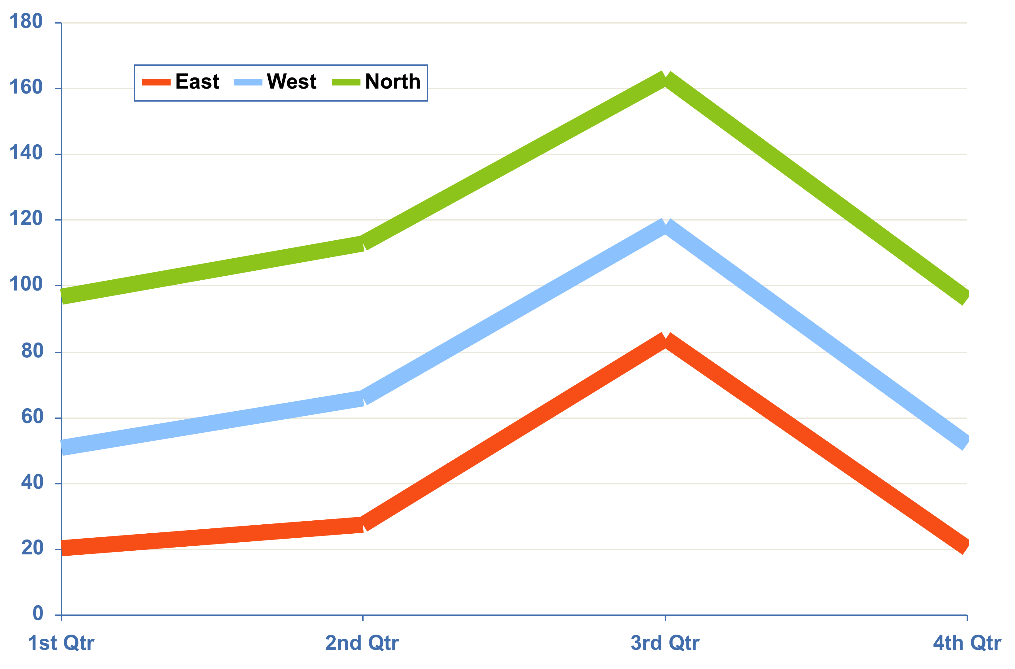
Chart 1. Line CHART input title
Chart 2. BAR CHART input title
Figure 1. Place your image inside box below
For best results importing text from another program such as Word, please save out the file as a “Plain text” .txt. This will erase all existing formatting.
Copy and paste function can then be applied
Chart 1. Pleff lorem monaq morel plaff lerom
Chart 2. Pleff lorem monaq morel plaff lerom
Table 1. input title
xx | xx | xx | xx | xx | xx | xx
x | x | x | x | x | x | x
x | x | x | x | x | x | x
x | x | x | x | x | x | x
Figure1. Pleff lorem monaq morel plaff lerom
Figure 2. Insert your image inside box below
Table 1. Pleff lorem monaq morel plaff lerom
Table 2. input title
xx | xx | xx | xx | xx | xx | xx
x | x | x | x | x | x | x
x | x | x | x | x | x | x
x | x | x | x | x | x | x
x | x | x | x | x | x | x
Figure 2. Pleff lorem monaq morel plaff lerom
Commonly used symbols
° Δ Θ Ξ Φ Ψ Ω Σ α β γ δ ε ζ η θ λ ξ ν π ρ σ ς υ φ ψ ω ϑ ϒ ϕ ϖ œ ů § ¶ ¼ ½ ¾ ± α β μ ζ ≤ ≥ © ® √ ∞ ∨∧ ≈ ≅ < > ≤ ≥ = ≠ ⁄ ± ÷ × −+ ™

