Slide 1
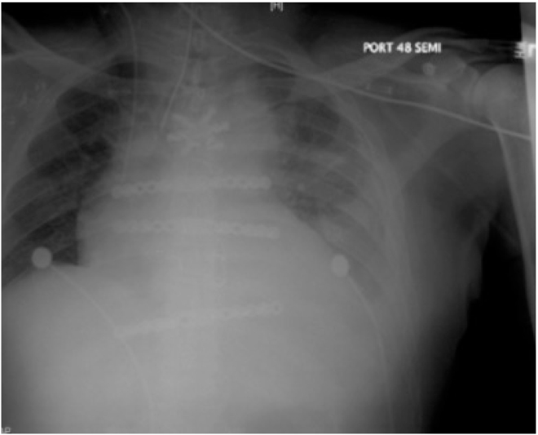
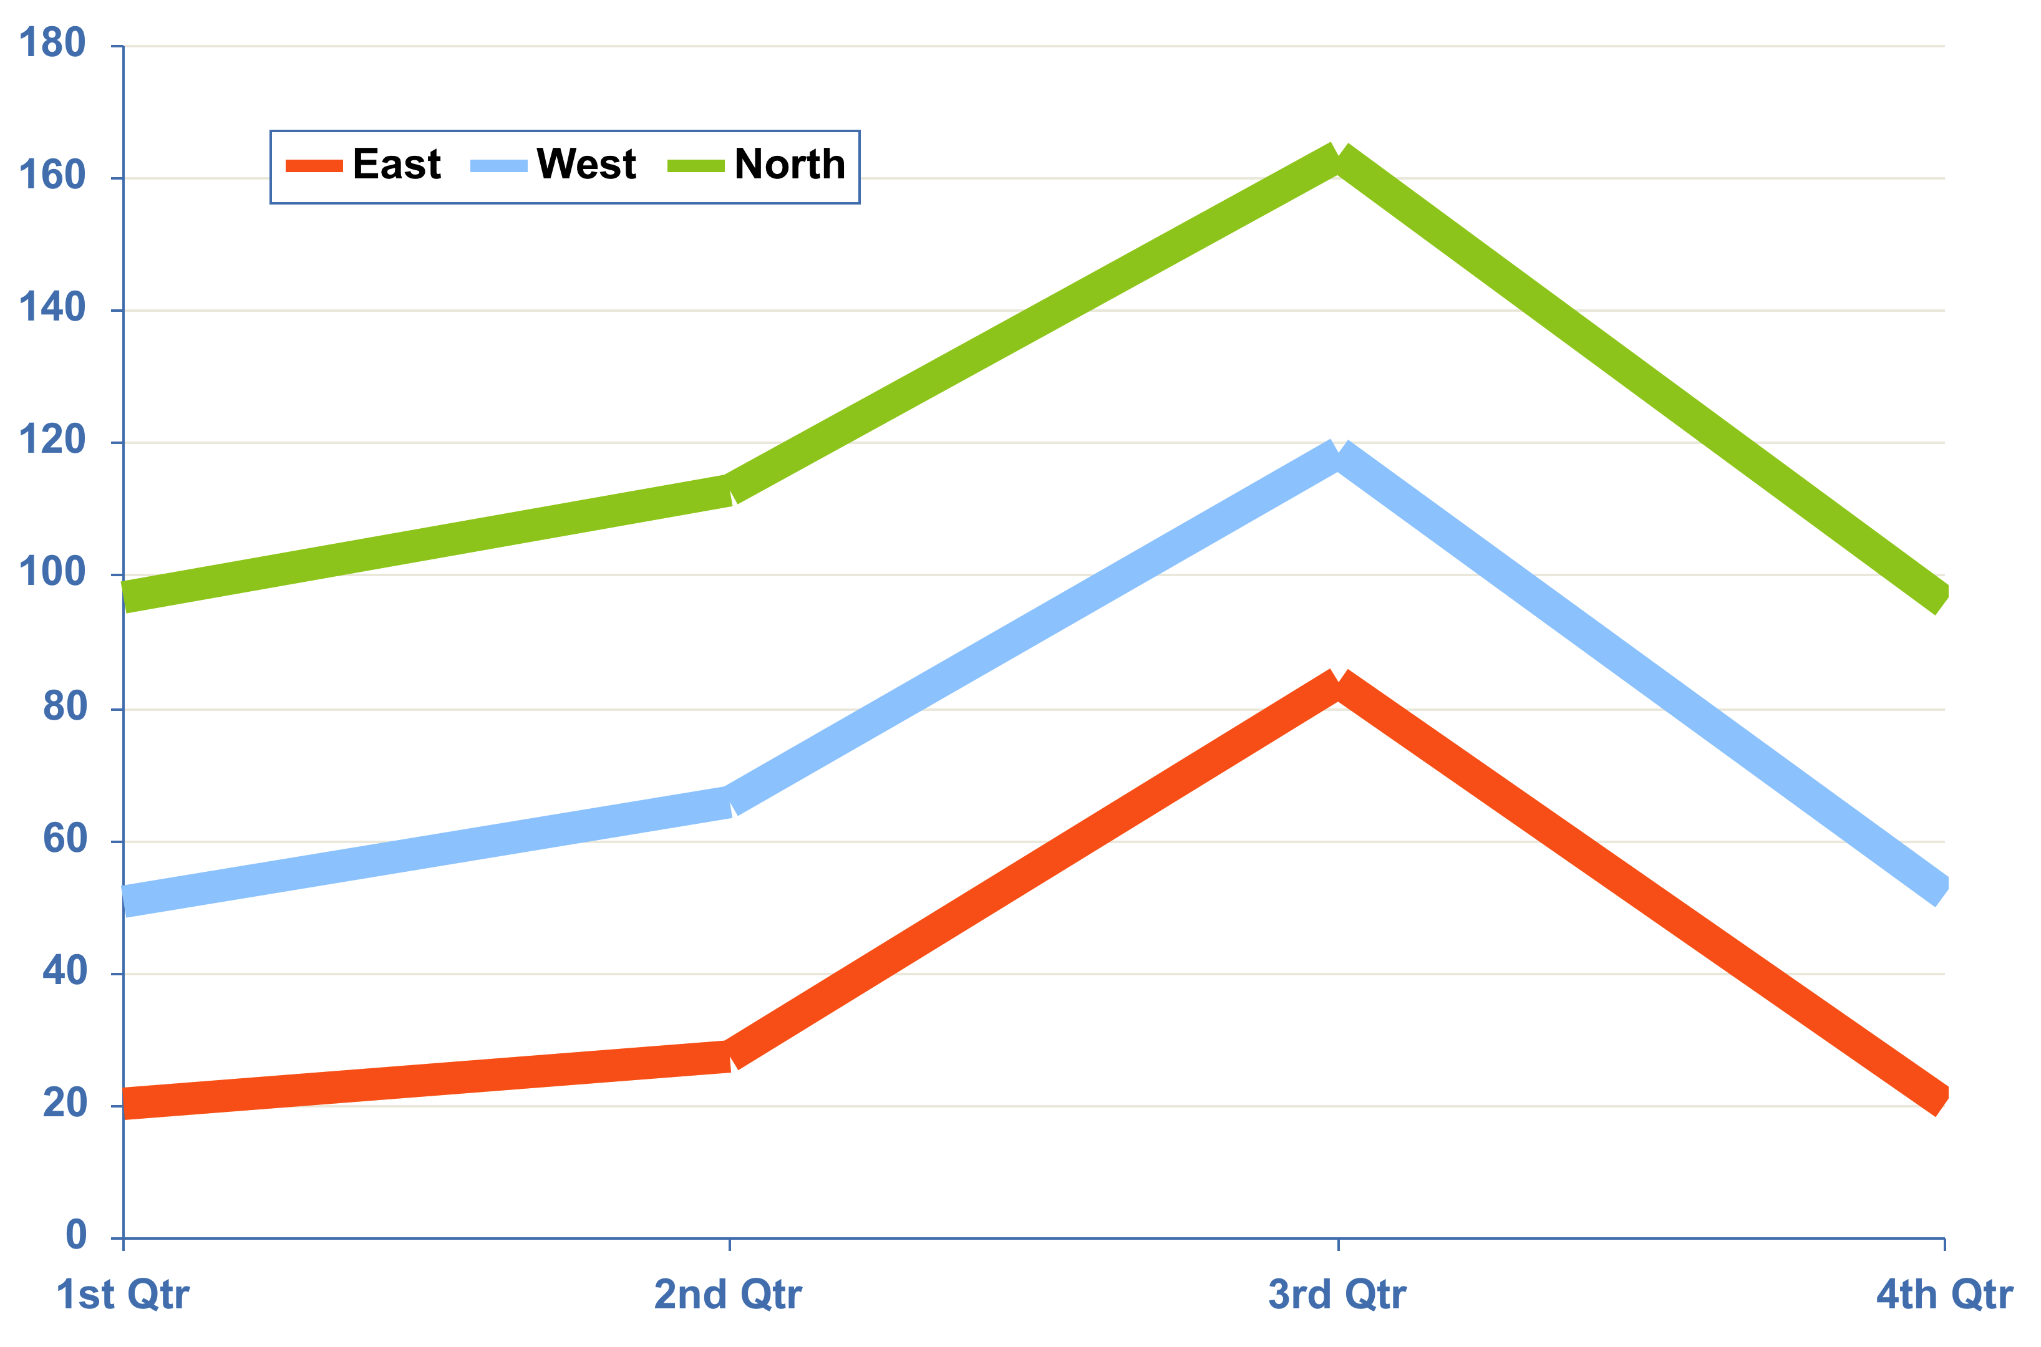
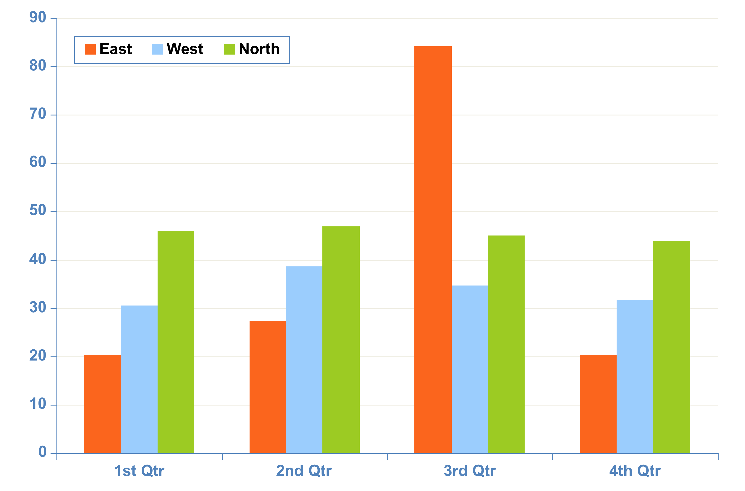
Commonly used symbols
° Δ Θ Ξ Φ Ψ Ω Σ α β γ δ ε ζ η θ λ ξ ν π ρ σ ς υ φ ψ ω ϑ ϒ ϕ ϖ œ ů § ¶ ¼ ½ ¾ ± α β μ ζ ≤ ≥ © ® √ ∞ ∨∧ ≈ ≅ < > ≤ ≥ = ≠ ⁄ ± ÷ × −+ ™
Table 2. input title
xx | xx | xx | xx | xx | xx | xx
x | x | x | x | x | x | x
x | x | x | x | x | x | x
x | x | x | x | x | x | x
x | x | x | x | x | x | x
Chart 1. Line CHART input title
For best results importing text from another program such as Word, please save out the file as a “Plain text” .txt. This will erase all existing formatting.
Copy and paste function can then be applied
Table 2. Pleff lorem monaq morel plaff lerom
Chart 2. BAR CHART input title
Chart 1. Pleff lorem monaq morel plaff lerom
Figure 1. Place your image inside box below
Chart 2. Pleff lorem monaq morel plaff lerom
Figure1. Pleff lorem monaq morel plaff lerom
Figure 2. Insert your image inside box below
Right Click inside Box
Select Format (Picture or Shape)
Select Fill
Select Picture
Select (Insert from: File or Choose a Picture)
Figure 2. Pleff lorem monaq morel plaff lerom

