Slide 1

I COMMIT TO…Welcoming to all
Friendly, Warm, Smiling, Inviting, Pleasant
S.T.A.R.T. with HEART, 10/5 Rule, Compassionate Connection, Active Listening, NO PASSING ZONE
W
Welcoming to all
E
Fair, Just, Impartial, Unbiased
An Army of Problem Solvers, A Learning Organization
Equity
Teamwork, Cooperative, Build Relationships
Cross Check, Repeat Back, Clarifying Questions, SBAR, IPASS, Teach Back, Effective Handoffs
C
Collaboration
A
Ownership, Directness, Clarity, Empathy
Empathy Statement, Know Why and Comply, ARCC it Up
Accountability
R
Revere, Honor, Esteem, Empower, Engage Communicate with Intentional Language, Communicating with HEART Service Recovery
Respect
E
Quality and Safety Outcomes, Distinction, Top Decile Performance
SelfCheck with STAR, Validate & Verify
Excellence
Notes:
Speaker Notes: WREN LESTER
SAY:
We are now going to discuss our FIRST WE CARE Value: Welcoming to All
You see that our behavior standards are Friendly, Warm, Smiling, Inviting and Pleasant
You see several Universal Skills to help us achieve our Value of Welcoming to All
They are 10/5 rule, Compassionate Connection and Active Listening
We will review each in detail

Slide 2
LDA Retention - Value of the Month
Universal Relationship & Reliability Skills
Value | Skills | Month
Welcoming to all Friendly, Warm, Smiling, Inviting, Pleasant | S.T.A.R.T. with HEART, 10/5 Rule, Compassionate Connection, Active Listening, NO PASSING ZONE | May/June 2023
Equity Fair, Just, Impartial, Unbiased | DEI, LGBTQ+ Training, An Army of Problem Solvers, A Learning Organization | July 2023
Collaboration Teamwork, Cooperative, Build Relationships | Cross Check, Repeat Back, Clarifying Questions, SBAR, IPASS, Teach Back, Effective Handoffs | Sept2023
Accountability Ownership, Directness, Clarity, Empathy | Empathy Statement, Know Why and Comply, ARCC it Up | Oct 2023
Respect Revere, Honor, Esteem, Empower, Engage | Communicate with Intentional Language, Communicating with HEART Service Recovery | Nov 2023
Excellence Quality and Safety Outcomes, Distinction, Top Decile Performance | SelfCheck with STAR, Validate & Verify | Dec 2023
Notes:
WREN LESTER

Slide 3
S.T.A.R.T. with Heart®
Mnemonic​ | Behaviors​ | In action​
Smile and greet warmly​ | Make pleasant eye contact, genuinely smile, and greet the person.​ | Smile and make comfortable eye contact​
Tell your name, role, and expectations​ | Introduce yourself professionally by sharing your full name, role, and how you will assist them.​ | “Hi, I’m Megan Thompson, a pharmacy technician. How may I help you with your prescription?”​
Active listening and assist​ | Hear their entire story without interruption, attend to verbal and nonverbal cues, reflect back what you heard, and allow them to clarify details, if needed. Provide some appreciation for what was shared and express empathy. Then, assist them yourself or find someone who can help.​ | Listen to their story without interruption.​ “Yes, your medication has been refilled. I'm glad we were able to fill it for you. Let me get it for you.”​
Rapport and relationship building​ | Show interest in the other person in a culturally appropriate manner by engaging in brief social interactions and connecting with them empathetically.​ | “I’ve heard it’s getting colder outside today. Is it raining too?”​
Thank the person​ | Express appreciation for them or what they did, acknowledge their effort, and sincerely express what it means to you.​ | “Thank you for choosing our pharmacy to fill your medication order. We appreciate your trust in us. What else I may do for you before you go?”​
Notes:
START is how we interact with everyone – WREN LESTER

Slide 4
S.T.A.R.T. with Heart®
Mnemonic​ | Behaviors​ | In action​
Hear | Hear the entire story without interruption, attend to verbal and nonverbal cues, reflect back what you hear, allow time for clarification, and summarize what you heard. | “You called us to order your prescription and didn’t know there weren’t any refills left. You weren’t notified about the delay. Now you’re here and your medicine isn’t ready for you.”
Empathize​ | Imagine yourself in the other person’s place to understand their perspective, feelings, desires, and ideas. Use verbal and nonverbal cues to express compassion | “That’s frustrating! I’d be upset too if I made the trip up here for nothing.”
Apologize | After empathizing, acknowledge the concern and express sincere regret for what the person is experiencing. | “I’m sorry we didn’t notify you ahead of time.”
Respond​ | Take ownership of the situation, address what you realistically can do, and set expectations and time frames. When appropriate give options and follow up. If you are unable to resolve the situation or if it escalates, bring in your manager to assist. | “I will contact your physician by phone right now and see if I can obtain their permission to refill it right away. Would you like to wait for a few minutes or would you rather I call you back once I get an answer?”
Thank | Remember, it is a privilege to take care of each other and thanking communities what we value. Express appreciation for them or what they did, acknowledge their effort, and sincerely express what it means for us to receive this information. | “Thank you for trusting us with your care.”
Notes:
START is how we interact with everyone – WREN LESTER

Slide 5
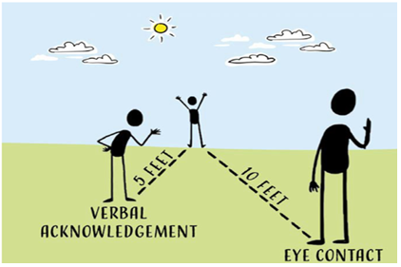
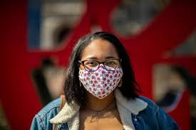
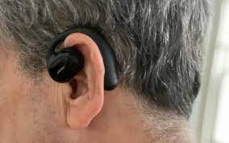

Acknowledge Others!
The 10-5 Rule is simple, It says that anytime you come within ten feet of a customer, you attempt to make eye contact. Smile or nod, and use positive body language.
When you are within five feet, you acknowledge them verbally with a “Hello”, “Good Morning”, or something similar.

Slide 6

Compassionate Care Video.mp4 (sharepoint.com)
Notes:
INGRID SUMMERS

Slide 7
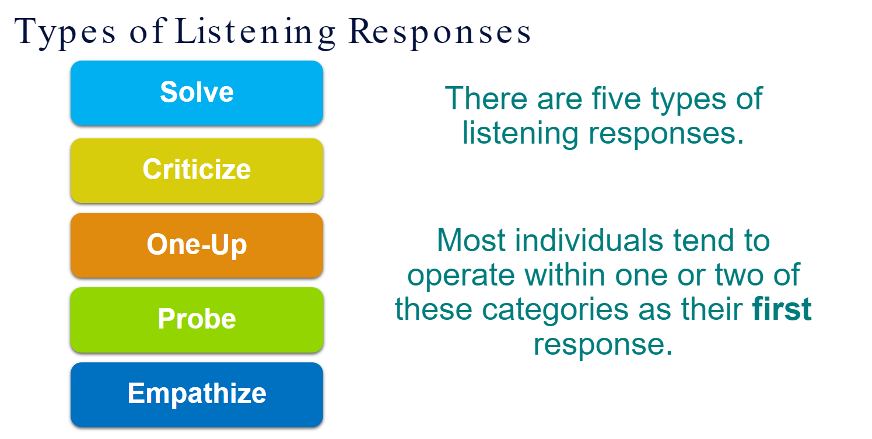
Notes:
INGRID SUMMERS

Slide 8
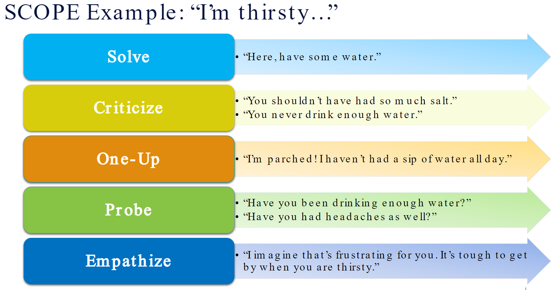
Notes:
INGRID SUMMERS

Slide 9
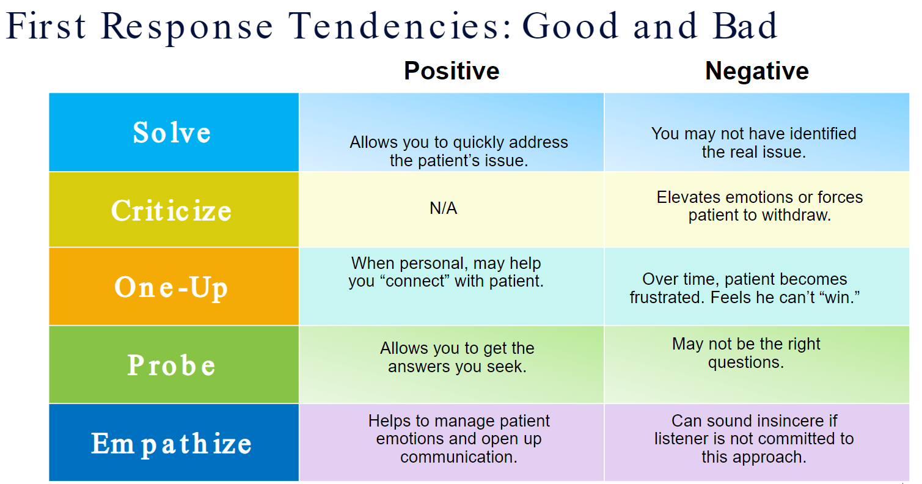
Notes:
INGRID SUMMERS

Slide 10

NO PASSING ZONE
Responsiveness
NO PASSING ZONE – All employees are reminded that the care of the patient is everyone’s responsibility
If a patient/visitor looks lost or needs help ALL employees should lend a hand.
Call bells are to be ANSWERED within 5 rings and responded to within 5 minutes
ANY EMPLOYEE walking down the hallway should NOT PASS by the flashing call light:
  Knock, wash hands, and enter the patient’s room to acknowledge the request for help
  Inform the patient that help is on the way
  Alert the patient’s nurse or nurse’s aide immediately.
Notes:
PAULINA BOATENG with in 5 Rings
No Passing Zone empowers all caregivers to not pass by patient call lights without acknowledging, answering, or resolving the patient's needs. No passing zone also applies to never passing by a patient or visitor in the hallway who may appear to be lost. Always ask if they need help and try to assist them.

Slide 11
NS 74 Ortho/Rehab & NS 72
Patient Experience
Haris Choudry, MD & Paulina Boateng, RN
Notes:
Paulina BOATENG

Slide 12
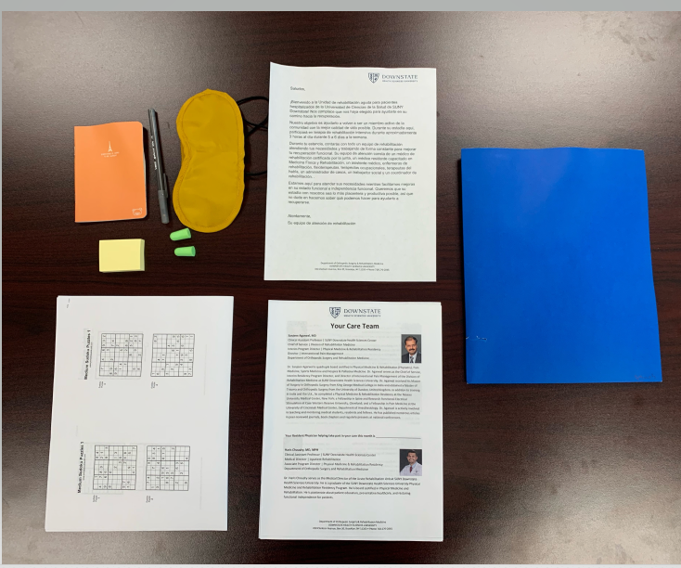
NS 74 – Ortho/Rehab Patient Experience
Welcoming all patients in their Native language.
Welcome and good morning in native language written on the white board in patient’s room.
Welcome folder in different languages.
Folder Content: Welcome to downstate in native language; introduction of the Rehab Team with a Picture and introduction of each team member.
A small note book; a small post it; a pen to write ; ear plugs and sleeping mask and a puzzle book.
Notes:
Paulina BOATENG

Slide 13
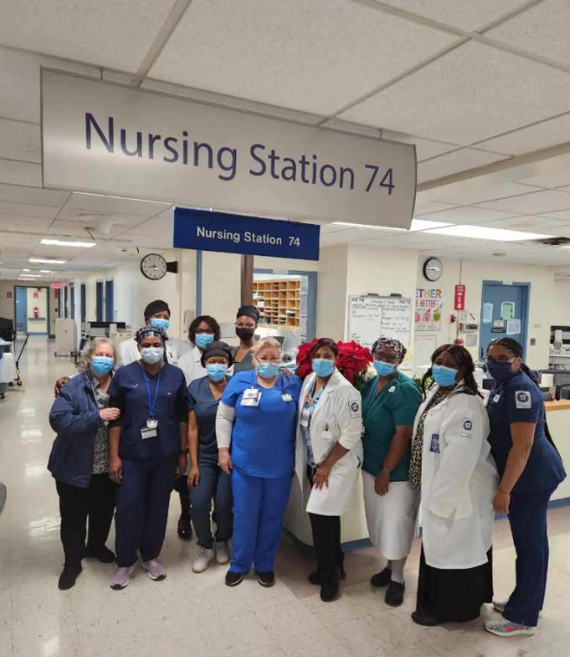
NS 74 Ortho/Rehab Patient Experience
Library on Wheels for the patients.
Physician care team (Attending and Resident) go down to therapy gym and see patients actively performing their rehab with therapy staff.
Afternoon Tea for Rehab Patients.
No Pass Zone – PI Project on the unit; where no one passes a call light.
Notes:
Paulina BOATENG

Slide 14
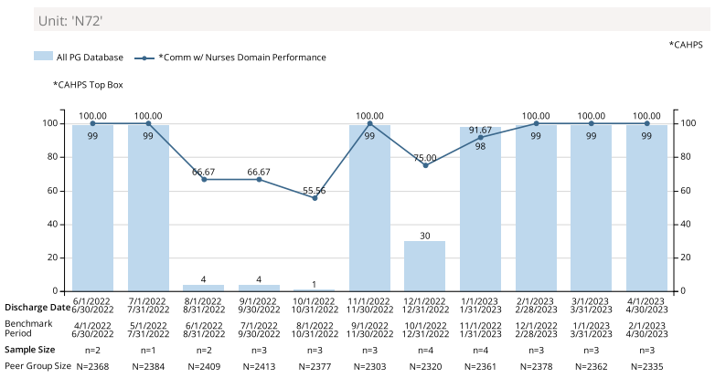
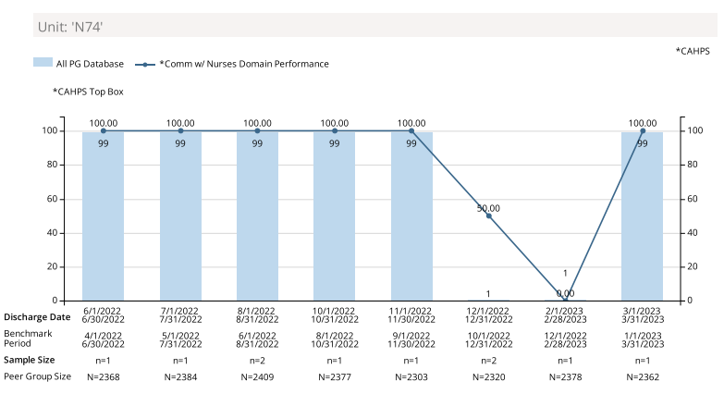
NS 72 & NS 74 – Comm w/ Nurses Domain
Notes:
Wren Lester & Paulina Boateng

Slide 15
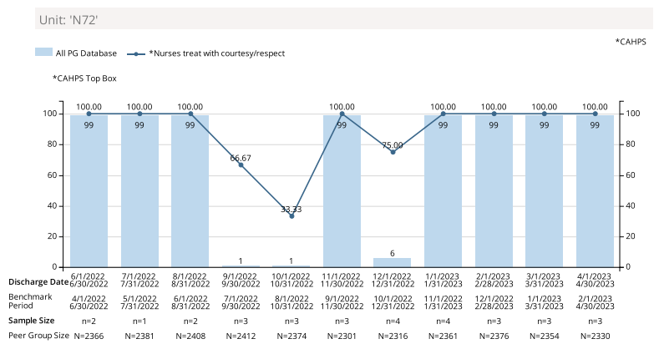
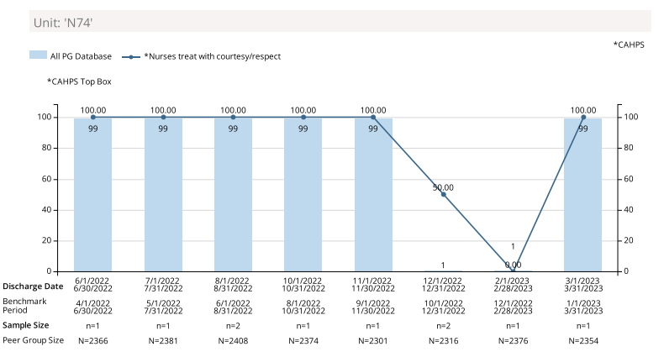
NS 72 & NS 74 – Nurses treated you w/ Courtesy and Respect
Notes:
Wren Lester & Paulina Boateng

Slide 16
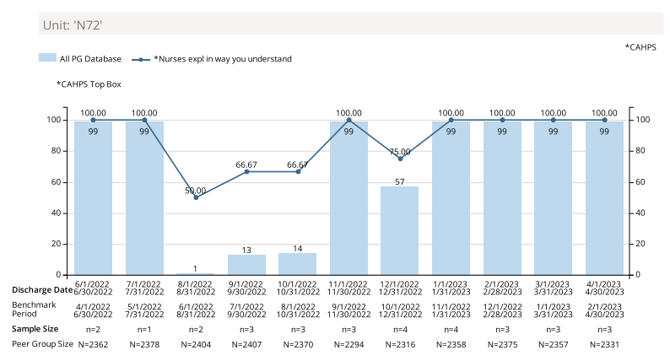

NS 72 & NS 74 – Nurses Explained in a Way you can Understand
Notes:
Wren Lester & Paulina Boateng

Slide 17
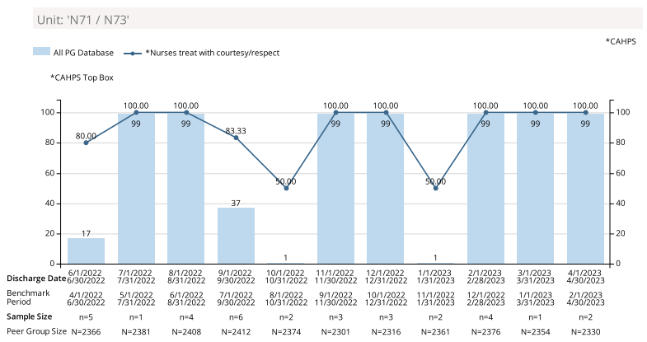
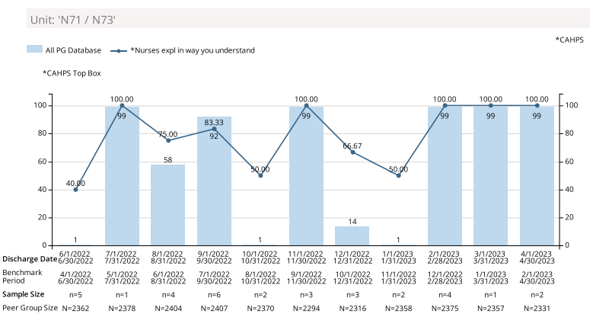
NS 71/73 - Nurses Treated You with Courtesy And Respect
Notes:
Wren Lester & Paulina Boateng

