Slide 1

Drafting Learning Objectives for Your Field Experience
Make your life easy!

Slide 2
Why?
Save time getting your paperwork signed
Learn to plan your professional learning
Apply standards required by accrediting agency (CEPH*)
*Council on Education in Public Health

Slide 3

What’s a Learning Objective?
It defines what you will be able to do by the end of your field experience.

Slide 4

Example
By the end of a field experience, a student working with health fairs will be able to
Identify social determinants of health in communities served by health fairs
Describe the role of faith-based organizations in health promotion

Slide 5
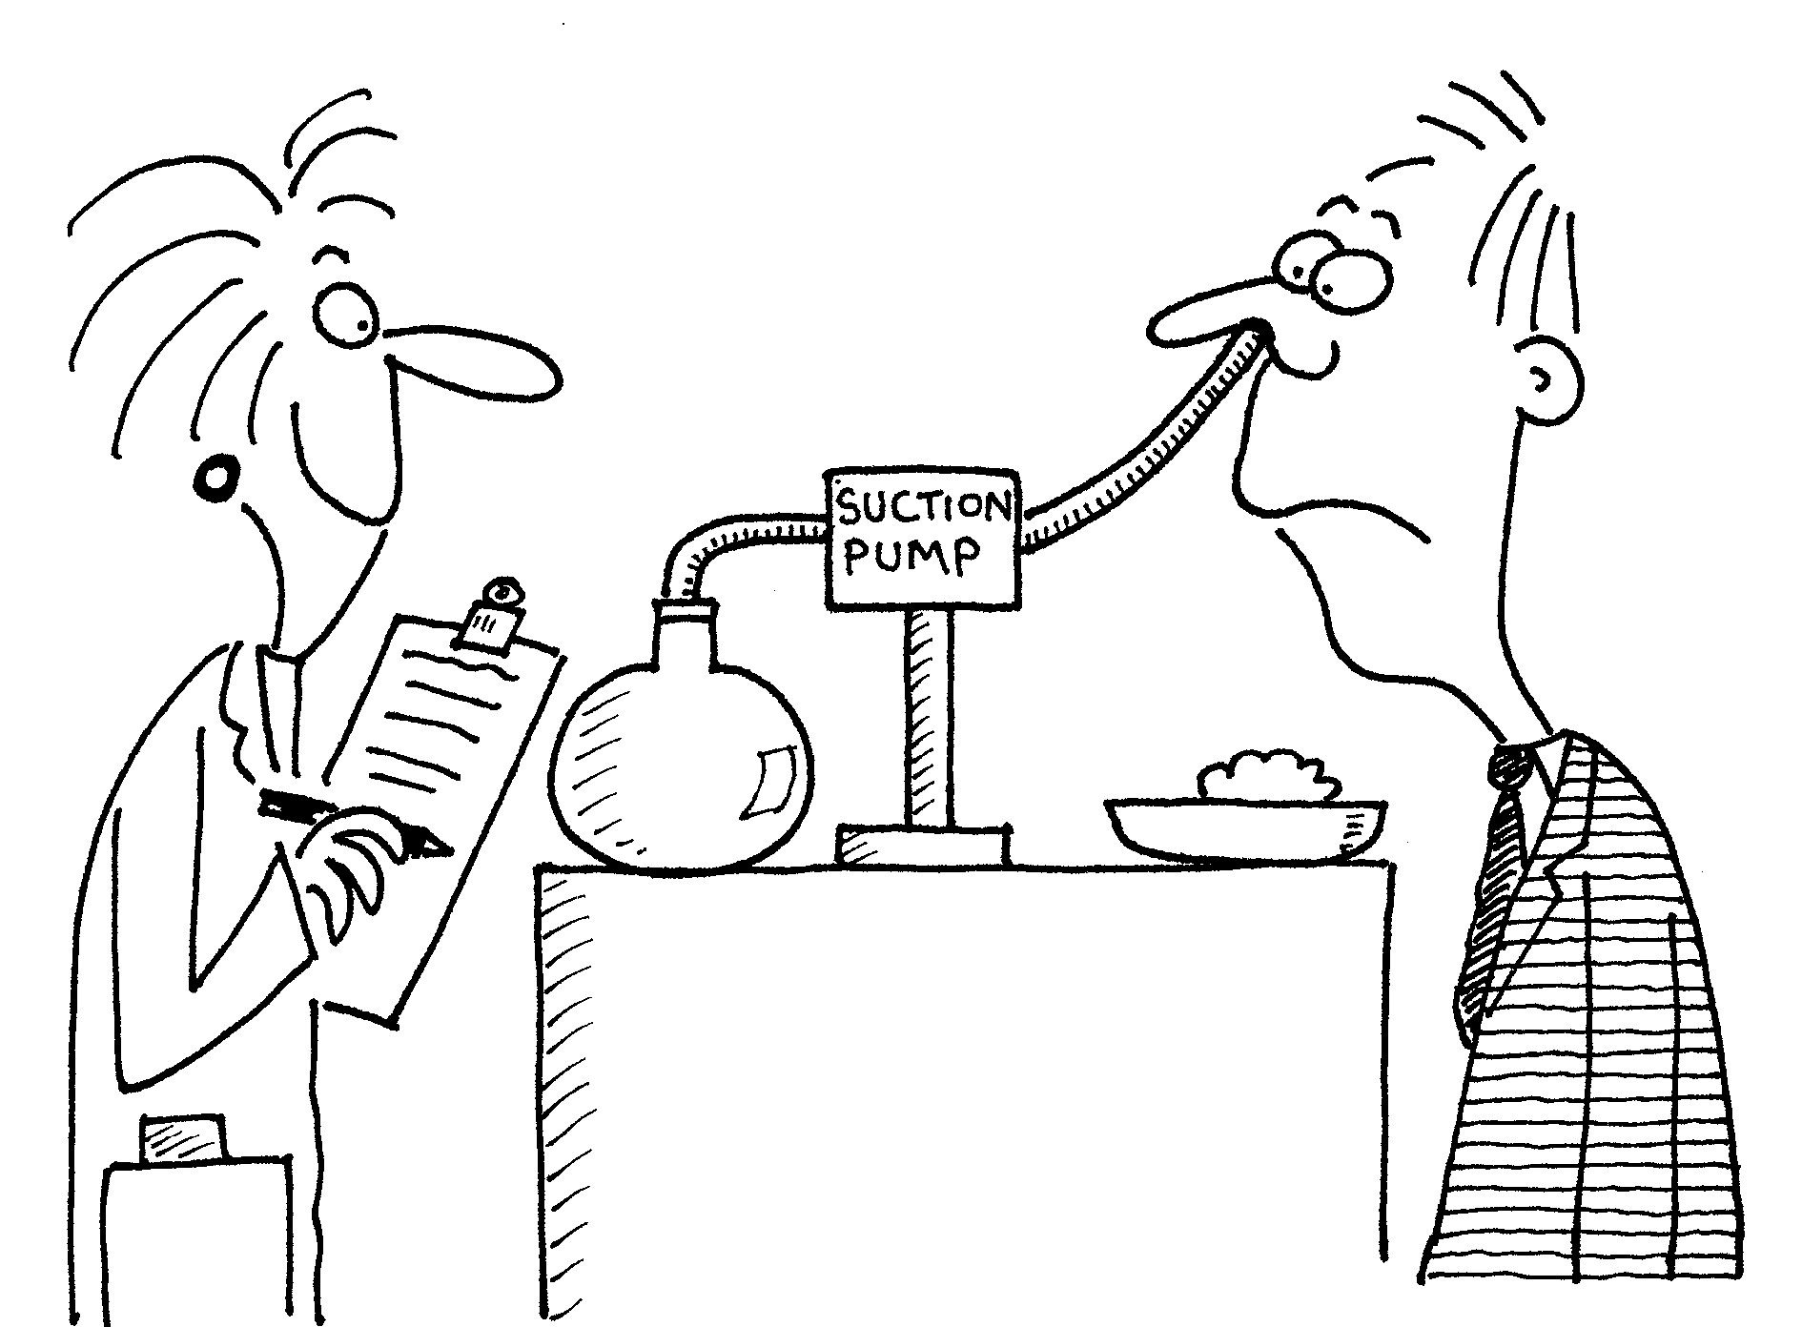
Example
By the end of a field experience, a student working with a clinical study will be able to
Complete documents for approval by an Institutional Review Board
Analyze data on effectiveness of an intervention

Slide 6


Common Misconceptions About L.O.s
Activities LOs
Research Topic LOs
Example:
Assist in screening participants at health fairs for diabetes and hypertension
= an activity, not a LO
Example:
Determine the effectiveness of text messages in decreasing childhood obesity
= a research topic, not a LO
**Remember: What do you want to be able to do by the END OF THE FIELD EXPERIENCE?**

Slide 7
Any Question?
I’m here to help!
arlene.mbonu@downstate.edu
718 613-8376

