Slide 1
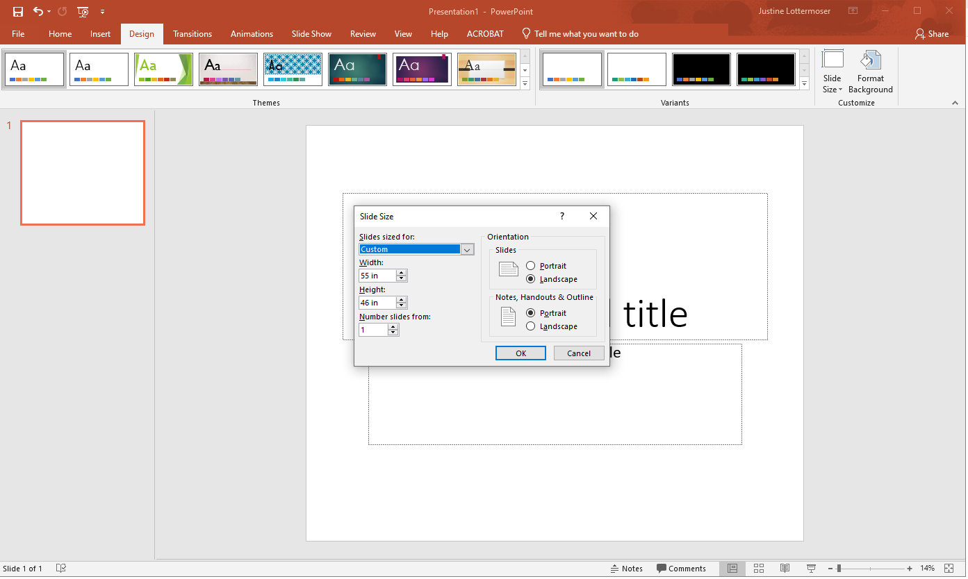
Adjust your slide dimensions to your desired size. Make note of the maximum poster size that fit on the poster boards (no larger than 60" wide by 40" tall)

Slide 2
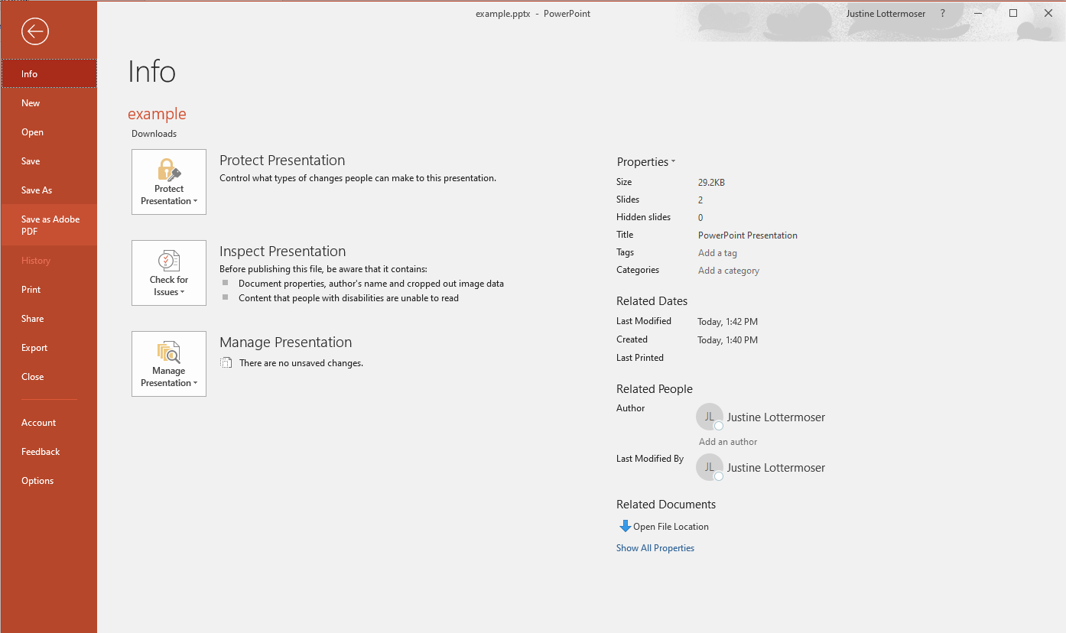

File>Save as Adobe PDF

Slide 3
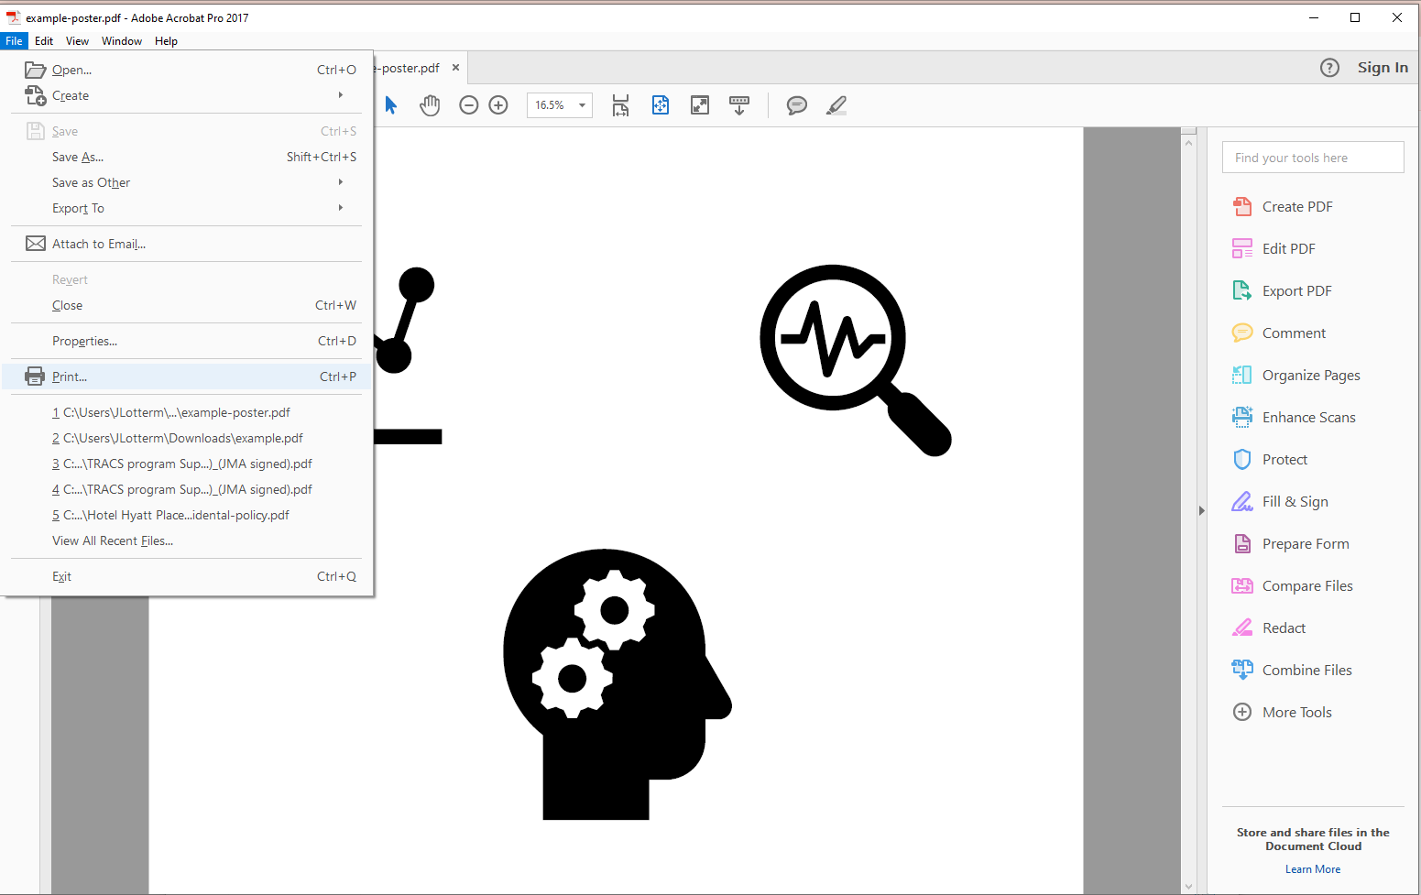
Open your poster.pdf file to print

Slide 4
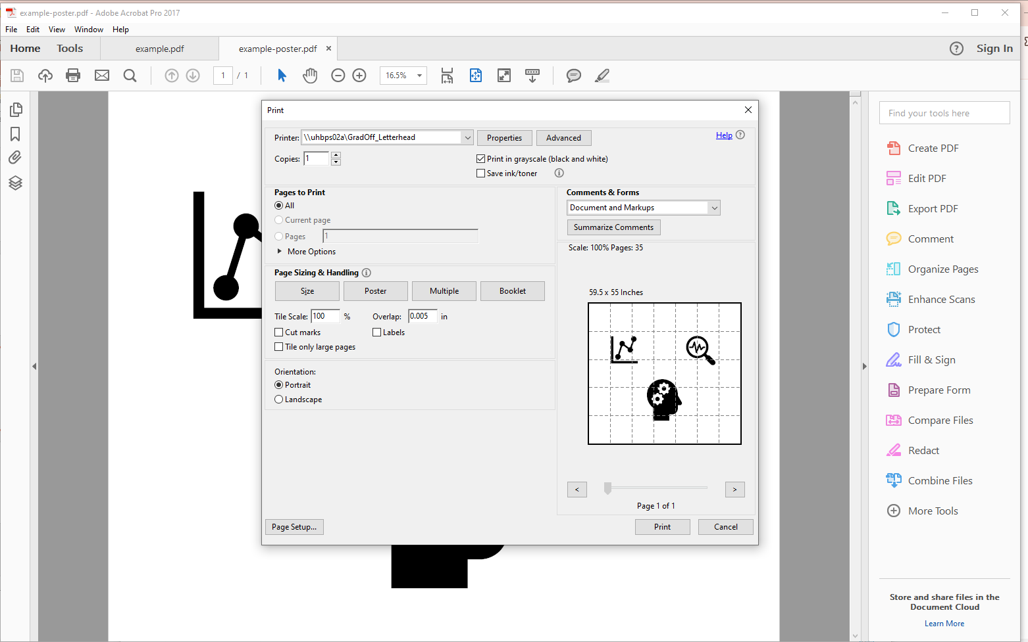
If you are printing a large banner or poster that is made up of many horizontal or vertical pages, you can increase or decrease the margin between the pages so that you can tape the pages together without covering some of the printed area.

Slide 5
Annual Research Day's only restriction for posters is that it be no larger than 60" wide by 40" tall. We will have pins and velcro on the day to attach your posters to our boards.
You can print it in-house and get some advice from them based on the large amount of Downstate posters they print: Communications and marketing on the 3rd floor of the EB (https://www.downstate.edu/news-events/communications-marketing/, elevators next to the library). They're good, but not the cheapest. Alternately, you can use any other local printer, or web printers like PhDposters, or posternerd or megaprint. Be careful what you send to outside printers. The in-house people will proofread (a little), but any outside printer will just print what you give them.
An alternative is to do it yourself. You can print your data and attach them to a few large or small cardboard panels that will fit in the space allows.
The Downstate´s general templates are here, although you don't have to use them:
https://www.downstate.edu/news-events/communications-marketing/new-media-services/design-resources/research-posters.html

