Slide 1
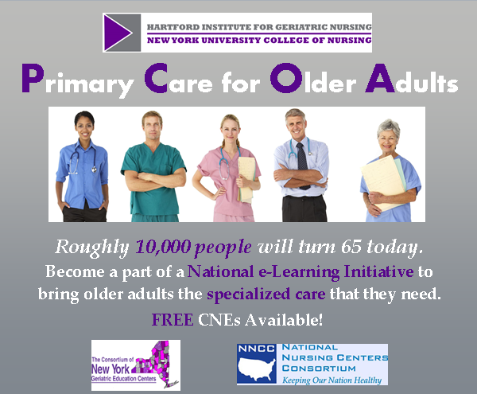
Building Workforce Capacity for Primary Care of Older Adults
Tara A. Cortes, PhD, RN, FAAN
Executive Director, The Hartford Institute for Geriatric Nursing, and Professor, NYU College of Nursing

Slide 2
Primary Care of Older Adults
“These projects are supported by funds from the Department of Health and Human Services (DHHS), Health Resources and Services Administration, the Bureau of Health Professions (BHPr), Division of Public Health and Interdisciplinary Education (DPHIE)”
Enhance the capacity of the workforce to provide the care necessary to maintain older adults at their highest level of function

Slide 3
Aging, ACA, and Primary Care
There is an increasing number of older adults needing age sensitive primary care
The ACA focuses on prevention of disease
Primary Care is the hub of prevention and disease management
Care coordination across the care continuum
Prevention of transitional care issues
Diagnoses are often a challenge
Undifferentiated
Family issues
Behavioral health
Management of chronic diseases
Patient Centered Care
Prevention of avoidable function loss

Slide 4
Demographics of Aging
2013: 35 Million people 65 years old or older- 16% of our population
2030: 72 Million people – 20% of our population
Nearly 10,000 people turn 65 every day!
People 75 and older use 3-4Xs more hospital days than people 45-55 years old
People 85 and older spend about 5X more on healthcare than people 45-55 years old
Very few providers are prepared to care for the UNIQUE NEEDS of this population

Slide 5
Workforce
Very few providers are trained in geriatrics
The IOM report (2007) “Retooling for an Aging America” was a call for action underscoring that our health care system is not ready to meet the pending crisis when we look at the demographics of older adults, their health status, long-term needs and challenges of caring for this unique population

Slide 6
Projection of Geriatricians Geriatric Workforce Policy Studies (2009)

Slide 7
Nurse Practitioners
Nurse practitioners are the future of primary care in this country
Provide accessible quality care regardless of ability to pay
There are >55,000 Family Nurse Practitioners
There are >25,000 Adult Nurse Practitioners
There are <5,000 Geriatric Nurse Practitioners
We need to increase the capacity of NPs to deliver age sensitive care to this growing number of older adults
Notes:
Talk of two systems for consumers at many hospitals through faculty practices and clinics. Different environment, different practitioners, different resources, different team.

Slide 8
Nurses
There are nearly three million nurses
Less than 1% are certified in geriatrics
63% of newly licensed nurses report that 2/3 of their practice is older adults
Only 33% of baccalaureate programs and 20% of associate programs offer geriatrics as a free standing course
Surveys show that nurses are not comfortable caring for older adults

Slide 9
Heath Care is a Team Sport
Each discipline has its own body of knowledge and scope of practice
Each professional cannot be all things to all people
Each professional must practice to their full scope
Coordination of care must create the right plan with right resources
Collaboration requires knowledge of and respect for what each discipline brings to the table
Communication must be open and inclusive of all team members including the patient and family

Slide 10
Years of Addressing IPEP
In 1972 the IOM addressed the need for interprofessional education.
In 2000,2001 IOM recognized patient error in US hospitals was avoidable through effective teams and redesigned systems
In 2003 IOM identified competencies for interprofessional education
Patient centered
Quality improvement
Evidence based practice
Informatics
Interdisciplinary teams
The passage of the ACA (2010) all of these concepts

Slide 11
Comprehensive Geriatric Education Program HRSA Grant Program
This program funded the Hartford Institute at NYU College of Nursing to develop online resources to help Primary Care Providers (NPs, MDs and PAs) provide age sensitive care to older adults.
Person focused
Interprofessional
Evidence based
Age specific
Enhance the capacity of the workforce to provide the care necessary to maintain older adults at their highest level of function

Slide 12
Survey of Primary care providers
64% of respondents said that adults over the age of 65 years made up 50% or more of their practice
96% felt that it would be helpful to have more knowledge about older adults
75% did not have a certification in geriatrics
Most participants ranked interactive e-learning modules as preferred method of receiving content on care of older patients

Slide 13
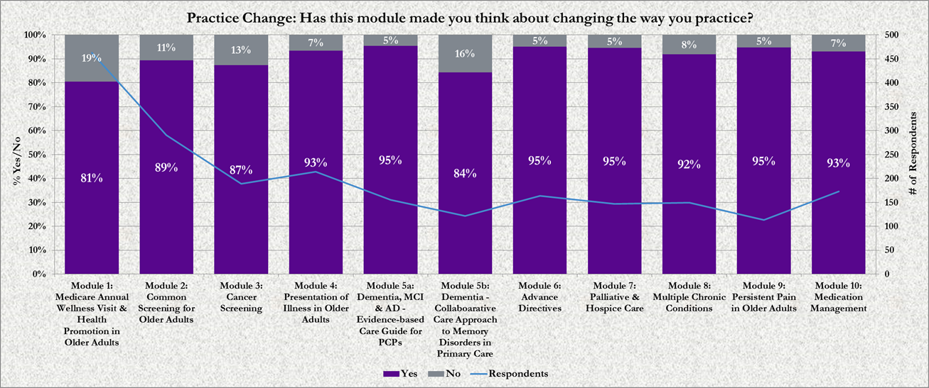

Slide 14
Interprofessional Care for Older Adults HRSA Grant
Post master’s certificate program for NPs
APNs
FNPs
12 credits
Primary care medical residents
Integrated into the geriatric rotation
Focus on the care of patients with multiple chronic conditions in an interprofessional model

Slide 15
Interprofessional Program
InterProfessional Education and Practice (IPEP)
Increase geriatric and IP expertise of care providers to enhance person centered primary care to older adults with MCC as well as families and caregivers.
Eight modules -10-15 minutes each
Roles and responsibilities
Effective teams; barriers and facilitators
Teamwork skills and leadership
Effective communication
Conflict resolution
Interprofessional care planning
Two virtual patient modules

Slide 16
Interprofessional Experience
One week summer session shared by NPs and medical residents
4 hours of didactic/day
Interprofessional team of faculty
4 hours of joint practice /day
Hospice
LTC
PC clinics
Lab simulation

Slide 17
The Collaborative Continuous Care (3C’s) for Primary Care HRSA Grant
Program is a partnership between the HIGN, NYUCN, Touro College of Pharmacy, the NYU Silver School of Social Work, and VNSNY
Interprofessional education and practice around a quality initiative
NPs, SWs and Pharmacists and students from the same disciplines work together
Focus on a QI initiative to provide a common goal for the team.

Slide 18
3C’s project
Interprofessional team focused on reduction of medication complexity in frail adults admitted to home care services from the hospital
Preliminary data
Benefit of team members
Need to have MD involved
Improved adherence and organization of meds
Some reduction in use of high risk and duplicative medications

Slide 19
Opportunities for IP PC
Managed long term care
FIDA
MLTC
PCMHs
Wellness and Chronic Disease Management
Clinical Practice and Community : one primary care system
Diversity and population health
Social determinants of health
Building Healthy Communities
Community activation

