Slide 1
Trajectories of schizophrenia in late life
Ipsit V. Vahia, M.D.
Stein Institute for Research on Aging
Department of Psychiatry
University of California, San Diego

Slide 2
disclosures
Travel Support from the John A. Hartford Foundation and the UCSD Stein Institute for Research on Aging.
Data from NIMH and NIA funded studies.

Slide 3
SCHIZOPHRENIA CIrCA 1970
It is a disease of modern civilization (Torrey & others)
There are very few older people with schizophrenia (ECA)
There is no new onset of this illness after age 40 or 45 (RDC, DSM-III)
It is a dementing disorder; and Remission of schizophrenia is not possible (Kraepelin & others)
Psychosocial interventions do not work in older people (Freud & others)
Slide courtesy Dilip Jeste, M.D.

Slide 4
aging and outcomes in schizophrenia
COGNITION
EMOTIONAL
FUNCTIONING
PSYCHOPATHOLOGY
SELF-RATED SUCCESSFUL
AGING
PSYCHOLOGICAL
PROTECTIVE FACTORS
PHYSICAL
FUNCTIONING

Slide 5
Physical Aging
Cognitive Aging
Psychosocial Aging
Interventions

Slide 6
Physical Aging
Cognitive Aging
Psychosocial Aging
Interventions

Slide 7
Trajectories in schizophrenia: the paradox of aging
Age-associated decline in physical and some cognitive functions stands in sharp contrast to the enhancement of subjective quality of life and psycho- social functioning
Jeste, Wolkowitz and Palmer, Schiz Bull, 2011

Slide 8
PHYSICAL aging in schizophrenia
Evidence for accelerated physical aging:
Avg lifespan is 20-25 years shorter
60% may have metabolic syndrome
10-year risk of CAD increased by 79%
Shorter telomeres than healthy subjects

Slide 9
PHYSICAL aging in schizophrenia
Partly explained by lifestyle – sedentary, chronic smoking, substance use, side effects from atypical antipsychotics.
Partly explained by inadequacy of medical care, despite adequate access.
Oxidative stress and/or chronic exposure to inflammatory cytokines may form a pathogenic pathway culminating in accelerated cell aging

Slide 10
Telomeres in schizophrenia
Robust indicator of biological age
Rate of telomere loss in schizophrenia patients (n=31) was twice that in NCs (n=41) (Kao et al., 2008)
Significantly greater telomere shortening in WBCs from treatment-resistant schizophrenia patients (n=34) than in NCs (n=76) (Yu et al., 2008)
Newly diagnosed, antipsychotic-naive patients with schizophrenia and other non-affective psychoses (n=41) had significantly shorter telomeres than NCs (n=41) - this difference was not related to age, ethnicity, smoking, gender, BMI, or socioeconomic status (Fernandez-Egea et al., 2009)

Slide 11
COGNITIVE aging in schizophrenia
No evidence of greater than age- expected cognitive change in any neurocognitive do- main.
Overall pattern and rate of cognitive changes with aging parallel those in the general population (but with a downward shift of the curve indicating greater cognitive impairment at all ages).

Slide 12
Antipsychotic safety in older adults: The MCCE study
Objective: To compare longer-term safety and effectiveness of the 4 most commonly used atypical antipsychotics (aripiprazole, olanzapine, quetiapine, and risperidone) in 332 patients, aged >40 years, having psychosis associated with schizophrenia, mood disorders, PTSD, or dementia (Jin H, et al., J Clin. Psychiatry, on-line 2012)
Quetiapine was discontinued midway through the trial

Slide 13
Antipsychotic safety in older adults: The MCCE study
Significant differences among patients willing to be randomized to different drugs, suggesting that treating clinicians tended to exclude olanzapine and prefer aripiprazole as one of the possible choices in patients with metabolic problems
Yet, the drug groups did not differ in longitudinal changes in metabolic parameters or on most other outcome measures
Overall results suggested a high discontinuation rate (median duration 26 weeks prior to discontinuation), lack of significant improvement in psychopathology, and high cumulative incidence of metabolic syndrome (36.5% in one year) and of serious (23.7%) and non-serious (50.8%) adverse events for all the 4 atypical antipsychotics used in the study

Slide 14
Physical Aging
Cognitive Aging
Psychosocial Aging
Interventions

Slide 15
COGNITIVE AGING: STABILITY OF PERFORMANCE
Global NP T-Score
Short Followup
Long Followup
(Heaton et al., Arch. Gen. Psychiatry, 58:24-32, 2001)

Slide 16
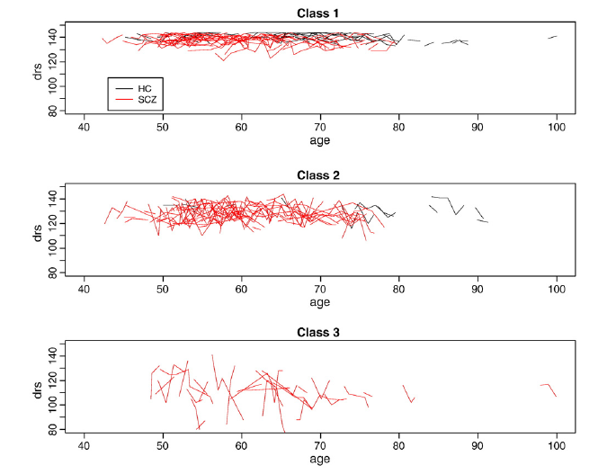

Slide 17
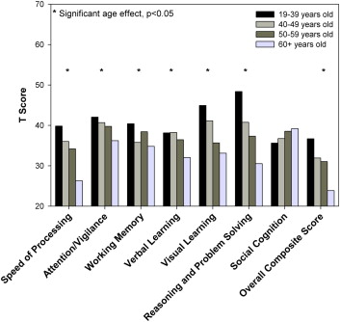
AGE EFFECT ON cognition in schizophrenia
Rajji et al, Am J Geriatr Psych, 2013

Slide 18
Cognition, functioning and hospitalization
Cognitive/Functional Decline Acute/Chronic Institutionalization
Brain Changes
(?ventricular enlargement)
(?frontal lobe reduction)
Interventions
(?Clozapine)
(?Cognitive Rehabilitation)
Harvey et al, Neurobiology of disease, 2013)

Slide 19
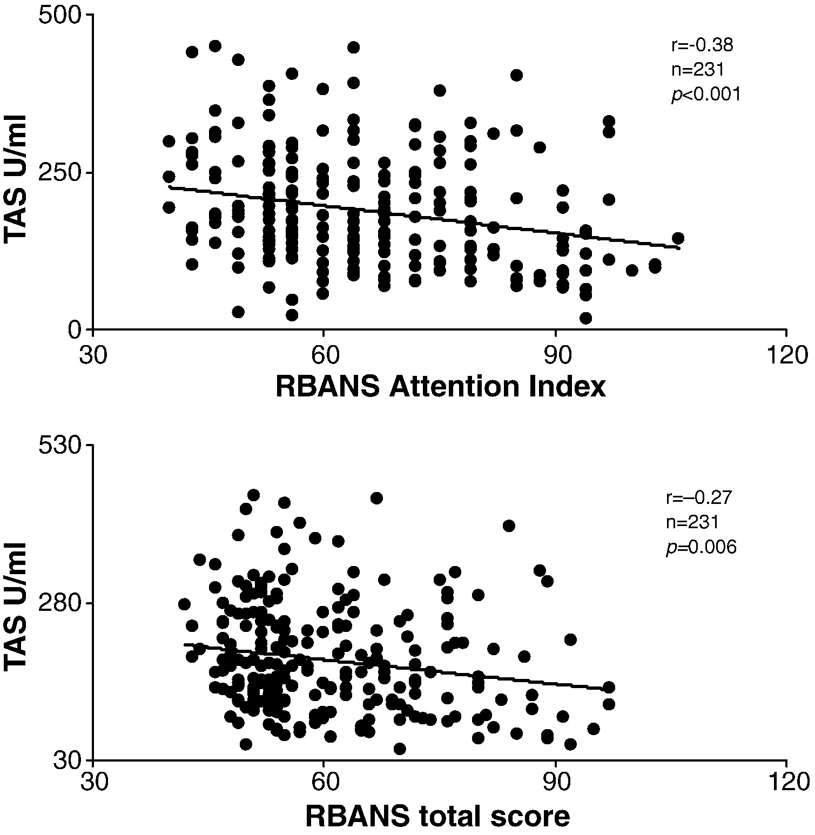
Oxidative stress and cognitive performance: a predictor of decline?
AGE EFFECT ON cognition in schizophrenia
Zhang et al, Schiz Research, 2012
Notes:
290 Han Chinese patients with a mean age of 48

Slide 20
Physical Aging
Cognitive Aging
Psychosocial Aging
Interventions

Slide 21
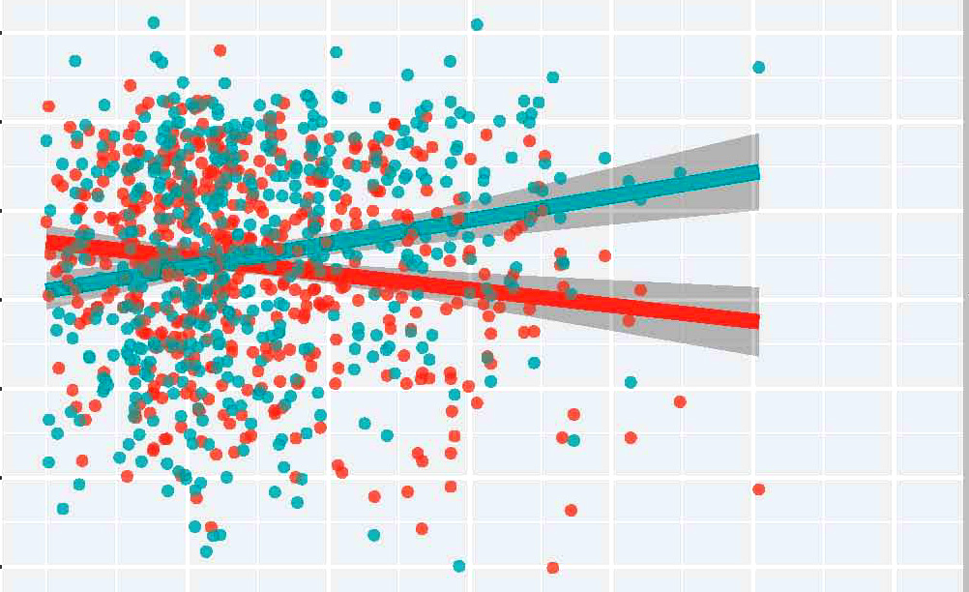
AGE AND SF-36: SCHIZOPHRENIA
70
Mental Comp.
SF-36
40
Physical Comp.
10
40
50
60
70
80
90
100
Age

Slide 22
Successful aging in schizophrenia
Schizophrenia Group
Community Comparison Group
Objective Successful Aging = 2% *
Subjective Successful Aging = 13% *
Community Integration = 23% *
Remission = 49%
Recovery = 17%
* Comparison significant at p-value 0.05
Objective Successful Aging = 19%
Subjective Successful Aging = 27%
Community Integration = 41%
Cohen, Pathak, Ramirez and Vahia, CMHJ, 2008

Slide 23
Successful aging in schizophrenia
Community Integration (CI) in Schizophrenia
CI conceptualized as a component of the recovery experience i.e. individual’s pursuit of personal goals, self-efficacy, self-determination and community life, (but not absence of symptoms)
Facilitates the process aspects of recovery
Operationalized based on theoretical model of Wong and Solomon into 4 dimensions: (a) Independence (b) Physical Integration (c) psychological integration (d) social integration
Abdallah et al, Psych Svcs, 2009

Slide 24
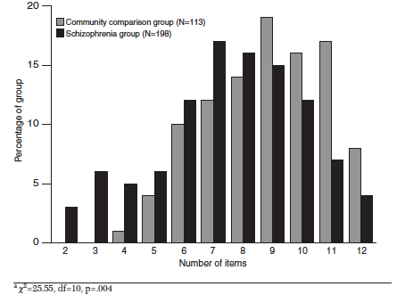
Successful aging in schizophrenia
Community Integration (CI) in Schizophrenia
Abdallah et al, Psych Svcs, 2009

Slide 25
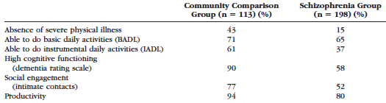
Successful aging in schizophrenia
Successful Aging in Older Adults with Schizophrenia
Study conceptualized successful aging based on Rowe and Kahn’s model.
Selection of variables based on Yanos and Moos’ Model of Functioning.
Ibrahim et al, AJGP, 2010

Slide 26
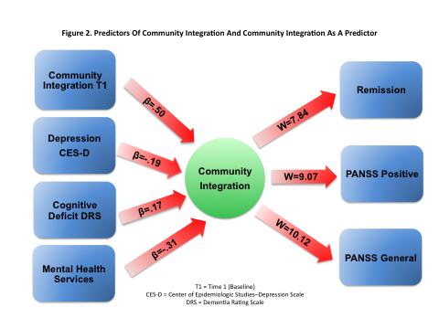

Slide 27
Qualitative Personal Interviews of
Older People with Schizophrenia
32 individual interviews of independent-living people with schizophrenia over age 50 (mean duration of illness 34 years), audio-taped & transcribed.
Main Themes:
Post-onset: Upheaval, confusion, despondency
Course: Sx improvement, Insight, Active adaptation
Outlook: Positive vs. Negative

Slide 28
Qualitative Interviews (Quotes):
Post-Onset Reactions
“… when you are labeled a schizophrenic and you don't understand it because you didn't learn about it prior to and all of a sudden you're in this nightmare, and with nobody to help you because nobody understands. The whole world is dead; you’re the only one alive in this big graveyard. You have to survive with no money and no place to sleep and all these dead people trying to kill you or whatever, rob you of your sanity.”

Slide 29
Qualitative Interviews (Quotes):Course
“I was sitting in the courtyard (of my) unit. I was smoking my cigarette, looked up and saw this razor wire and I go, “Is this really what I want?” ….. I’ve been here a long time. Am I really going to be here until I die?” I put out my cigarette and told my [counselor] “I don’t want to die here, what can I do?”
“Yeah, I was able to change my way of thinking to the point where I can use the intelligence that God gave me to reason my way through this paranoia. People who hardly know me aren’t going to be talking about me.”

Slide 30
Qualitative Interviews (Quotes):
Outlook - Positive
“It’s now, like I say, in remission. I can lead a normal and productive life. I can do anything anybody else can do, you know? I can drive a car, I can open bank accounts, I can get a new cell phone line, and I can function.”
“The people here, we talk, we laugh, we joke, and they’re always there for me. If I feel bad, they’re there to help me go through it together. And I feel better about myself now than I did when I was a kid.”

Slide 31
Physical Aging
Cognitive Aging
Psychosocial Aging
Interventions

Slide 32
COULD interventions help?
Pharmacotherapy for schizophrenia has not be shown to impact cognition (Chou H.H., et al, 2012)
Treating co-existing depressive symptoms with SSRIs does not confer additional cognitive benefits. (Dawes et al, 2012)
- Evidence that manualized cognitive rehabilitation may improve outcomes, to a modest but clinically significant degree (Twamley et al, Schi Bull, 2003)

Slide 33
Interventions: specialized training
Cognitive-Behavioral Social Skills Training (CBSST)
Group psychotherapy designed to improve social and daily functioning.
Randomized clinical trial of 2x/week sessions for 24 weeks compared to treatment-as-usual
Primary outcomes related to psychosocial functioning
‘Thought Challenging’ Module
‘Asking for Support’ Module
‘Problem Solving’ Module
Granholm et al, AJP, 2005

Slide 34
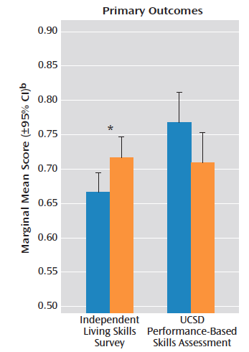

Interventions: specialized training
Cognitive-Behavioral Social Skills Training (CBSST)
Improvements maintained
at 1-year follow-up
Granholm et al, 2005, 2007

Slide 35
Interventions: individualized health promotion
Individualized program to promote healthy lifestyles for persons with chronic psychiatric illness.
Each participant assigned a health mentor.
Weekly sessions to learn about exercise and healthy eating.
Free access to local gym.
Group-based education sessions for nutrition.
Goals and incentives.
N=98
9-month f/u: reduced hip-waist circumference, higher satisfaction with health/fitness, improvements in functioning an negative symptoms.
Bartels et al, CMHJ 2011

Slide 36
Interventions: vocational training
Individual Placement and Support (IPC) found to be more beneficial than Conventional Vocational Rehabilitation (CVR)
Persons had better outcomes when “learning on the job”
IPC resulted in higher rates of competitive employment
Persons with competitive employment reported better quality of life.
Twamley et al, 2005, 2009

Slide 37
INTERVENTION TARGETS
CBSST, Cognitive Training
COGNITION
Pharmacotherapy, exercise,
HOPES
Religion?
Pharmacotherapy
EMOTIONAL
FUNCTIONING
PSYCHOPATHOLOGY
SELF-RATED SUCCESSFUL
AGING
PSYCHOLOGICAL
PROTECTIVE FACTORS
PHYSICAL
FUNCTIONING
FAST, Vocational Training, HOPES
Adequate Medical Care, SHAPE
Vahia et al, International Psychogeriatrics, 2011

Slide 38
cognitive reserve
Cognitive reserve (measured as a composite of premorbid IQ, leisure activities and educational-occupational level) predicted better performance on working memory and attention in a sample of Spanish young adults with first episode schizophrenia at 2 year follow-up
De la Serna et al, Schiz Research, 2013

Slide 39
Resilience and recovery?
In a small study of 17 Norwegian patients with schizophrenia (Mean age = 52.1 years), resilience (measured by CD-RISC) predicted stability of recovery at 15 year follow-up
Torgalsboen et al , Clin Schizophrenia Related Psychosis, 2012

Slide 40
summary
Aging related trajectories may differ, depending on domain studied.
While physical health worsens, cognitive decline trajectory may be more heterogenous
Protective factors (resilience, cognitive reserve) may have a role
Evidence-based interventions exist, that can improve outcomes.
Even in early life, management with a lifespan perspective is likely to predict better treatment outcomes.

Slide 41
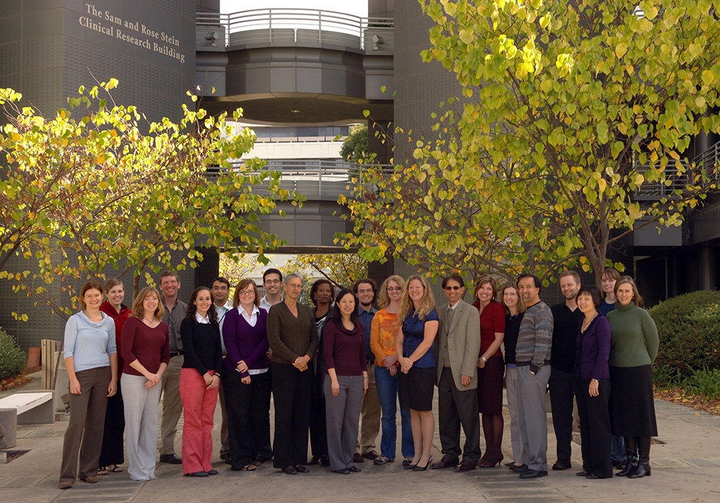
acknowledgements
…and specially
Colin A. Depp, Ph.D.
Wesley Thompson, Ph.D.
Carl I. Cohen, M.D.
Dilip V. Jeste, M.D.
CONTACT INFORMATION
ivahia@ucsd.edu
+1 858 822 3151

