Slide 1
HEALTH CARE ORGANIZATION AND MANAGEMENT: THE IMPACT OF HEALTH REFORM
HOWARD S. BERLINER, Sc.D.

Slide 2
ISSUES IN U.S. HEALTH CARE
COST
UNINSURED/ UNDER-INSURED
DISPARITIES
FRAYING TIE TO EMPLOYMENT
ROLE OF THE GOVERNMENT

Slide 3
COST
OVERALL COST COMPARED TO OTHER COUNTRIES
COST OF INSURANCE
COST OF HOSPITALS
ELIZABETH ROSENTHAL (NYT); BITTER PILL (BRILL)
COST OF DRUGS
HEP C SOLVADI $84,000/12 WEEKS
CANCER DRUGS
SHIFT OF COSTS ONTO THE INSURED

Slide 4
Per Capita Total Current Health Care Expenditures, U.S. and Selected Countries, 2010
^ 2009 data
Notes: Amounts in U.S.$ Purchasing Power Parity, see www.oecd.org/std/ppp; includes only countries over $2,500. OECD defines Total Current Expenditures on Health as the sum of expenditures on personal health care, preventive and public health services, and health administration and health insurance; it excludes investment.
Source: Organisation for Economic Co-operation and Development. “OECD Health Data: Health Expenditures and Financing”, OECD Health Statistics Data from internet subscription database. http://www.oecd-library.org, data accessed on 08/23/12.

Slide 5
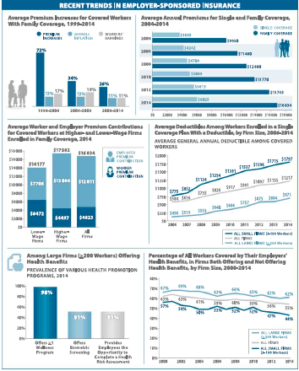

Slide 6
UNINSURED
NUMBER REDUCED DUE TO ACA
STILL 25-30 MILLION WITHOUT INSURANCE
STATES NOT DOING MEDICAID EXPANSION
THE UNDOCUMENTED
8-10,000,000 EXPLICITLY UNCOVERED
GROWTH OF THE UNDER-INSURED
GROWTH OF COPAYS AND DEDUCTABLES
INCREASING PROBLEM FOR MD’S AND HOSPITALS

Slide 7
DISPARITIES
RACIAL, ETHNIC, GENDER, GEOGRAPHIC, AGE DIFFERENCES IN:
PREVALENCE RATES
ACCESS TO AND AVAILABILITY OF CARE
TREATMENT LOCATIONS
PROCESS OF CARE
OUTCOMES

Slide 8
VALUE BASED PURCHASING AND QUALITY OF CARE
MEDICARE PAYMENTS WILL INCREASINGLY BE BASED ON OUTCOME MEASURES
HOSPITALS IN LOW SOCIOECONOMIC AREAS AT RISK
READMISSIONS POLICIES
CAN/SHOULD HEALTH PAYMENTS BE BASED ON QUALITY METRICS?

Slide 9
FRAYING TIE TO EMPLOYMENT
EMPLOYERS WITH OVER 50 FULL TIME WORKERS REQUIRED TO PROVIDE INSURANCE OR PAY A FINE ( BUT ONLY FOR WORKERS– NOT DEPENDENTS)
INCREASING NUMBER OF JOBS IN SMALL BUSINESS, SELF-EMPLOYED, CONTINGENT EMPLOYED
WHAT IS THE VALUE OF EMPLOYER-BASED INSURANCE?

Slide 10
ROLE OF THE GOVERNMENT
WHO SHOULD BE RESPONSIBLE FOR PROVISION OF SERVICES AND PAYMENT FOR CARE?
INDIVIDUAL
EMPLOYER
INSURANCE COMPANY
GOVERNMENT

Slide 11
CURRENT ISSUES
IS INSURANCE THE ANSWER?
ACA ISSUES:
KING v. BURWELL
REPEAL EFFORTS
MEDICAID PRIVATIZATION PLANS
CHANGES TO THE LAW
WILL ANOTHER PRESIDENT OR CONGRESS GET INVOLVED WITH HEALTH CARE IN THE NEAR FUTURE?

Slide 12
Concentration of Health Care Spending in the U.S. Population, 2009
Percent of Total Health Care Spending
(≥$51,951)
(≥$17,402)
(≥$9,570)
(≥$6,343)
(≥$4,586)
(≥$851)
(<$851)
Note: Dollar amounts in parentheses are the annual expenses per person in each percentile. Population is the civilian noninstitutionalized population, including those without any health care spending. Health care spending is total payments from all sources (including direct payments from individuals and families, private insurance, Medicare, Medicaid, and miscellaneous other sources) to hospitals, physicians, other providers (including dental care), and pharmacies; health insurance premiums are not included.
Source: Kaiser Family Foundation calculations using data from U.S. Department of Health and Human Services, Agency for Healthcare Research and Quality, Medical Expenditure Panel Survey (MEPS), Household Component, 2009.

