Slide 1

Geriatrics Assessment
Shavon Dillon, MD
Notes:
What does geriatrics mean to you?
What are the goals of a geriatrics assessment? The purpose of this is to promote wellness and independent function.

Slide 2
Locations for Geriatrics Assessment
Ambulatory (aka clinic visit)
Emergency room
Hospital
Nursing home
Home

Slide 3
Domains of Geriatrics Assessment
Functional status:
  Activities of daily living (ADLs)
  Mobility
Nutrition
Vision
Hearing
Cognitive function
Depression
Notes:
There are 6 domains of geriatrics assessment. We have to look at the physical aspect of the patient which deals with functional status. And functional status is subdivided into ADL and mobility.

Slide 4
Functional Status: Activities of Daily Living
Basic ADLs | Instrumental ADLs
Bathing | Using the telephone
Dressing | Preparing meals
Transfer | Managing finances
Toileting | Taking medications
Grooming | Laundry
Feeding oneself | Housekeeping
 | Shopping
 | Transportation
Notes:
Basic ADLs assess if a person can take care of themselves. Is what you and I take advantage of on a daily basis. However, some elderly people have difficulty performing these tasks independently. So your job is to figure out if bathing, dressing, transfering, etc is something that they need assistance with or not. Bathing has the highest prevalence of disability out of all the ADLs. At this time, also inquire about assistive devices (cane or walker).
IADLs is what we need to live in society independently.

Slide 5
Functional Status: Mobility
Mobility:
  Transfer
  Gait
  Balance
Testing for mobility:
  Timed up and go test (aka Get up and go)
  Tandem gait
Gait abnormalities:
  Path deviation
  Diminished step height or length
  Trips
  Slips
  Near falls
  Difficulty turning
Notes:
Demonstrate test for gait and balance to students. A rapid screening test for mobility is the “Timed up and go test”. It assess a patient’s risk for fall.

Slide 6
Nutrition
BMI<20
Unintentional weight loss (>10lbs or 5% of your body weight over 6 months)
Medical illness
Depression
Dementia
Inability to shop or cook
Inability to feed oneself
Financial hardship
Ill fitting dentures
No teeth
Tooth pain
Oral candidiasis
Notes:
(Ask question before showing the first column on slides which will fly onto the page) Besides visual inspection for poor nutrition, what are 2 things we as physicians can do to assess nutrition status?
(2nd column) Our job is to figure out why the patient has poor nutrition which may be a result of…. Also, dental issues play a role…

Slide 7
Vision
Difficulty with driving
Watching television
Reading
Read magazine
Snellen chart
Notes:
As we get older, there is the possibility of developing visual impairment (cataracts, glaucoma, macular degeneration). Ask if they have:
Office test: snellen chart (cant read >20/40)

Slide 8
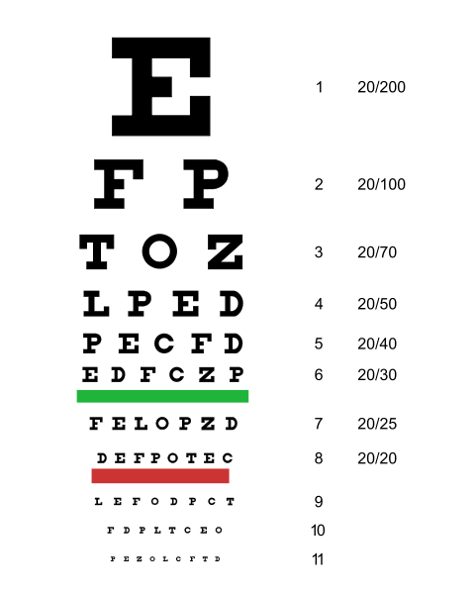
Snellen chart
Notes:
Hold the snellen chart 6 feet away from them and have them read it, but 1 eye at a time with and without glasses. Can’t read >20/40, there is visual impairment.

Slide 9
Hearing
Bilateral
High frequency
Screening test
  Whisper voice test
  Finger rub
Notes:
Before 1 and 2) Its important to assess hearing loss since it is associated with depression, disatisfaction with life and withdrawal from social activities.
After 1 and 2) What’s the first thing that must be ruled out? Cerumen impaction
Whisper test: A hearing test in which the examiner stands 2 feet behind the patient and whispers 3 letters/numbers while gently using the end of his or her finger to occlude and rub the external auditory canal of the patient’s nontested ear. The patient is considered to have passed the screening test if they repeat at least 3 out of a possible total of 6 letters/numbers correctly.
Finger rub: With eyes closed, the patient should be instructed to acknowledge hearing the gentle rubbing of the examiner's fingers approximately 3-4 inches away from his right and left ear.

Slide 10
Cognitive function
Why is it important to assess?
    Most people with dementia won’t complain of memory loss or volunteer symptoms unless asked
Screening test
  3 word recall
  3 word recall plus orientation
  Mini mental status exam (MMSE)
    Score 21-24: mild dementia
    Score 10-20: moderate dementia
    Score ≤9: severe dementia
    Score <24 warrants further evaluation
    Parts of MMSE: Orientation, registration, recall, attention, language, repetition and commands
Notes:
Shortcoming of MMSE: 1)interpretation depends on educational background, race and age and 2)does not test executive function

Slide 12
Cognitive function
Minicog
  Consist of the clock drawing test and 3 item recall
  Score 0-2: positive for dementia
  Score 3-5: negative for dementia
Alternative executive function
  Name as many 4 legged animals <1 minute
  <8-10 animals suggest further evaluation

Slide 13
Depression
PHQ2: anhedonia sadness/depressed
PHQ9: Mnemonic “SIGECAPS”
      Sleep
      Interest
      Guilt
      Energy
      Concentration
      Appetite
      Psychomotor agitation or retardation
      Suicide
Notes:
PHQ=Patient health questionnaire
Diagnosis of depression: 5 or more symptoms present, but anhedonia or sadness must be one of the symptoms. Also, symptoms must be present almost daily for at least 2 weeks.

