Slide 1


Slide 2
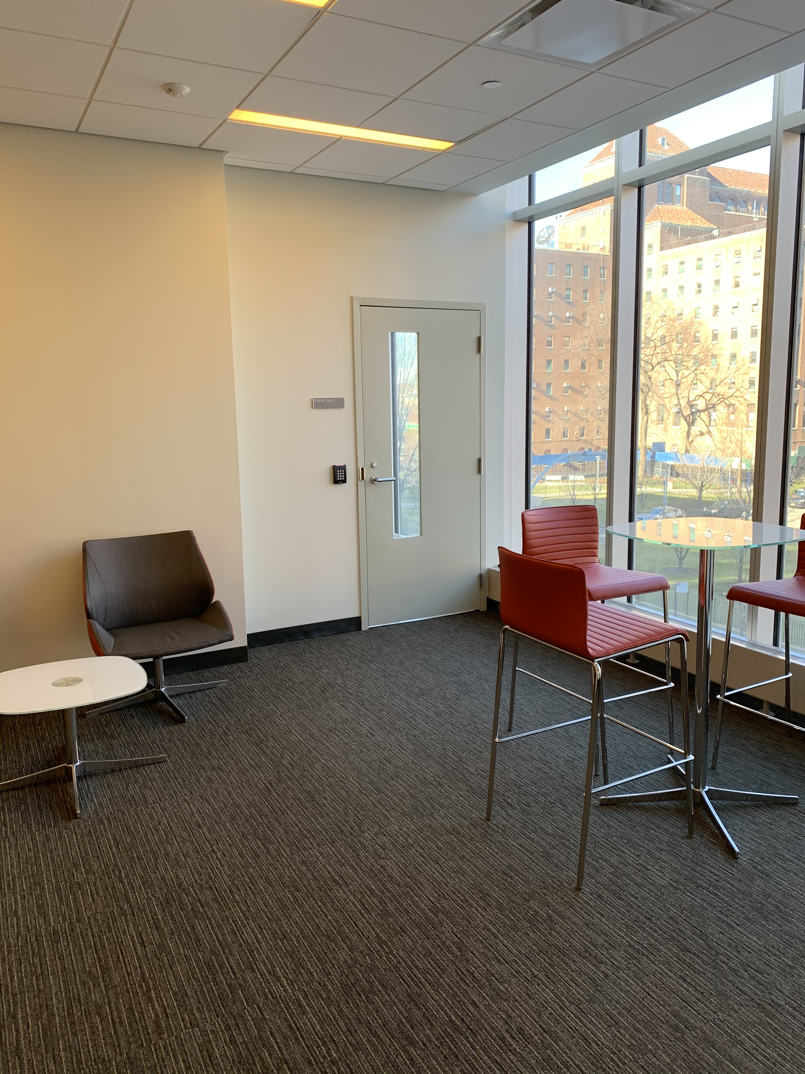
The Login Process

Slide 3
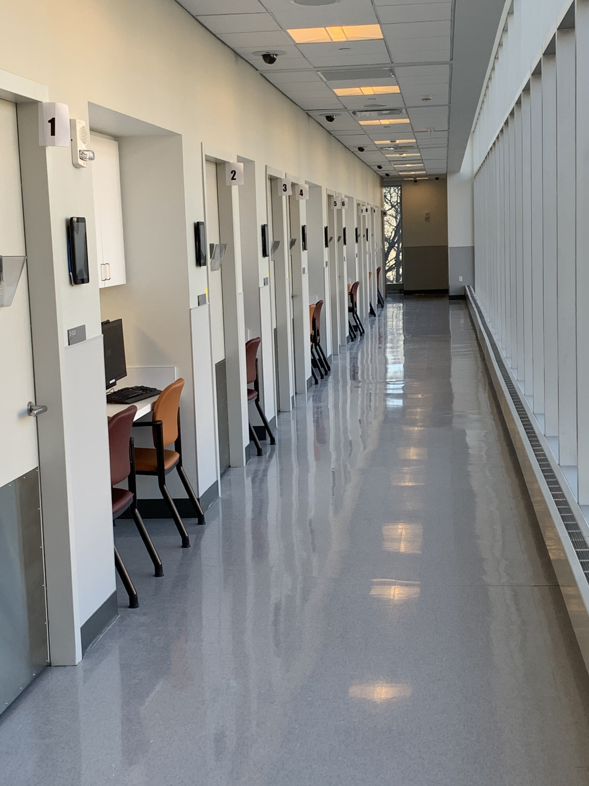
You'll be escorted to the SP wing.

Slide 4
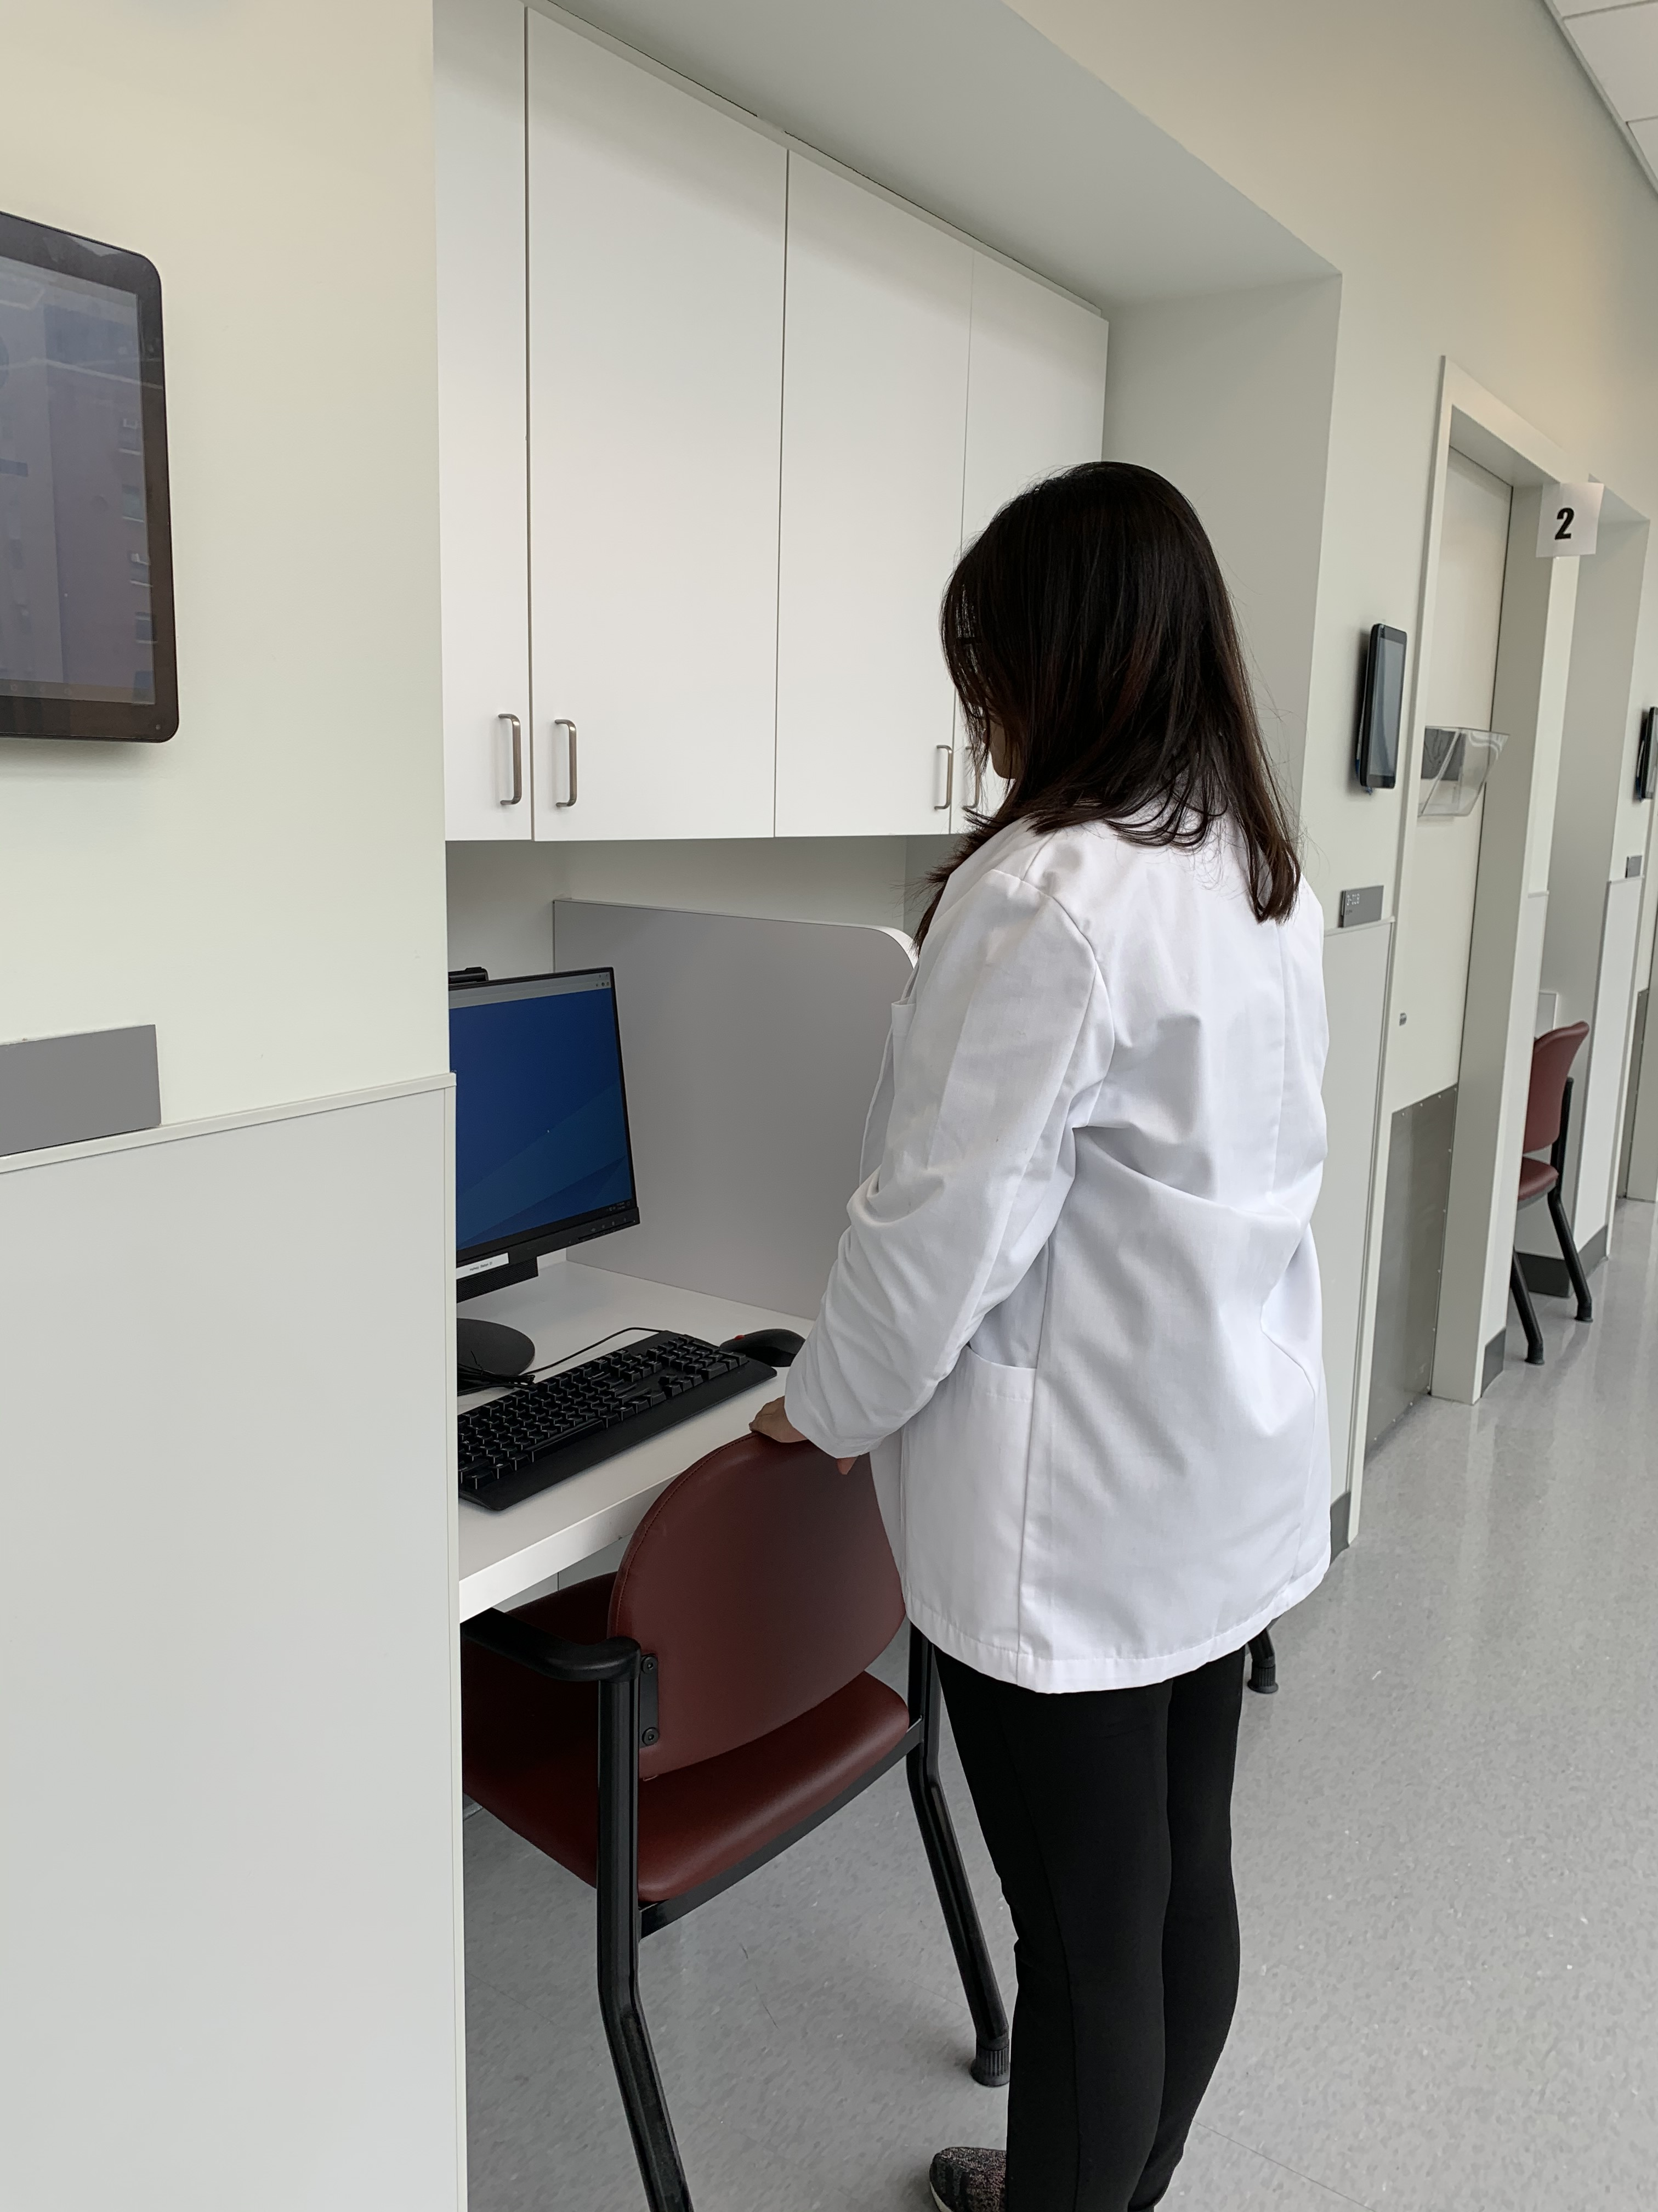
Stand in front of your log in station.

Slide 5
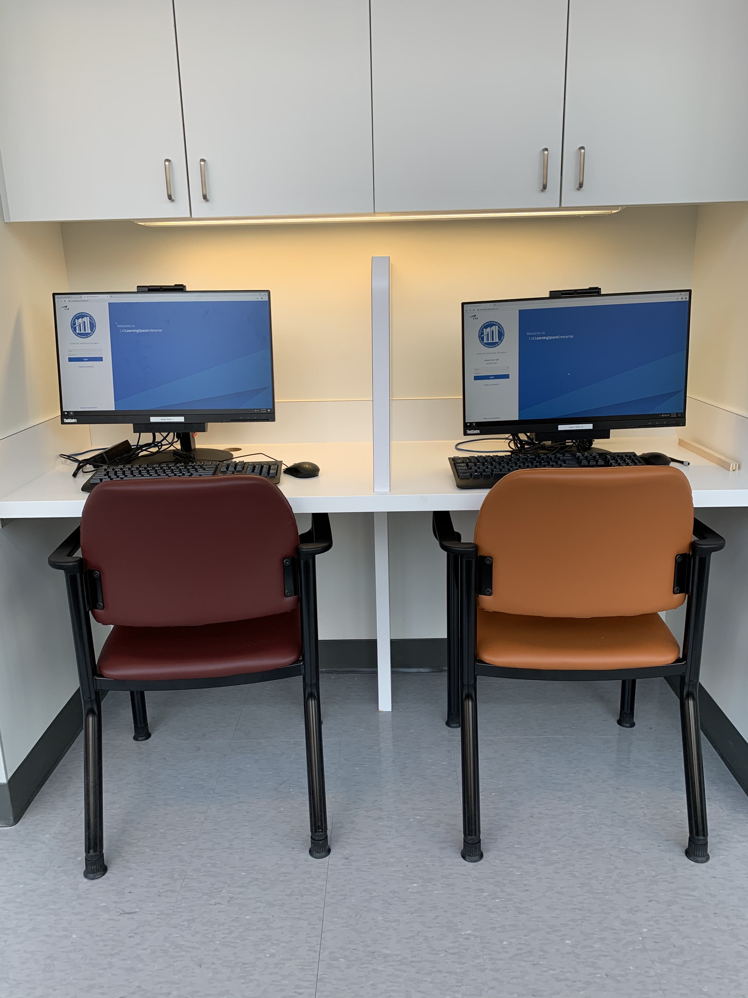

Slide 6
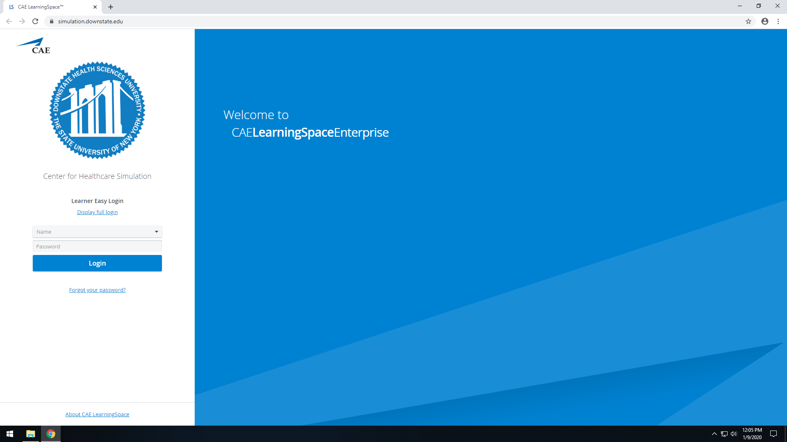
When instructed, you'll sit down and log in here.

Slide 7
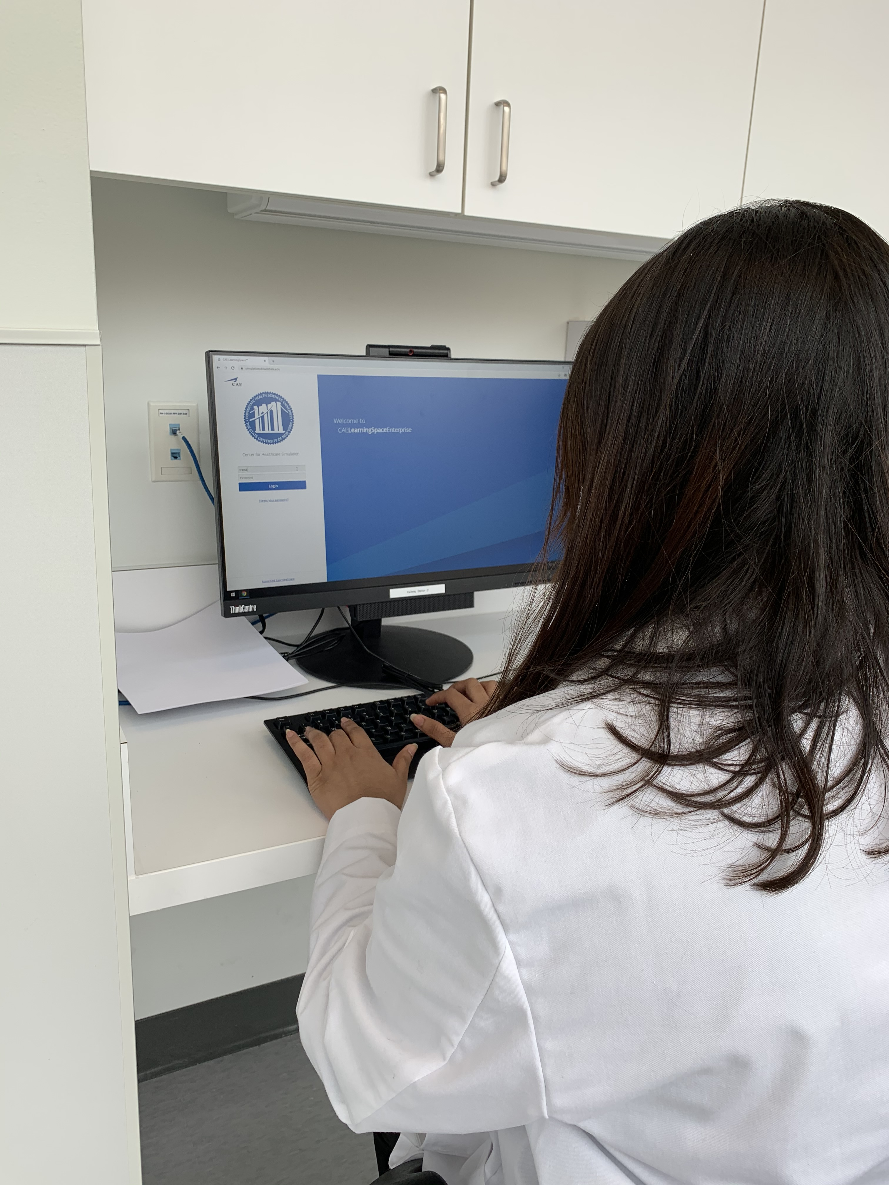
Log in with
your Net-ID
& password
when instructed
to do so.

Slide 8
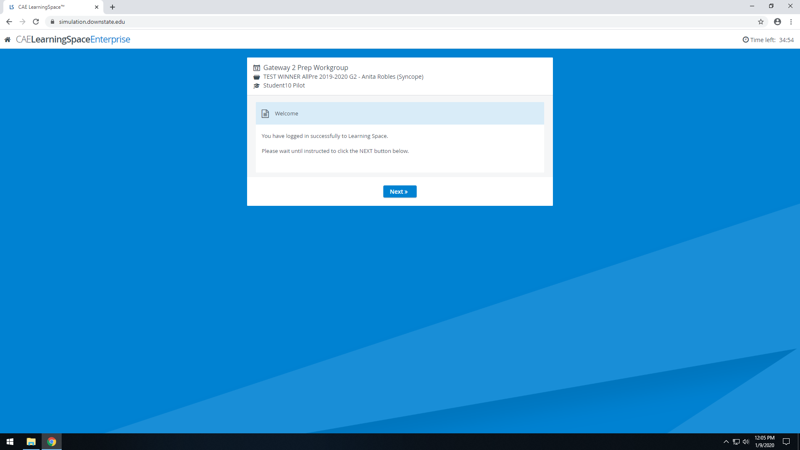
Do not click the NEXT button until AFTER your encounter!!

Slide 9
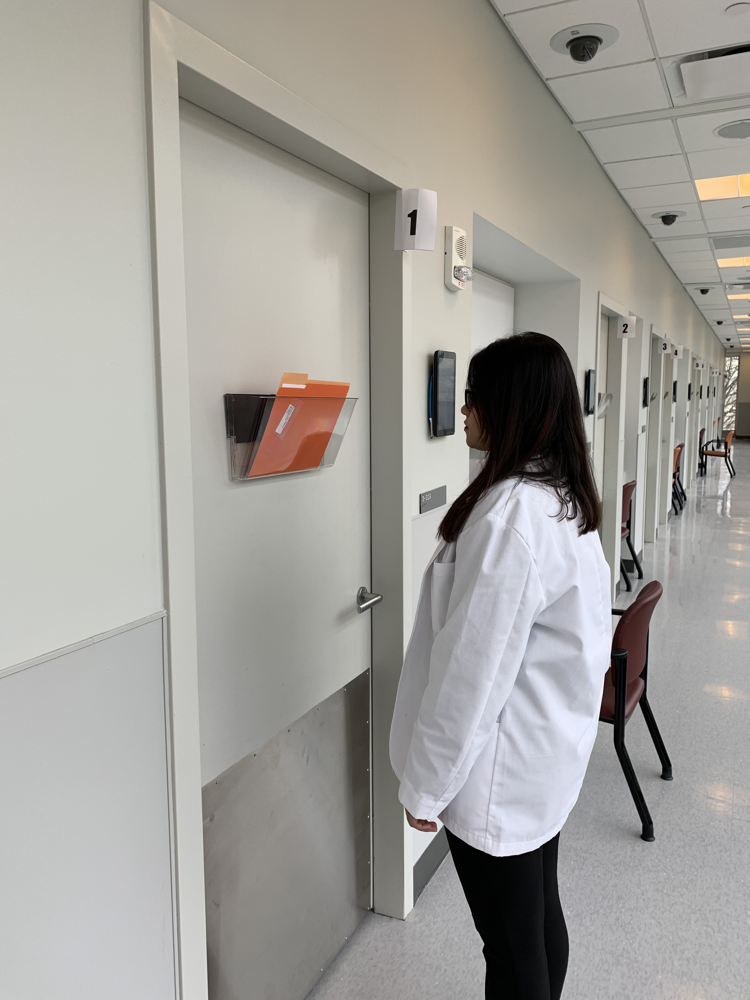
Once you've logged in, stand in front of your encounter room door.

Slide 10
After your encounter, click NEXT to access the presenting information.

Slide 11
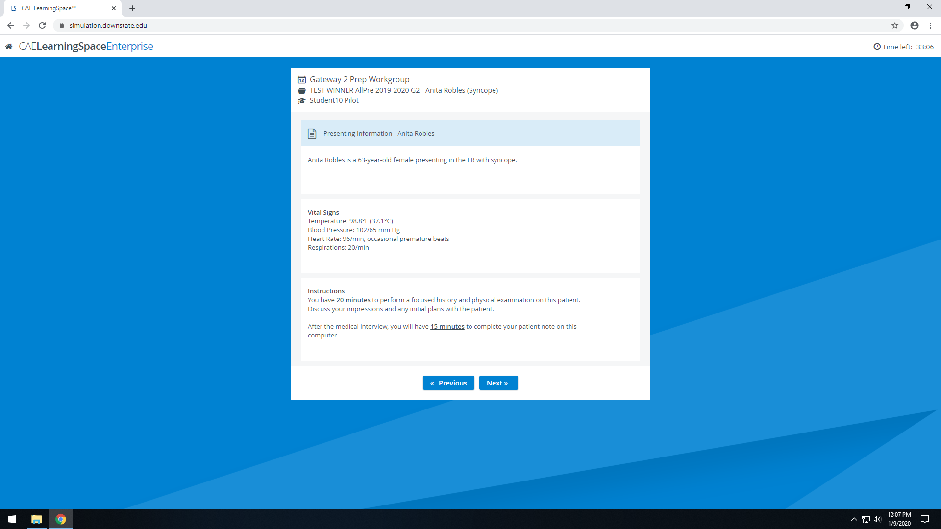
Click NEXT again to fill out the post-encounter note.

Slide 12
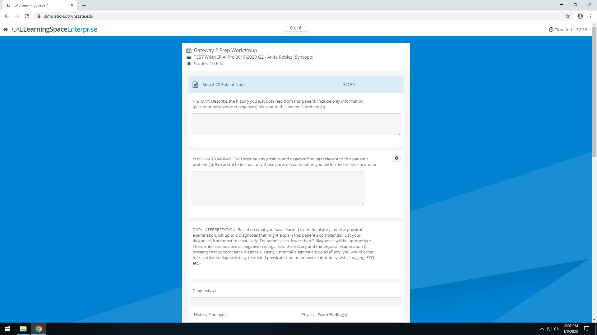
You have 15 minutes to complete the post-encounter note. Work through the form scrolling down if necessary.

Slide 13
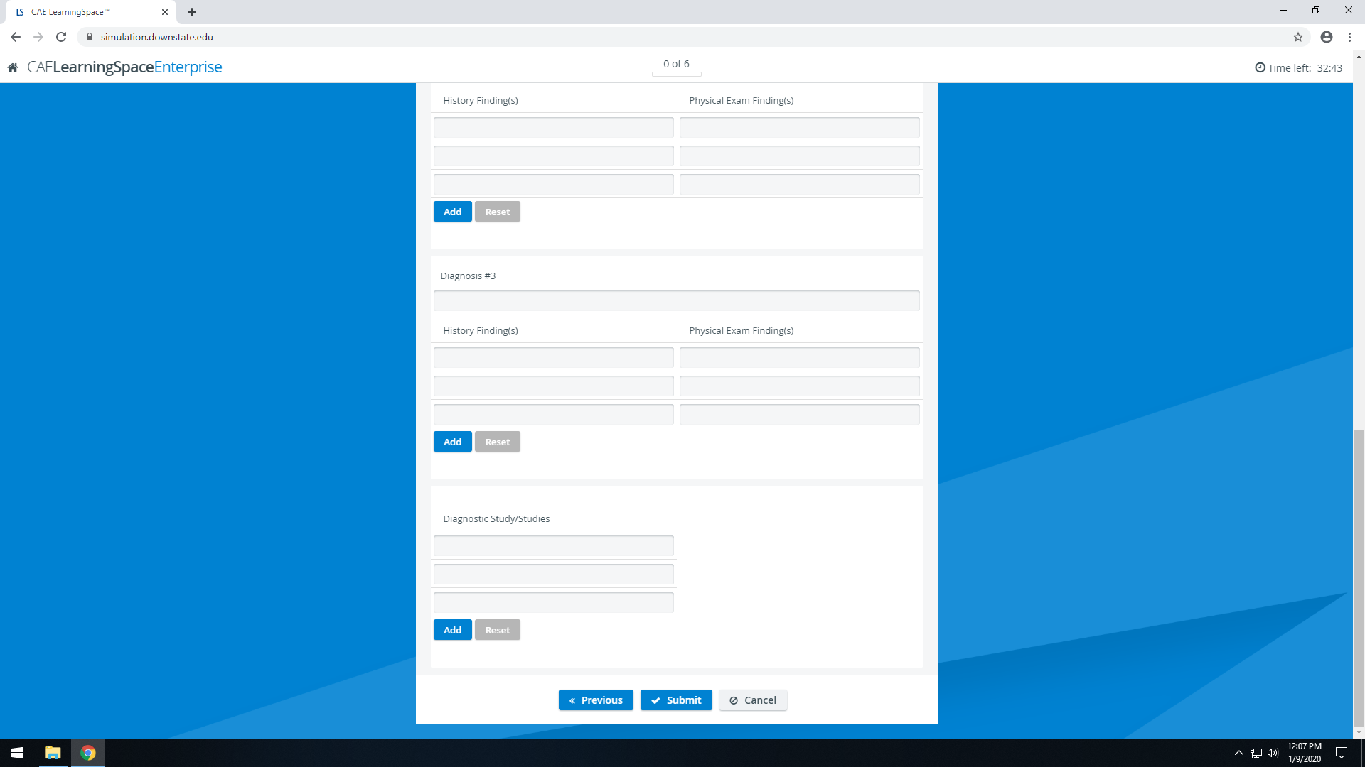
If you finish before the time is up, DO NOT CLICK SUBMIT
and remain seated at your station.
You will be given a "two minutes remaining" announcement. When the two minutes are up, your note will submit automatically.

Slide 14
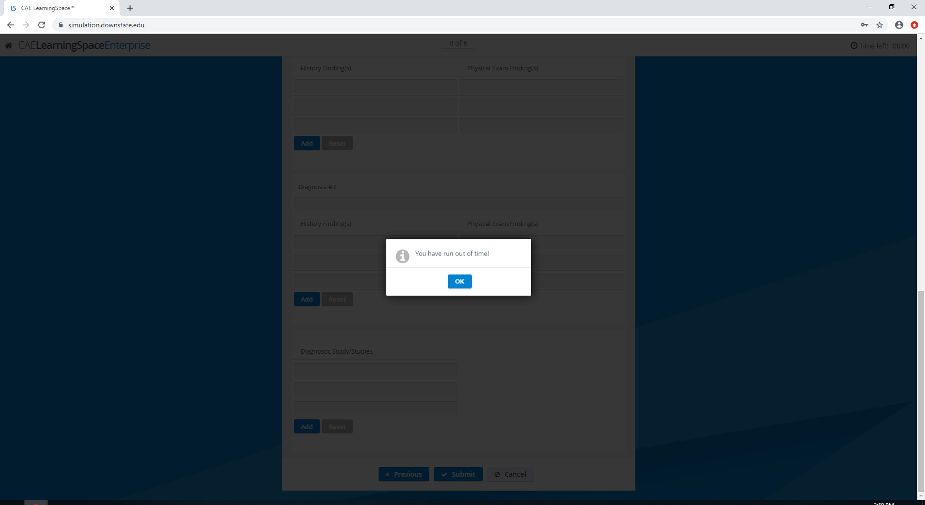
If you run out of time and your note is automatically submitted, you'll see this pop-up. Please click OK as you await further instructions

Slide 15
When instructed by the proctor, move to your next assigned station.

