Slide 1
Tenecteplase (TNKase)
WHAT IS TNKase
Thrombolytic agent used in the treatment of adult acute ischemic stroke
Mechanism of Action
Breaks up clots form in blood vessels
Binds to fibrin, coverts plasminogen to plasmin → fibrinolysis

Slide 2
What is the change
Transitioning from Alteplase (tPA) to Tenecteplase (TNKase) for
Acute Ischemic Stroke (AIS) at Downstate
Alteplase (tPA) will remain on formulary for other indications (non-AIS) or when TNKase is not available (for AIS)

Slide 3
Why Tenecteplase over Alteplase?
Targeted specificity and Reduced risk of bleeding complications
Higher efficacy in clot lysis
Single bolus IV administration
Non-inferior to Alteplase and potentially superior in patients who receive thrombectomy
Easier to dose, prepare and administer

Slide 4
Why Tenecteplase over Alteplase?
Easier to dose – tPA has 2 different dosing for IV bolus and infusion
Less time to prepare (Simple reconstitution) – tPA requires multiple steps
No infusion, No pump: Single IV bolus over 5 seconds – tPA requires IV bolus then IV infusion given via smart pump
0.9% Normal Saline (NS)* flush instead of IV infusion of 0.9% NS • More cost effective

Slide 5
FDA-approved Indications
ST-Elevation Myocardial Infarction (STEMI)

Slide 6
Off-Label Indications
Acute Ischemic Stroke
Acute Pulmonary Embolism

Slide 7
TNKase Dosing – Acute Ischemic Stroke
IV: 0.25 mg/kg (maximum total dose: 25 mg)
Bolus over 5 seconds

Slide 8
TNKase - Acute Ischemic Stroke
Indications
BE FAST Positive
Ruled out stroke mimic (hypoglycemia, Bells Palsy, Seizure etc.)
CT Scan – No Hemmorhage
BP <185/110 (treat HYPERTENSION with Labetolol IVP or Nicardipine Drip to manage BP until goal met)

Slide 9
Medication Safety
Tenecteplase (TNKase)
Contraindications
CT demonstrating extensive clear hypoattenuation/obvious hypodensity (bleeding)
Acute or history of Intra Cranial Hemorrhage (ICH)
Ischemic stroke ≤3 months
Acute head trauma
Intracranial/intraspinal surgery ≤3 months
Subarachnoid Hemorrhage (SAH)
GI malignancy/bleed ≤21 days

Slide 10
Medication Safety (Contraindications cont’d)
Concomitant abciximab (Reo Pro)
Concomitant IV aspirin
Infective endocarditis
Aortic arch dissection
Intra-axial intracranial neoplasm
Active bleeding diathesis, including but not limited to:
  Platelet count <100,000/mm³
  Heparin ≤48 hours, resulting in abnormally elevated aPTT >40 secs
  Enoxaparin treatment dose ≤24 hours
  Concurrent use of warfarin with INR >1.7 or PT >15 secs
  Concurrent use of direct thrombin inhibitors or direct factor Xa inhibitors
≤48 hours (or longer if abnormal renal function)

Slide 11
Medication Safety (Cont.)
Warnings & Precautions
Arrhythmias (ensure patient is on cardiac monitor before administration)
Bleeding (2-3%), including symptomatic intracranial hemorrhage (patient may exhibit s&s of increased ICP – nausea, vomiting, headache, change in LOC)
Cholesterol embolization
Hypersensitivity reaction (including anaphylaxis and angioedema) o
  o Risk can be 6x higher in patients taking ACE inhibitors

Slide 12
Medication Safety (Cont
Adverse Reactions
Heart failure (12%)
Cardiogenic shock (6%)
Antibody development (<1%)

Slide 13
Order Entry – HealthBridge Order
Dosing Instructions:
Tenecteplase IV push 0.25 mg/kg
  Obtain actual body weight
  Max dose 25 mg/5 mL, round to the nearest 1 mg (2 mL)
  Refer to the dosing table
Ensure 0.9% Sodium Chloride Flush is ordered (no dextrose)

Slide 14
TNKase Drug Retrieval
EMERGENCY DEPARTMENT
- RN retrieve TNKase kit from ED Pyxis
- RN Reconstitute medication and administers as ordered
ICU
- The pharmacy will prepare medication and deliver it to the unit
- RN administers as ordered
OTHER INPATIENT UNITS
- The pharmacy will prepare medication and deliver it to the unit
- Stroke Team Provider administers as ordered

Slide 15
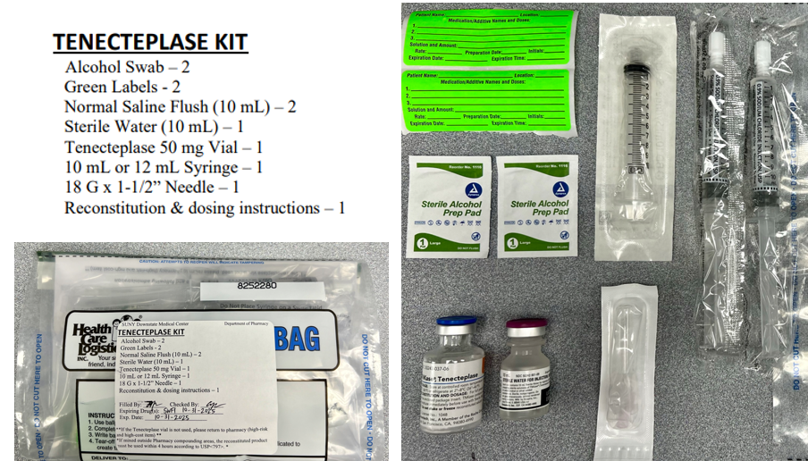
Preparation and Administering

Slide 16
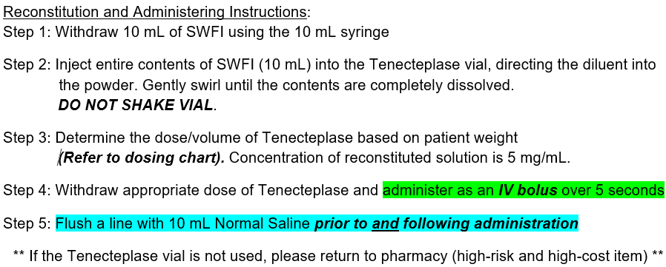

Slide 17
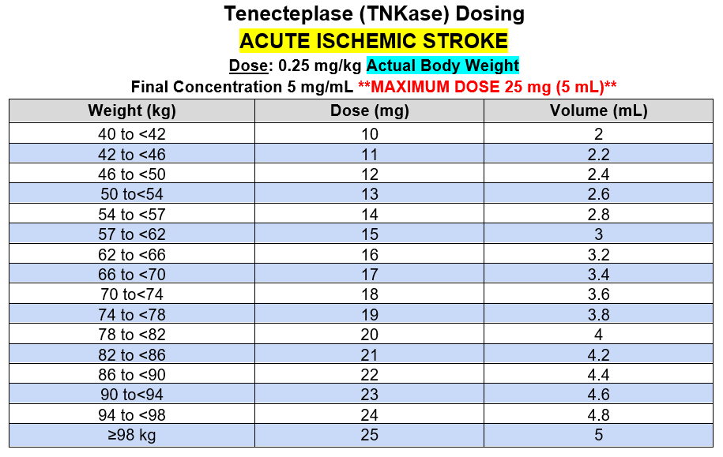


Slide 18
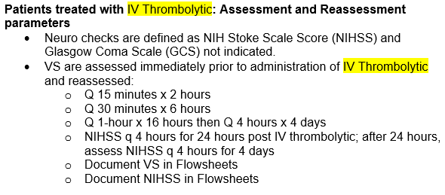
Patient Monitoring

Slide 19
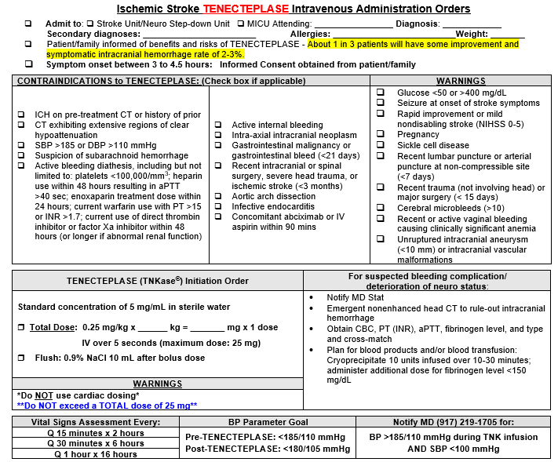
DOWNTIME Order Entry
MUST include patient location, height, weight, and allergy information
Fax order to Pharmacy’s “STAT” fax machine (x2855) & call to confirm receipt
Refer to STK-03 Policy Attachment

Slide 20
Notify Provider
BP greater than 180/105
Signs and symptoms of adverse reaction (angioedema, anaphylaxis, changing loc, bleeding from any site, headache, nausea, vomiting)
Change of greater than 2 in NIHSS score.

Slide 21
Safety Precautions
NPO for stroke patients until swallow eval and physician diet order is obtained.
Bedrest for 24 hours
No anticoagulants for 24 hours (apply sequential compression device SCD)
Fall precaution

Slide 22
Documentation
Signs and symptoms
BEFAST, Vital signs and NIHSS Score
Patient weight
Care plan
Medication dose and time administered
Patient response to medication and/or progress
Patient and family education (specific to medication and patient risk factors)
Safety precautions initiated

