Slide 1
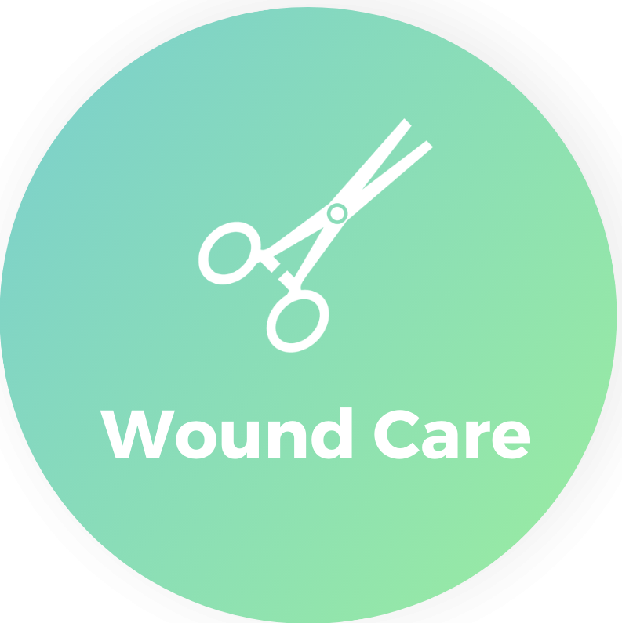
Pressure Injury Prevention & Care
DEPARTMENT OF NURSING EDUCATION
INSTITUTE OF CONTINUOUS LEARNING

Slide 2
Pressure Injury
DEFINITION
presentation
CAUSES
A pressure injury is localized damage to the skin and underlying soft tissue usually over a bony prominence or related to a medical or other device.
Intact Skin or
Open ulcer
Note: It is painful!
Intense Pressure
Prolonged Pressure
Pressure + Sheer
(NPIAP – National Pressure Injury Advisory Panel, 2016)

Slide 3
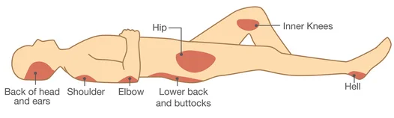
Pressure Injury – Risk Assessment
THE BRADEN SCALE
evidenced-based tool
predicts the risk for developing a hospital-acquired pressure injury.
Scores 6 risk factors:
THE BRADEN SCALE – SCORING:
19-23 = no risk
15-18 = mild risk
13-14 = moderate risk
Less than 12 = High Risk
less than 9 = severe risk

Slide 4
Pressure Injury –Braden Scale Risk Factors
Moisture
Activity
Sensory Perception
Mobility
Nutrition
Friction & Sheer
SOURCE: Barbara Braden and Nancy Bergstrom. Copyright, 1988

Slide 5
Pressure Injury –Braden Scale Risk Factors
Moisture
Activity
Sensory Perception
Mobility
Nutrition
Friction & Sheer
Ability to respond meaningfully to pressure-related discomfort
Degree to which skin is exposed to moisture
Degree of physical activity
Ability to change and control body position
Usual food intake pattern
Movement up and down in bed & potential injury
SOURCE: Barbara Braden and Nancy Bergstrom. Copyright, 1988

Slide 6
Braden Scale – Interventions
Moisture
Activity
Sensory Perception
Mobility
Nutrition
Friction & Sheer
Turn & Position Q2 hours & PRN
Create Toileting Schedule
Activity as ordered (fall prevention measures)
Turn and position Q2 hours and PRN
Obtain nutrition consult
HOB not elevated >30% (unless contraindicated)
Change/clean patient when wet
Keep bed tidy and free of objects
One sheet, one pad!
Utilize ‘Purewick’ or Texas Catheter
Change position Q2 hours in chair
If bedrest, turn/change patient
Apply moisture barrier to skin
Off-load heels
Protect bony prominences
PROM (as ordered)
Pressure-relieving mattress
Manage other risk factors (nutrition, moisture etc.)
Provide supplementation
Assess % of meal complete
Assess protein intake & supplement as ordered
Supplement vitamins A, C, E
Use lift sheet to move patient up in bed
Ask patient to help/use trapeze to move up
SOURCE: Barbara Braden and Nancy Bergstrom. Copyright, 1988

Slide 7
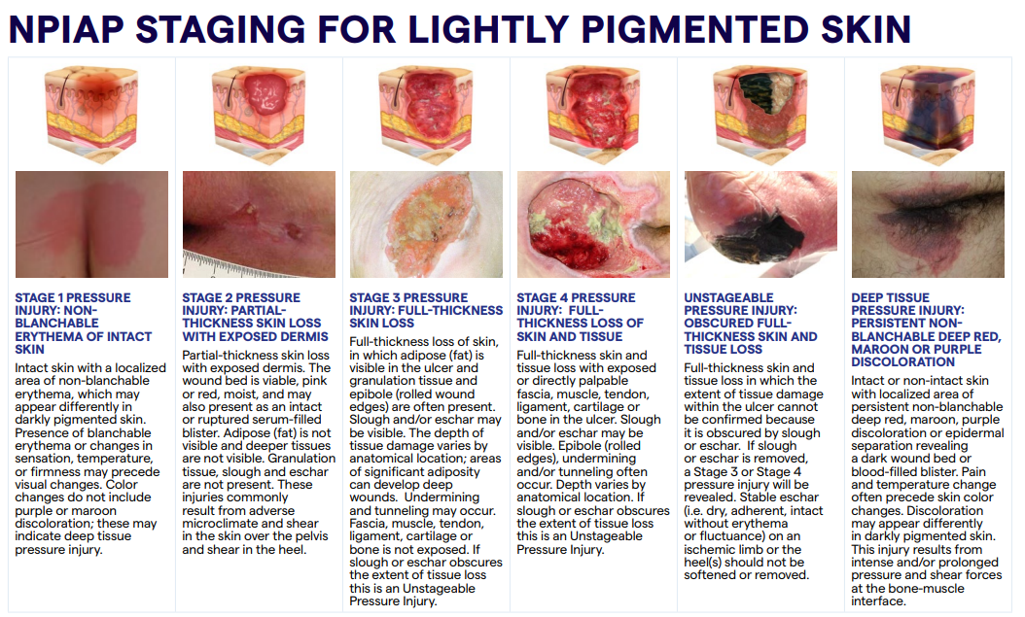

Slide 8
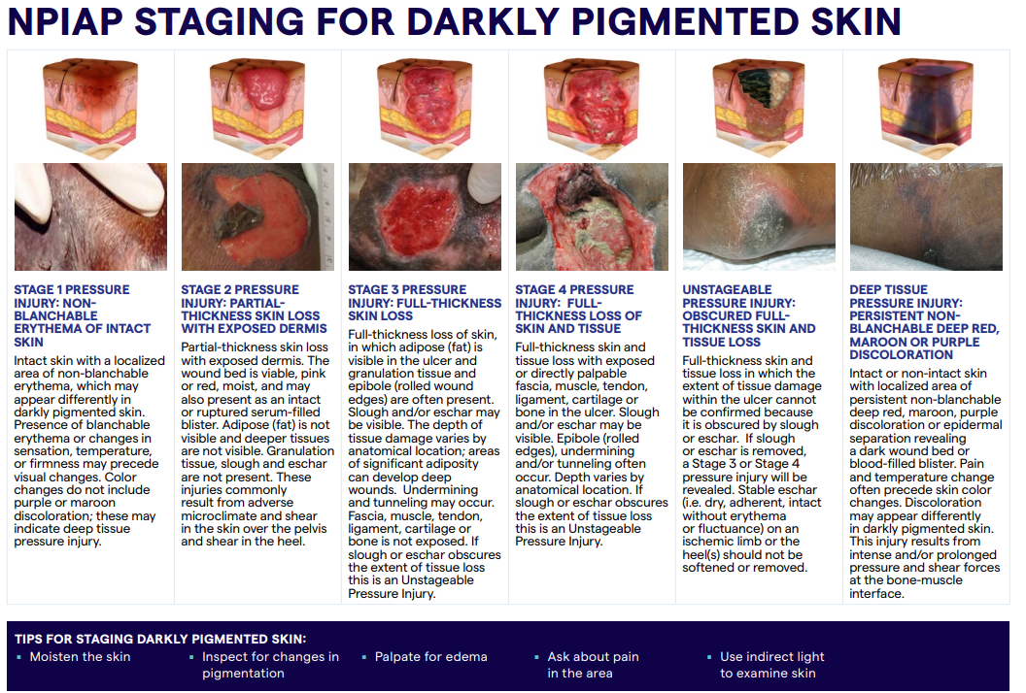

Slide 9
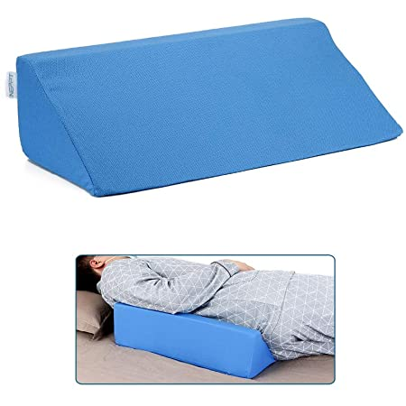
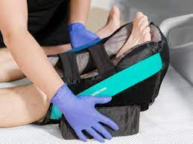
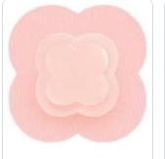
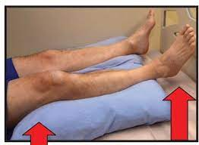
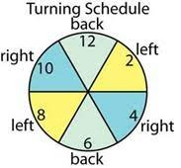
Pressure Injury Prevention
Products Used at UHB

Slide 10
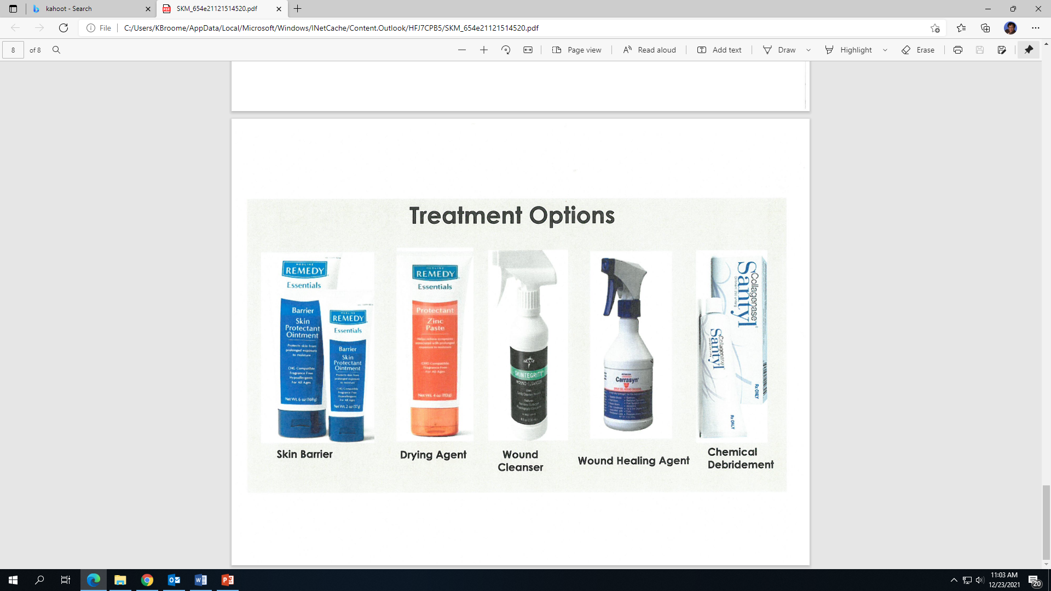
Pressure Injury Treatment Products UHB

Slide 11
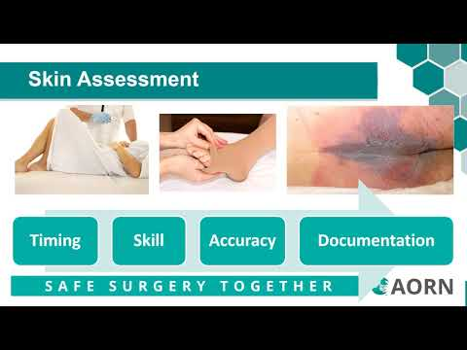
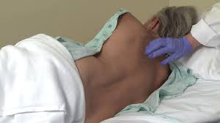
Wound Care Referral & Consult
On Admission:
RN Performs Full Head to Toe Assessment
If no pressure injury – Braden scale to determine risk factors
If suspected pressure injury, RN:
Involves WTA (wound treatment associate)
Submits wound care referral (in Healthbridge)
Notifies LIP………LIP enters treatment order

Slide 12
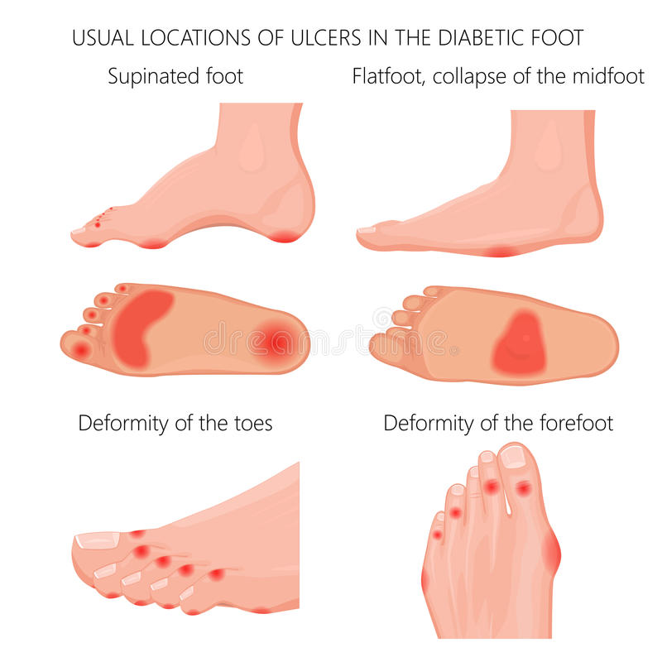
Non-Pressure Injury
Most common types:
  Diabetic
  Venous
  Arterial
  Moisture-related
  Traumatic

Slide 13
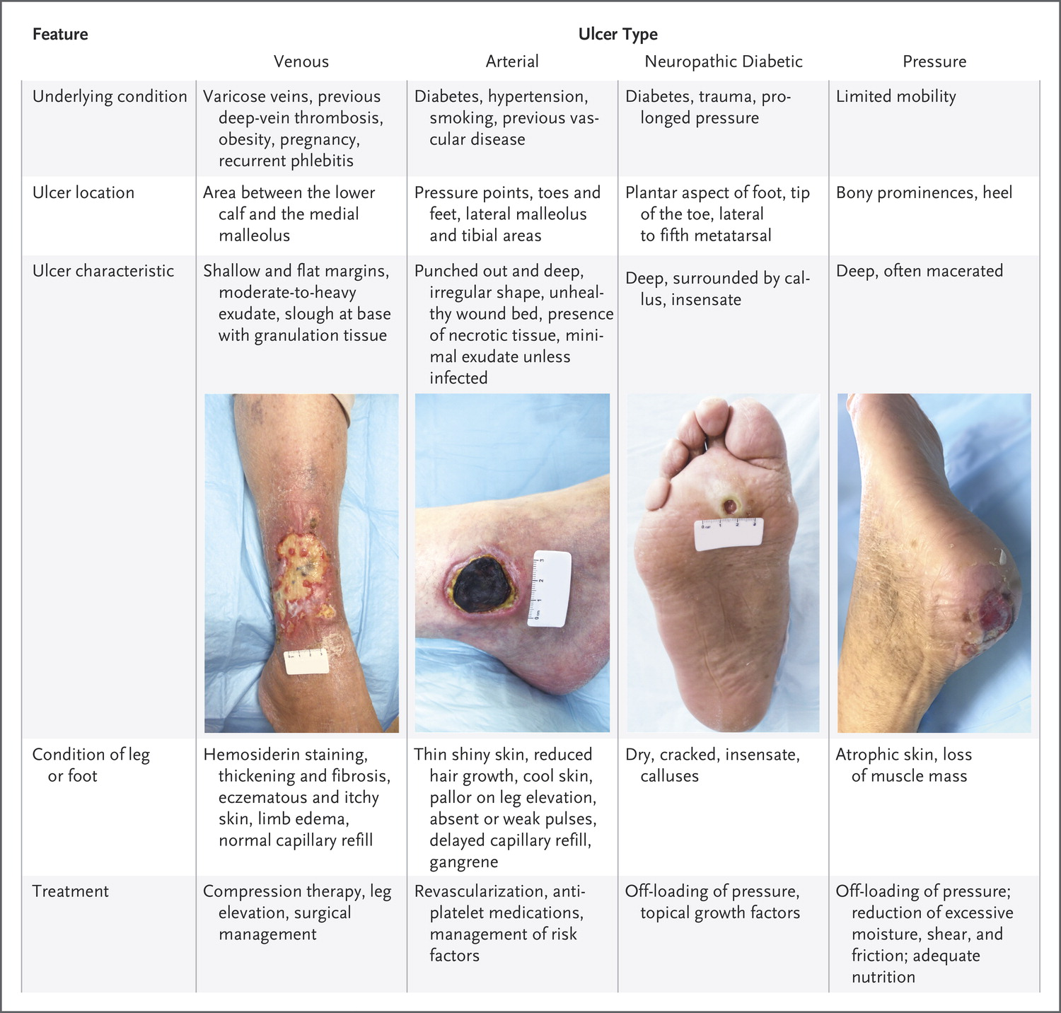
NON-PRESSURE INJURY

Slide 14
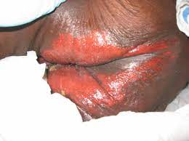
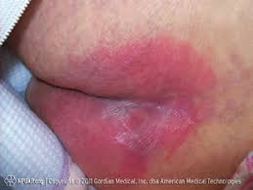
Moisture-Related Skin Injury

Slide 15
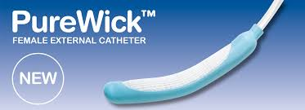
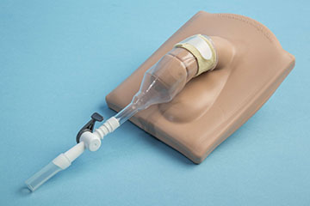
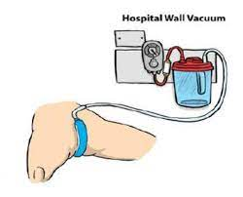
Moisture-Related Skin Injury Prevention
Products Used at UHB
FEMALE
MALE

Slide 16
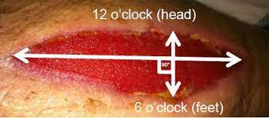
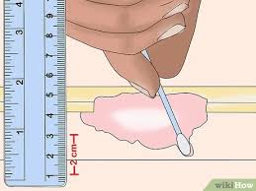
Pressure Injury Measurement
Depth
Length & Width

Slide 17
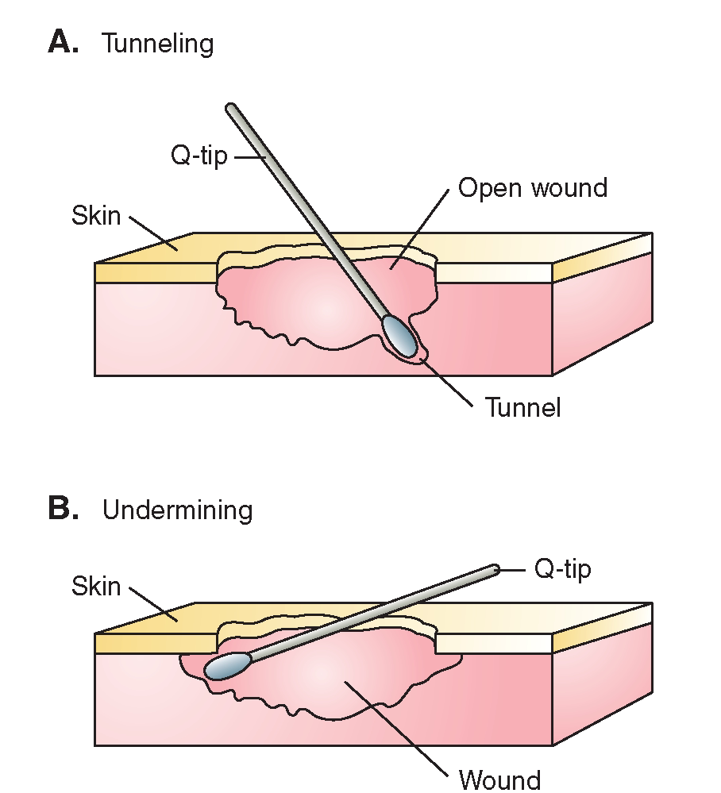
Pressure Injury Measurement

Slide 18
Document
- Early recognition is key (hospital vs community acquired)
- Initial measurement, appearance, odor
- Treatment and preventative interventions per shift
- Progression and updates in measurement weekly and PRN
- Referrals (e.g. nutrition)
- Healed pressure injury always referred to as ‘healed stage ____’

Slide 19
References
Baris, Nuray MSN; Karabacak, Bilgi Gulseven PhD; Alpar, Şule Ecevit Prof The Use of the Braden Scale in Assessing Pressure Ulcers in Turkey, Advances in Skin & Wound Care: August 2015 - Volume 28 - Issue 8 - p 349-357 doi: 10.1097/01.ASW.0000465299.99194.e6
By the Numbers: Braden Score Interventions, Advances in Skin & Wound Care: April 2004 - Volume 17 - Issue 3 - p 150

