Slide 1

State Payroll Department
Jennifer Del Rosario
Director, State Payroll
Patricia Ralph
Assistant Director, State Payroll
V2018-01-17

Slide 2
Mission Statement
The Payroll Department is a dedicated team of professionals committed to paying employees on-time and accurately; to providing employees with excellence in customer service and to supporting campus efforts to achieve its mission.

Slide 3
Vision Statement
The Payroll Department will always support SUNYDMC as it works to achieve its mission. We will provide leadership, professionalism and knowledge of payroll practices. We will make sure that SUNYDMC stays in compliance with SUNYHR, with respect to collective Bargaining agreements and The Office of the State Comptroller. We will be receptive and responsive to employees' and other department’s needs.

Slide 4
Vision Statement Cont’d
Our vision will be accomplished by:
  Fulfilling the Payroll Department's mission statement,
  Providing center-wide communication and training in usage and interpretation of TAS (Time and Attendance) and campus payroll policies, while enhancing employee development.
  Continuing the departmental education in regards to technology, and
  Exploring every available avenue to convey information to our customers and updating our website to facilitate communication with the campus community.
Core Values: Confidentiality, Individuality/ Empathy, Teamwork, Honesty, Accuracy/ Timeliness, Trust/ Accountability.

Slide 5
Payroll - Time and Attendance
It is an employment requirement for every State Employee to maintain their time record on a Bi-Weekly or monthly basis. Timely submission of time sheets/time records is mandatory.
Following is the schedule when Time sheets/records are due:
  Classified employees (CSEA, PEF and PBANYS/NYSCOPBA) time sheets / records are due in the Payroll Office two days after the close of each Bi-Weekly pay period.
  Non-classified employees (UUP and MC) time sheets/ records must be updated by the 10th day of the following month.
Manually prepared Time sheets
For those departments and staff that are NOT YET on the online TAS, time sheets can be scanned and submitted via email to the "CSEA Time Sheets“ inbox in DMC's Lotus Notes directory (CSEA Time Sheets@Downstate.edu), scanned to Payroll@downstate.edu or faxed to the Payroll Office 718-270-4143.
Payroll Website: https://www.downstate.edu/finance/departments/payroll.html
Most state employees now process time records online at SUNY Time and Attendance System (TAS).
This will require your login to access.

Slide 6
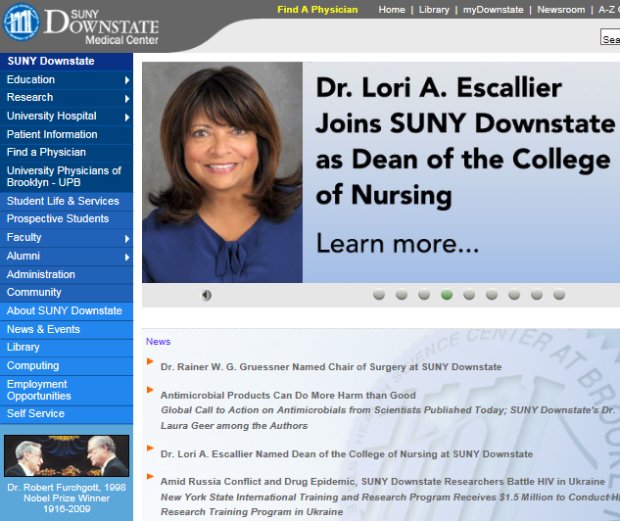
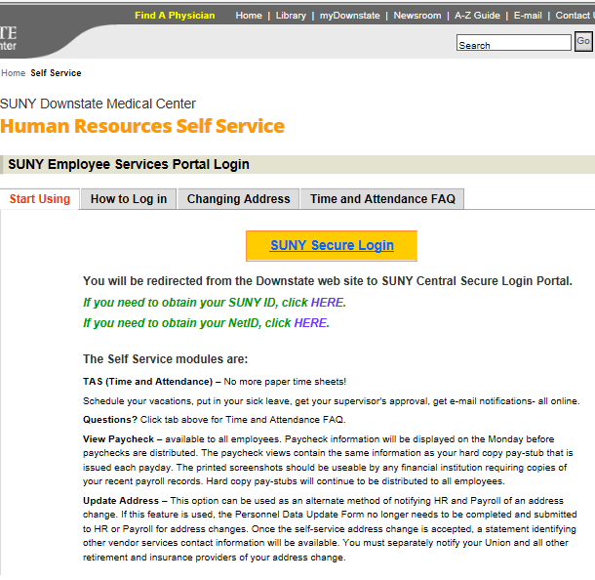

ACCESS TO SUNY HR WILL BE FOUND AT:
CLICK
CLICK
NOTE

Slide 7
First-time System Sign-in Information
For security reasons your sign-in will be different the first time you enter into the Time and Attendance System. You will be asked for your SUNY ID (which is provided by your campus) and your date of birth (DD/MM/YYYY).
Once you complete this security procedure, you will not need to verify your information again.

Slide 8
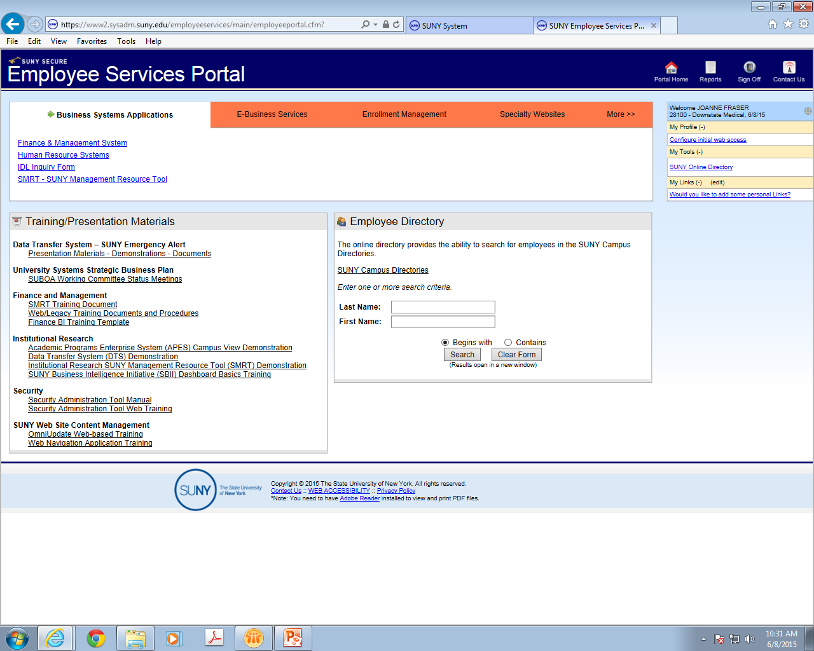
CLICK ON THE “HUMAN RESOURCES SYSTEMS” TAB

Slide 9
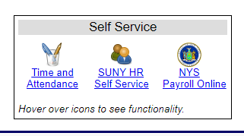
SUNY HR Self Service
Click on Icons

Slide 10
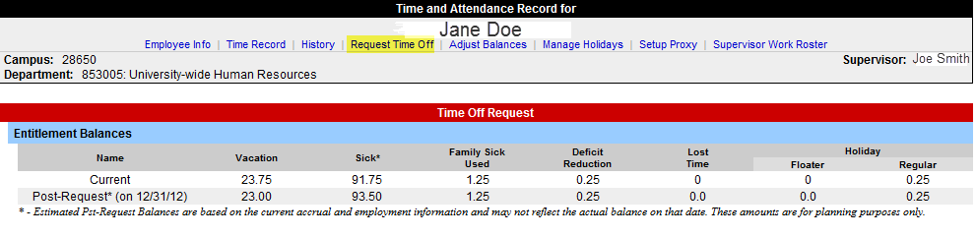
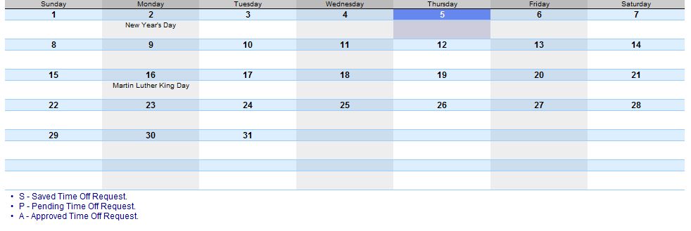
To Complete a Time Off Request:
Select Request Time Off from the menu bar located at the top of the screen (highlighted above).
To request time off from your supervisor, double click on the day you wish to request off or update on the calendar (shown above).

Slide 11
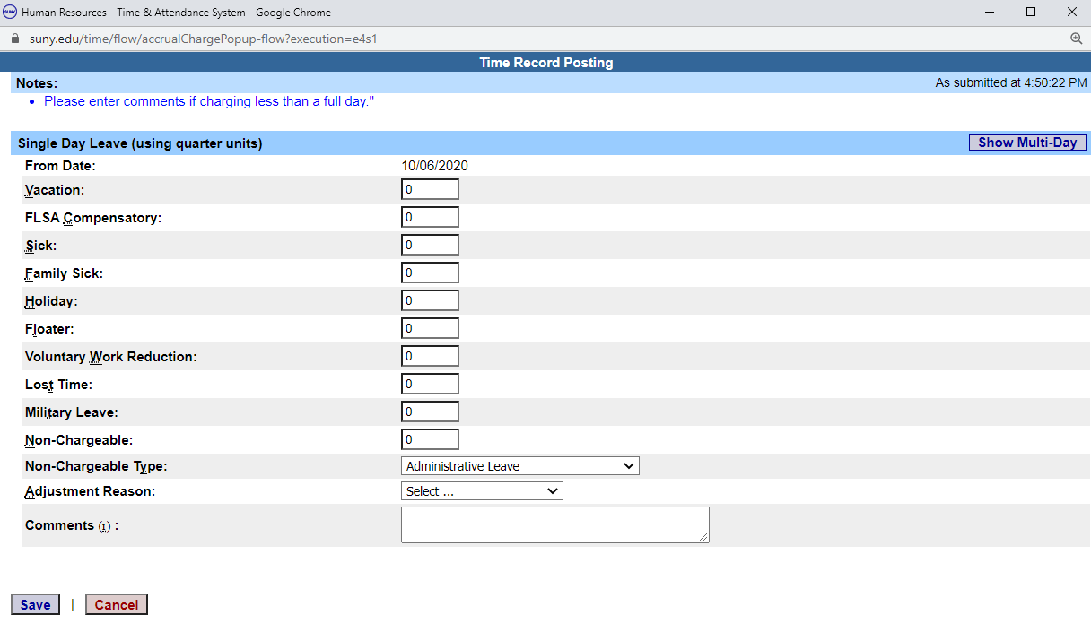

Slide 12
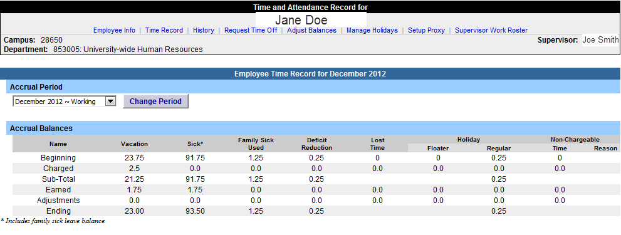
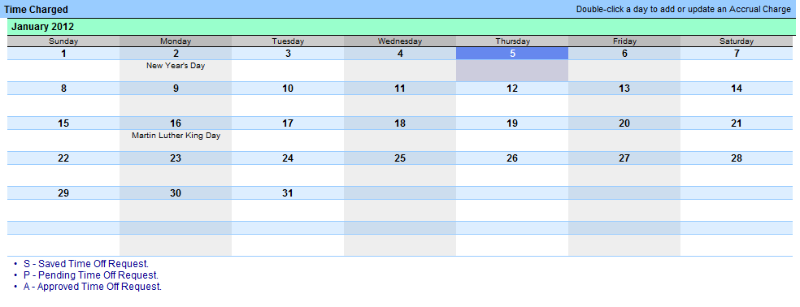
UUP/MC Time and Attendance Record
Double click on the day you wish to add or update time charged on the monthly calendar (shown above).

Slide 13
UUP Accruals – Years of Service
0-1 ……………….1.25 a month
2…………………..1.33 a month
3,4,5……………..1.50 a month
6…………………..1.67 a month
7……………………1.75 a month
Eligible full time employees also earn an extra annual day in January each year.
** The maximum annual leave days an employee can carry over on Jan 1st is 40 days. An employee cannot accrue more than 200 sick days.**

Slide 14
Management Confidential (MC)
Accruals for MCs:
1.75 Annual Day a month
1.75 Sick Day a month
Eligible full time employees also earn an extra day in January each year.

Slide 15
Vacation Accruals- UUP & MC
Vacation balance will not exceed 40 days as of January 1st of any calendar year. Vacation accruals may exceed 40 days during the calendar year.
You will be paid for up to 30 vacation days upon separation from State service.
  Your last time record must be approved and property tracking form submitted upon separation.
  Lump Sum Payments are processed (6 to 8) weeks after receiving final paycheck.
    We will need those documents to process Lump sum payment.
All time off requires prior supervisory approval.
No advances on vacation accruals.

Slide 16
PEF/CSEA Accruals-Yrs. of Service
0-7………………..3.75 hrs. Bi-Weekly - Vacation/Sick
7- until………….5.75 hrs. Bi-Weekly – Vacation /(3.75 Sick)
________________________________________________________________
An employee earns (5) Personal days on his/her Anniversary and will continue to earn vacation days as follows:
Year 1 …………… 1 day Year 5…..5 days
Year 2……………2 days Year 6…..6 days
Year 3……………3 days Year 7…..7 days
Year 4……………4 days
** Employees working 8hrs will accrue 4 hrs. annual/sick leave Bi-Weekly.**

Slide 17
PEF/CSEA Accruals-Yrs. of Service
Employees working 37.5 hrs. per week will begin with 37.5 hrs. of personal time.
Employees working 40 hrs. per week will begin with 40 hrs. of personal time.
Based on an employee’s years of service he/she will
continue to accrue vacation days as follows:
20-24 ……………1 additional day
25-29..…………..2 additional days
30-34…………….3 additional days
35/more………..4 additional days

Slide 18
PEF/CSEA Important Points
Vacation leave cannot be taken until you have completed (6) months of service.
Vacation accruals can be carried from one year to the next. Anything over 300 hours must be used by March 31st of the following year.
Vacation leave must be approved by your supervisor.
The maximum accruals for sick leave is 1500 hours. A doctor’s note must be submitted when an employee is out sick for three (3) or more days.
Death in the family or family sick must be charged to sick leave.

Slide 19
PBANYS BU 21 / NYSCOPBA BU 31
0-7………………..4 hrs. Bi-Weekly - Vacation/Sick
7- until………….6 hrs. Bi-Weekly – Vacation /(4 hrs Sick)
An employee earns (5) Personal days on his/her Anniversary and will continue to earn vacation days as follows:
Year 1 …………… 1 day Year 5…..5 days
Year 2……………2 days Year 6…..6 days
Year 3……………3 days Year 7…..7 days
Year 4……………4 days

Slide 20
PBANYS – BU 21 / NYSCOPBA -BU 31
Based on an employee’s years of service he/she will continue to accrue vacation days as follows:
20-24 ……………1 additional day
25-29..…………..2 additional days
30-34…………….3 additional days
35/more………..4 additional days
Max employee can earn per year is:
Sick Leave – 1700 hours / Annual Leave – 320 hours

Slide 21
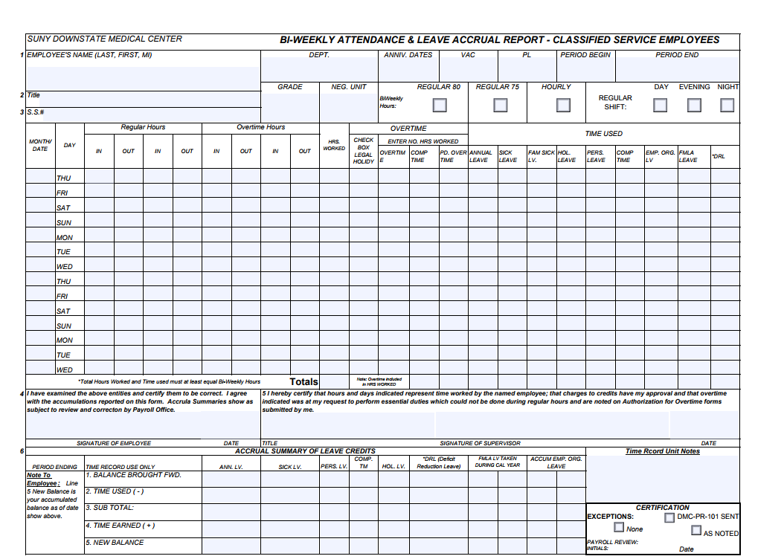
PEF/Security who are not on TAS
Please log onto the Payroll Internet Page to obtain Bi-Weekly Time sheet. (Bi-Weekly ATTENDANCE & LEAVE ACCRUAL REPORT - CLASSIFIED SERVICE EMPLOYEES)
  https://www.downstate.edu/finance/departments/payroll.html
It should be submitted Bi-Weekly and scanned to Payroll@downstate.edu or fax to 718-270-4143.

Slide 22
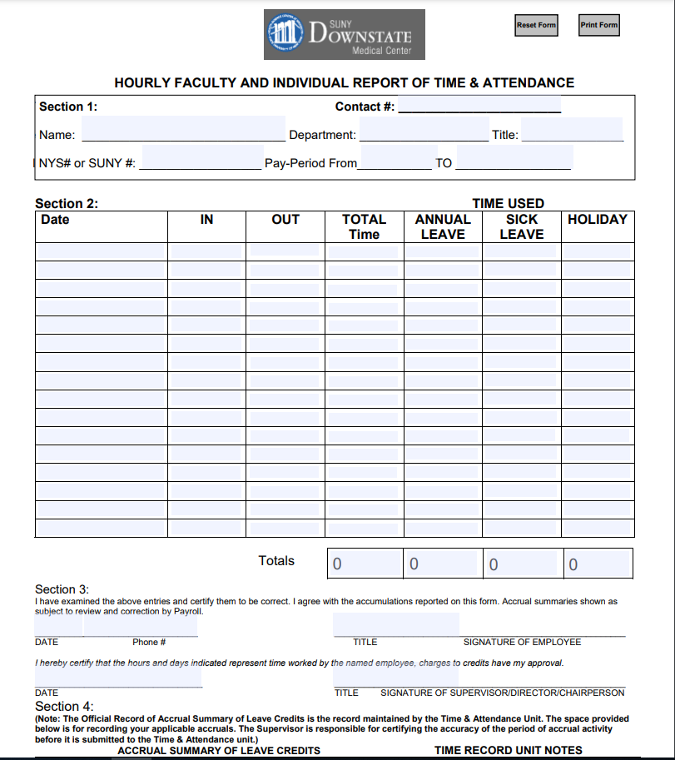
Faculty and Individual Hourly/Per Diem/Adjunct
Please log onto the Payroll Internet Page to obtain Hourly Time sheet. (HOURLY FACULTY AND INDIVIDUAL REPORT OF TIME & ATTENDANCE).
  https://www.downstate.edu/payroll/time-attendance.html
It should be submitted Bi-Weekly and scanned to Payroll@downstate.edu or faxed to 718-270-4143.

Slide 23
Payroll
Paid Bi-Weekly on Wednesdays for work performed two weeks earlier.
Salary Factor used to compute your Bi-Weekly salary
    Full-time employees
    Base Salary X Factor
    Part-time employees
    Base Salary X Factor X Percentage of obligation (FTE)
Please Note:
  Dividing your salary by 26 will not give you the correct salary. State paychecks are base on the State fiscal year which can not be equally divided.
The Salary Factor use is .038356 (for leap year is .038251).
Review all information for accuracy.
The pay week begins on Thursday and ends on Wednesday.
https://www.downstate.edu/payroll/forms.html

Slide 24
Overtime & Holiday
Overtime: Any hours worked in excess of 40 hours.
For the employee who works 37.5hrs, the 2 ½ hours worked after the 37.5 hrs. is Comp Time.
  Any additional time worked is considered overtime and the employee will be compensated accordingly.
Please indicate your regular hours, by indicating the time your shift begins and when it ends, for e.g. (7:00am – 3:00pm).
If a holiday falls on your regular day off, then you will automatically receive that HOLIDAY on the books.
Overtime is paid out (1) month prior depending on submission.
  (I.E. Pay date 02/17/2021 – Overtime covers from January 6 - January 20)

Slide 25
Overtime & Holiday Cont’d
Please note that your HOLIDAY hours cannot exceed 97.5 hours.
  However, if you opt to be paid for the Holiday you worked, then you will not be credited for the day on the books.
If you are transferring from another State Agency, you must inform The Time & Attendance Unit.
  (Accruals from your former agency, can be credited to either your annual or sick time).
Meal allowance:
  This is paid when you have worked (3) or more hours before or after your regular shift and after (6) hours on your day off.
Salary Withholding Program: (MC, PEF & CSEA)
  Employees newly added to the payroll shall have one (1) day held for the first five (5) pay periods. Employees shall recover monies deferred under this program at the time they leave State service.
  (Employee should be off the payroll for six weeks and not owing the State)

Slide 26
State Leaves
Leaves information in your packet include the following:
  Additional Sick Leave (Presidential Leave)
  Bone Marrow and Organ Donors
  Breast Cancer Screening (BCS): doctor’s note
  Family Medical Leave Act (FMLA)
  Jury Duty
  Conference
  Off Campus Meeting
  Professional Exam
  Training/Professional Development
  Sabbatical Leave
  Extra Ordinary Inclement Weather
  Military Leave
  Prostate Cancer Screening (PCS).
  Please Note: Documentation is required for all leaves and all leaves must be recorded on time record (TAS) or on paper.

Slide 27
Legal Holidays
New Years Day
Martin Luther King Day
President’s Day
Memorial Day Floating Holidays
4th of July Lincoln Day
Labor Day Election Day
Columbus Day
Veterans Day
Thanksgiving Day
Christmas Day

Slide 28
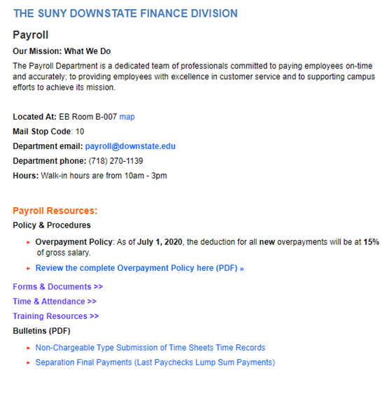
Payroll Internet Website
https://www.downstate.edu/finance/departments/payroll.html

Slide 29
DIRECT DEPOSIT
The Direct Deposit form is located on the Payroll website
https://www.downstate.edu/payroll/documents/payroll/payroll-ac2772-2012.pdf
Scan completed form with a voided check or bank letter with routing and account number t0 payroll@downstate.edu
DO NOT SUBMIT DIRECT DEPOSIT FORM UNTIL YOU RECEIVE YOUR FIRST PAYCHECK

Slide 30

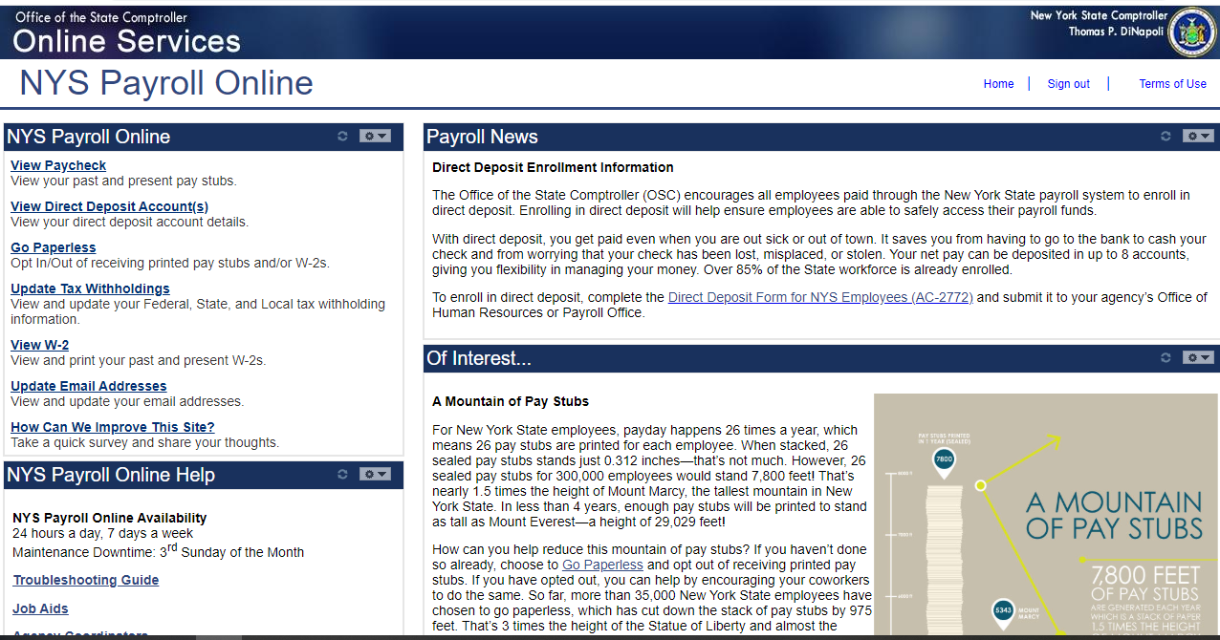
Click on this tab in TAS

Slide 31
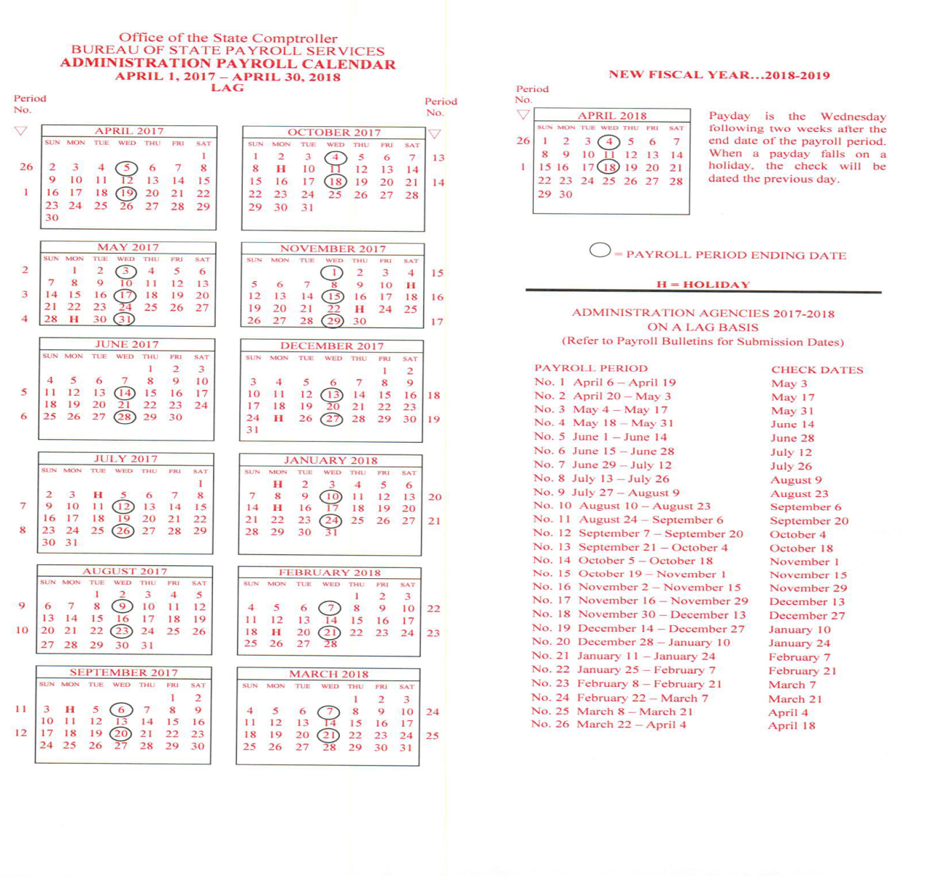
Payroll Calendar on our website
https://www.downstate.edu/finance/departments/payroll.html

Slide 32

OFFICE OF STATE PAYROLL
TIME AND ATTENDANCE
CONTACT INFORMATION
(Please Call for an appointment)
Telephone #(718)-270-1139
Fax # (718)-270-4143
Education Bldg Rm B-007
E-mail address: Payroll@downstate.edu
General Office Hours:
Monday – Friday 10:00am – 2:00pm
In an effort to provide prompt response to your inquiries regarding Payroll / Time and Attendance questions, please utilize the Payroll Inbox. (payroll@downstate.edu)
This email address will also serve to collect all documents relating to Payroll (e.g. Direct Deposit forms, time sheets, IT-2104, etc.).
Employees may also log onto the Payroll intranet page for additional information, tax information, commonly used forms and Time and Attendance (TAS) training resources.
https://www.downstate.edu/finance/departments/payroll.html

Slide 33

QUESTIONS & ANSWERS

