Slide 1

State Payroll Department
Jennifer Del Rosario
Director, State Payroll
Patricia Ralph
Assistant Director, State Payroll
V2018-01-17

Slide 2
Submission of Time Sheets
Key points to be covered:
Timely submission of time sheets/time records is mandatory
Delinquent Time sheets and Late Transactions results in a cost to the institution.
Overpayment
  Overpayment collection requires an exclusive team who works solely and exclusively on the refund of overpayments.
    A series of 3 letters go out the employee and then the case is referred to Attorney General’s office
  Overpayment Policy is on the Payroll Website
    https://www.downstate.edu/payroll/documents/overpayment-recovery-policy-07-2020.pdf
PEF employees are not yet online /TAS
  Parallel Testing will begin shortly – Electronic Time Sheet
The Payroll Internet Website
Direct Deposit
Payroll Calendar
Payroll General Office Hours

Slide 3
Payroll - Time and Attendance
It is an employment requirement for every State Employee to submit their time sheet/time record on a Bi-Weekly or monthly basis. Timely submission of time sheets/record is mandatory.
Following is the schedule when Time sheets are due:
  Classified employees (CSEA, PEF ) time sheets/ records are due in the Payroll Office within two days after the close of each Bi-Weekly pay period.
Manually prepared Time sheets
For those employees who are NOT YET on the online TAS, time sheets should be scanned and submitted via email to the "CSEA Time Sheets“ inbox in DMC's Lotus Notes directory (CSEA Time Sheets@Downstate.edu) or to Payroll@downstate.edu.

Slide 4
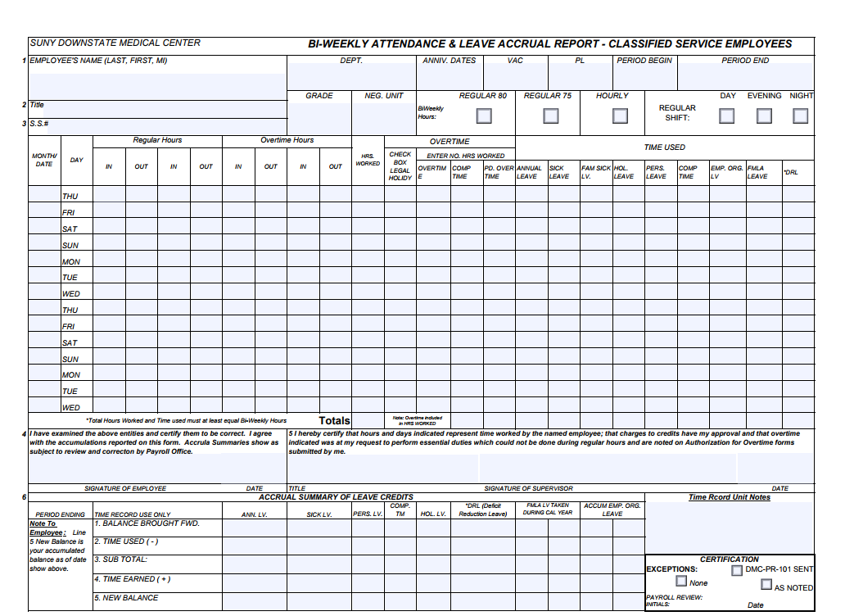
PEF who are not Online-TAS
Please log onto the Payroll Internet Page to obtain Bi-Weekly Time sheet.
  (Bi-Weekly ATTENDANCE & LEAVE ACCRUAL REPORT - CLASSIFIED SERVICE EMPLOYEES)
  https://www.downstate.edu/finance/departments/payroll.html
It should be submitted Bi-Weekly and scanned to Payroll@downstate.edu or faxed to 718-270-4143.

Slide 5
Delinquent Time Sheets

Slide 6
Overpayment Chart
Employee Titles | Sum of Balance Owed Amount | Sum of Balance as of 09/16/20 | Sum of Total Goal Amount
CLINICAL ASSNT IN HS | 22,164.71 | 12,125.33 | 34,290.04
CLINICAL INSTRCTR HS | 11,471.44 | 2,981.90 | 14,453.34
HOSP ATTENDANT 1 | 0.00 | 253.88 | 253.88
NURSING ASSNT 1 | 2,917.27 | 3,191.77 | 6,109.04
NURSING ASSNT 2 | 16,901.87 | 7,961.70 | 24,863.57
NURSING STATION CLK 1 | 5,011.20 | 3,464.72 | 8,475.92
T H CLINCL LAB TECH 2 | 4,779.86 | 7,987.67 | 12,767.53
T H CLINCL LAB TECH 3 | 2,183.84 | 0.00 | 2,183.84
T H CTS EEG ASSOC | 9,441.37 | 0.00 | 9,441.37
T H CTS EKG ASSOC | 0.00 | 1,060.60 | 1,060.60
T H MED RADIOGRPHR 1 | 4,131.24 | 491.05 | 4,622.29
T H OCCUPTNL THERP 3 | 2,504.89 | 0.00 | 2,504.89
T H PHARMCST | 14,412.39 | 0.00 | 14,412.39
T H PHYSCL THER 2 | 0.00 | 2,220.75 | 2,220.75
T H REC THERPY SPEC | 2,081.28 | 0.00 | 2,081.28
T H SR BIOMED ENGR | 0.00 | 6,083.43 | 6,083.43
T H SURGCL TECHNGST 1 | 1,871.81 | 0.00 | 1,871.81
T&R CNTR LIC PRAC NRS | 5,477.70 | 4,456.30 | 9,934.00
TEACHING&RSCH CTR N 2 | 144,944.03 | 43,264.73 | 188,208.76
TEACHING&RSCH CTR N 3 | 0.00 | 2,499.44 | 2,499.44
TEACHING&RSCH CTR S N | 15,374.04 | 20,626.31 | 36,000.35
VICE PRES HOSP AFFAIR | 0.00 | 71,454.35 | 71,454.35
GRAND TOTALS | $265,668.94 | $190,123.93 | $455,792.87
Notes:
Finance Budget can send out monthly the overpayment chart by departments.

Slide 7
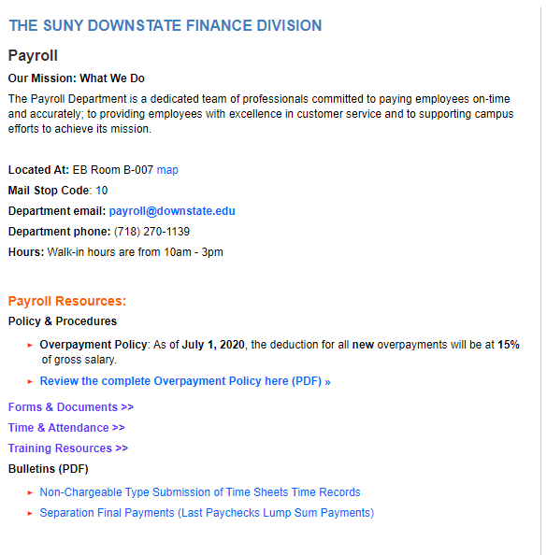
Payroll Internet Website
https://www.downstate.edu/finance/departments/payroll.html

Slide 8

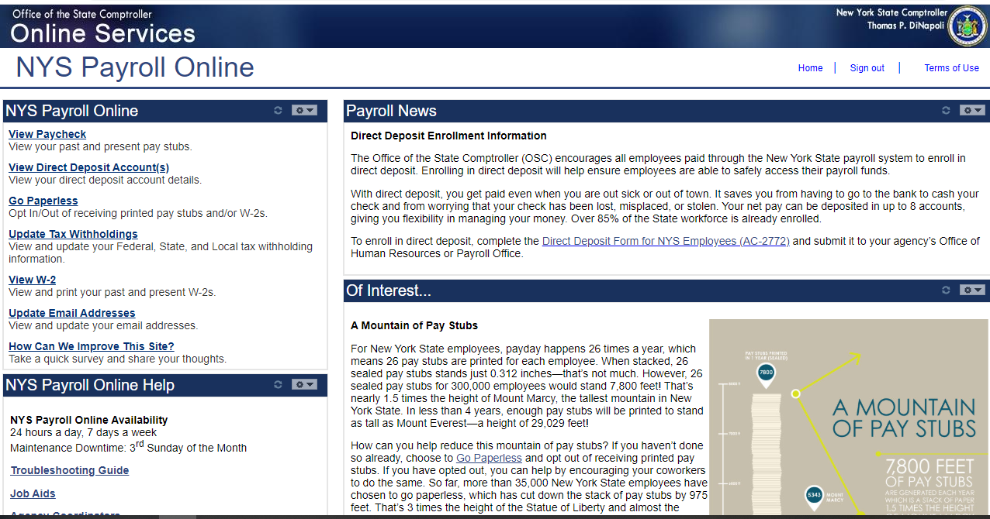
Click on this tab in TAS

Slide 9
DIRECT DEPOSIT
The Direct Deposit form is located on the Payroll website
https://www.downstate.edu/payroll/documents/payroll/payroll-ac2772-2012.pdf
Scan completed form with a voided check to payroll@downstate.edu

Slide 10
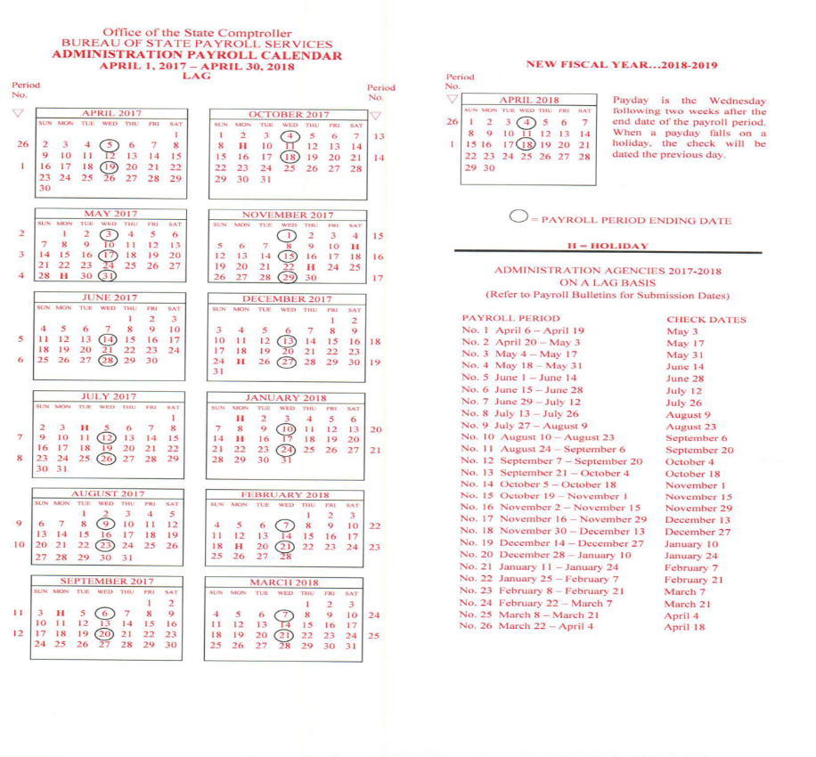
Payroll Calendar on website
https://www.downstate.edu/finance/departments/payroll.html

Slide 11

OFFICE OF STATE PAYROLL
TIME AND ATTENDANCE
CONTACT INFORMATION
(Please Call for an appointment)
Telephone #(718)-270-1139
Fax # (718)-270-4143
Education Bldg. Rm B-007
E-mail address: Payroll@downstate.edu
General Office Hours:
Monday – Friday 10:00am – 2:00pm
In an effort to provide prompt response to your inquiries regarding Payroll / Time and Attendance questions, please utilize the Payroll Inbox. (payroll@downstate.edu)
This email address will also serve to collect all documents relating to Payroll (e.g. Direct Deposit forms, time sheets, etc.).
Employees may also log onto the Payroll intranet page for additional information, tax information, commonly used forms and Time and Attendance (TAS) training resources.
https://www.downstate.edu/finance/departments/payroll.html

Slide 12

QUESTIONS & ANSWERS

