Slide 1
Downstate Medical Center’s
Electronic Time and Attendance
Training Module
Biweekly Process for CSEA
Notes:
1

Slide 2
ACCESS TO SUNY HR WILL BE FOUND AT:
CLICK
CLICK
NOTE

Slide 3
ACCESS TO SUNY HR WILL BE FOUND AT:
http://www.suny.edu/time
Suggested Bookmark
First, you will encounter a
Sign-on Screen
Enter your NET ID
Enter your
Network Access ID

Slide 4
RECOVER YOUR SUNY ID:
CLICK HERE
YOU SUNY ID # WILL APPEAR HERE

Slide 5
CLICK ON THE “HUMAN RESOURCES SYSTEMS” TAB
CLICK HERE

Slide 6
SUNY HR Self Service

Slide 7
Click on the “Time and Attendance” Tab Again
CLICK HERE

Slide 8
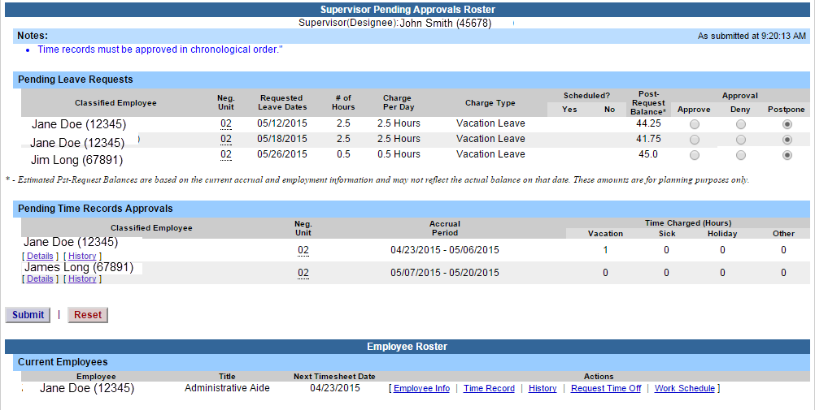
SUPERVISOR WORK ROSTER:
CLICK ON “WORK ROSTER,” TO VIEW THE PENDING TIME RECORDS AND/OR TIME OFF REQUEST, OF YOUR EMPLOYEES.
Select
“Work Roster”

Slide 9
Supervisor Work roster cont’d:
Pending Leave request – must be approved before any time records within the same pay period.
2) Determine the necessary Action (approve, Deny, or Postpone) **Denied action requires comments for the employee’s Information.
3) Then, “Submit”
4) Pending Time records – Supervisors must View Employee’s Electronic Time Record by clicking on Details under the employees name. This will bring up the completed time record for the employee.
5) Once time record has been reviewed, determine the necessary Action (Approve or Deny) **Denied action requires comments for the employee’s Information.
6) If […] icon appears under an employee’s name, this indicates the employee is also a supervisor within the department. If you click on the […] icon their supervisor work roster will be brought up, and you have all the same supervisor privileges.
Required action for Time off Request
2) Select: Approve, Deny, or Ignore
View Details or History of Time Record
3) Submit
Submit action for pending Time off Request

Slide 10
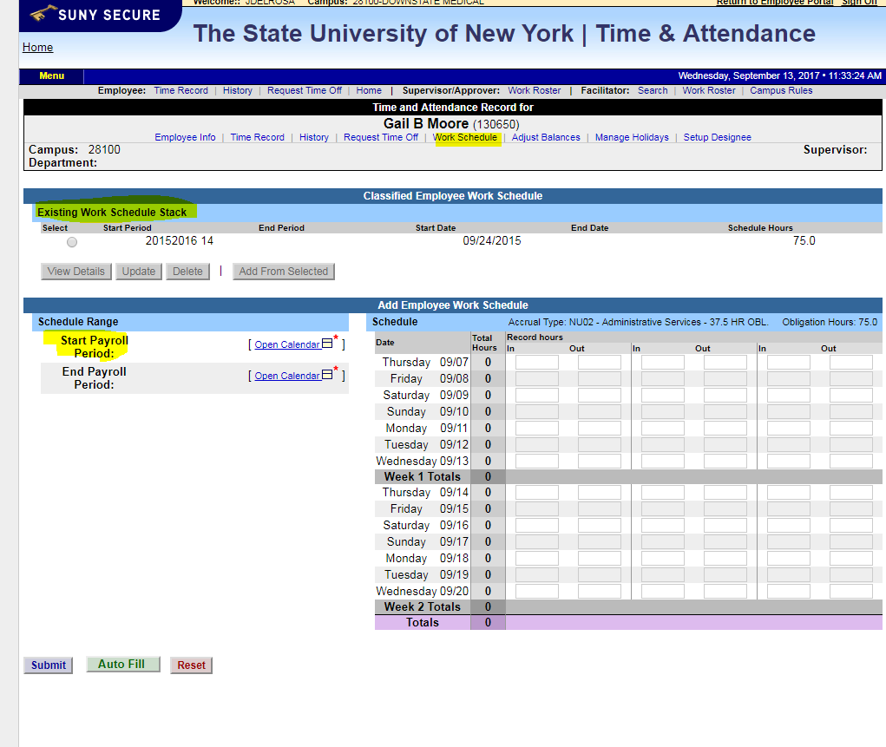
Create Work Schedule – Click on Work Schedule, Click on Start Payroll Period

Slide 11
Click on Start Pay Period, Select Radio Button, Select

Slide 12
Review Employee Work Schedule, Start Period, Start Date, Input Hours (In/Out) Work Schedule, Press Submit

Slide 13
Completed Work Schedule

Slide 14
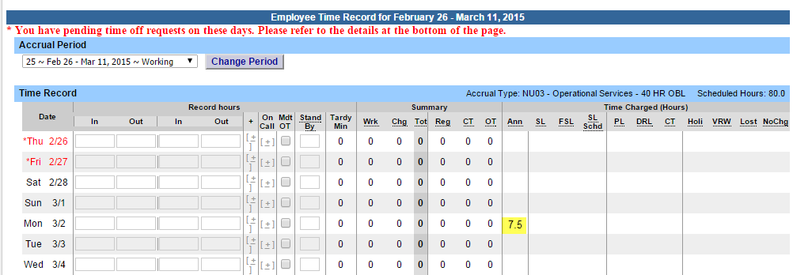
TIME RECORD:
Time record will automatically open to the current pay period in which you have been set up to being entering. To change pay periods, select from the drop down shown below and click change period.
Enter time in and time out in the fields indicated below with time worked each day. Enter A for AM and P for PM. Military time is also accepted.
If you need additional fields, please click on the first (+) button. This will open up more time in and out fields on the particular day.
If employee works overtime, please indicate whether it was mandatory overtime by selecting the box under the Mdt OT column.
To enter time for on-call (recall), please click on the (+) button under the on-call column and enter time worked.
If employee had stand by shifts, please indicate number of shifts under the Stand By column.
Once time worked has been entered, TAS will calculate the time worked within the summary columns (worked, charged, total, regular, comp time and overtime).
Time charged hours are only displayed on the time record once the time off request has been approved by the supervisor (highlighted in yellow). To charge accruals, employees must submit a time off request to their supervisors. See Time off Request section.
If an employee has pending time off request, the date of the request will appear on the time record in red with a note displayed at the top of the time record, indicating your pending request.
Accrual Period
Enter Time in and Time out in open fields.

Slide 15
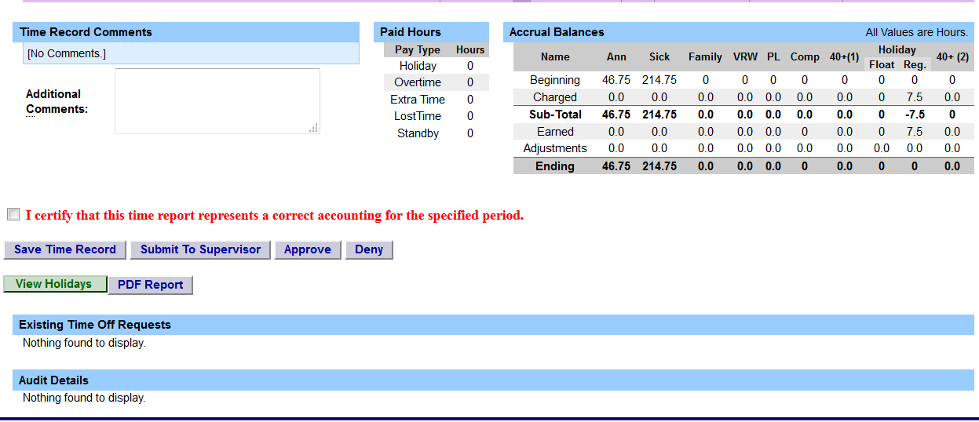
OTHER FEATURES ON THE TIME RECORD
Enter comments in the box indicated below if you wish to submit comments to your supervisor on your time record.
Paid Hours – total number of hours entered within the pay period for each pay type (Holiday, Overtime, Extra Time, Lost Time, Standby)
Accrual Balances – summary of accrual balances for each accrual type and any amount charged within the pay period.
View Holidays – list of all holiday/floaters that have been earned, charged and expiration date.
PDF Report - Printable time record.
Existing Time off Requests will be displayed.
Audit Details of when time records have been submitted and action has been taken.
Comments
Accrual
Balance
View Holidays and PDF Report

Slide 16
OTHER FEATURES ON THE TIME RECORD CONT’D
When time record is complete, either certify and submit to supervisor or save time record to submit at a later time.
To send to your Supervisor, click on the “I Certify” box and select Submit to Supervisor
NOTE: You will receive the pop up message if you navigate away from your time record in which changes were made and was not save or submit to their supervisor.
2. Save
1. Certify
b
3. Submit

Slide 17
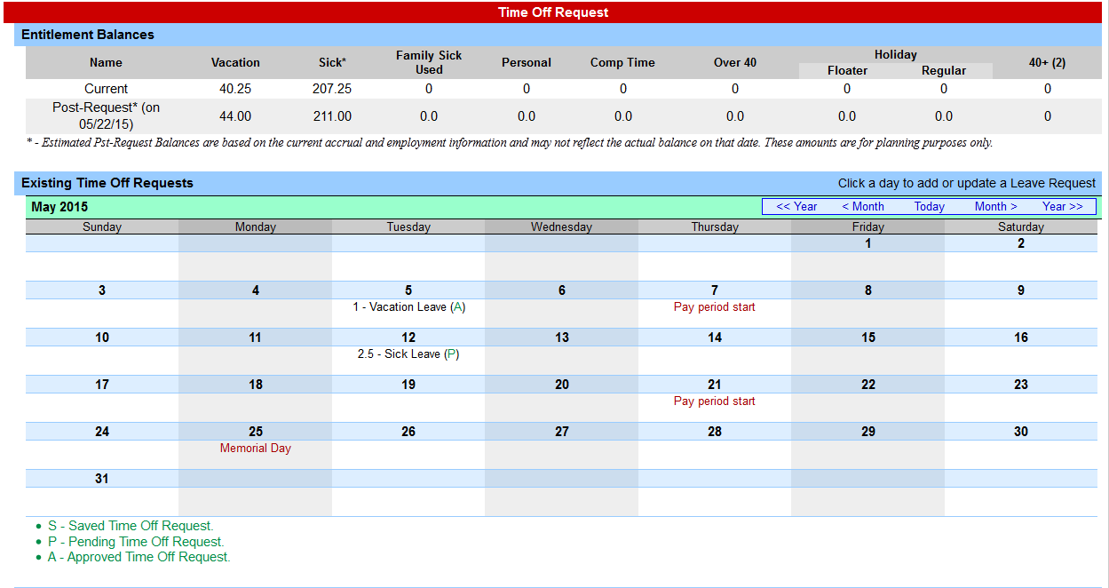
TO ENTER TIME OFF REQUESTS:
Click once on the day you wish to enter the accrual charge.
From the pop up box (shown on the next page), you will enter appropriate accruals.
Click once on the day to enter charges

Slide 18
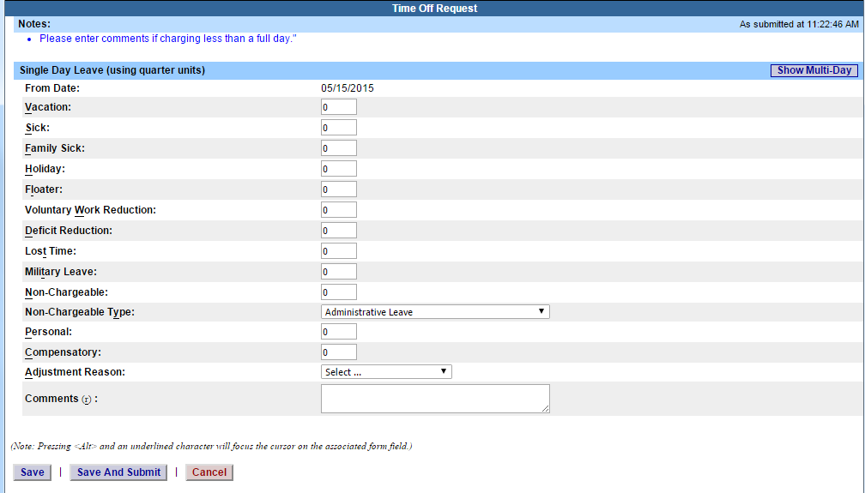
TIME OFF REQUEST – CONT’D
The pop up opens up a single day request (shown on the left).
To enter a date range, select the Show Multi Day button shown on the right (shown on next screen).
Enter the increment (increments of .25 hours only) in the accrual type you want to charge, then select Save or Save and Submit. Once approved, the accrual charge will appear on your time record.
Single Day
Multi-Day

Slide 19
MULTIPLE DAY TIME OFF REQUEST:
Enter the increment (increments of .25 hours only) in the accrual type you wish to charge, then select Save or Save and Submit.
Save – will allow employees to enter the time off request but not submit the request to the supervisor
Save and Submit – allows employees to save and submit the request all at once to the supervisor.
Reminders:
Pending Time off Request - the date of the request will appear on the time record in red with a note displayed at the top of the time record, indicating your pending request (see screen print under time record).
Approved Time off Request – will appear under the time charged section of the time record (see screen print under time record).
Charge accruals can not span across multiple pay period.
If a holiday falls within a time charged, a separate entry must be submitted, excluding the holiday.

Slide 20
STATUS OF TIME OFF REQUESTS:
Reminders:
Once the request has been saved or save/submit, it will appear on the calendar and under the Previously Submitted Leave Request along with the status (Saved, Pending and Approved). If you have not submitted the request to your Supervisor, select the radio button and click Submit Action. Once approved, the request will appear on the corresponding time record.
The status of your request will also appear in parenthesis on your monthly time record (S, P, A).
To withdraw a previously submitted leave request that has not been approved by the supervisor, simply select the withdraw radio button next to the associated request and then click Submit Actions.
Employees will have the ability to submit a time record with pending time off request.
Time off requests can not span across multiple pay periods.
If a holiday falls within a time off request, a separate entry must be submitted, excluding the holiday.
Status of Time Off Request
Select radio button and submit action

Slide 21
1) To take action on a pending time record once the supervisor has clicked on details from the work roster and reviewed the time record, please click approve or deny. 2) Once action has been taken, the pending time record will be removed from the work roster. 3) If approved, the time record will change to an approved status under the accrual pay period drop down 4) If Denied, the time record will show as denied with required comments for the employee to correct as necessary and resubmit to supervisor.
2) Select: Approve, Deny, or Ignore
Approve or Deny

Slide 22
SIGN OUT OF THE SUNY BROWSER AND CLOSE
To ensure your privacy and system security, please log off by clicking on “Sign Off” link in the upper right hand corner of your screen.
Sign Off

Slide 23
Legal Holidays
New Years Day
Martin Luther King Day
President’s Day
Memorial Day Floating Holidays
4th of July Lincoln
Labor Day Election Day
Columbus Day
Veterans Day
Thanksgiving Day
Christmas Day

Slide 24
Payroll Internet Website
http://www.downstate.edu/procurement/payroll.html

Slide 25
Payroll Calendar

Slide 26
Questions? Jennifer Del Rosario, Payroll Director x-1315 Patricia Ralph, Assistant Director x-8146 Email: Payroll@downstate.edu For Payroll Inquiries and Accrual Discrepancies Email: Payroll@downstate.edu or call x-1139

