Slide 1

Downstate Medical Center’s
Electronic Time and Attendance
Training Module
Monthly Process for Supervisors
Notes:
1

Slide 2
Overview of the Monthly Process -
SUPERVISORS
View Work Roster
View Time Information of your Direct Reports using the “Work Roster”
Review and Approve
Review Employee’s Time Record - then select “Approve,” “Deny,” or even “Ignore”
Submit
Submit, Log-off, and Close Browser

Slide 3
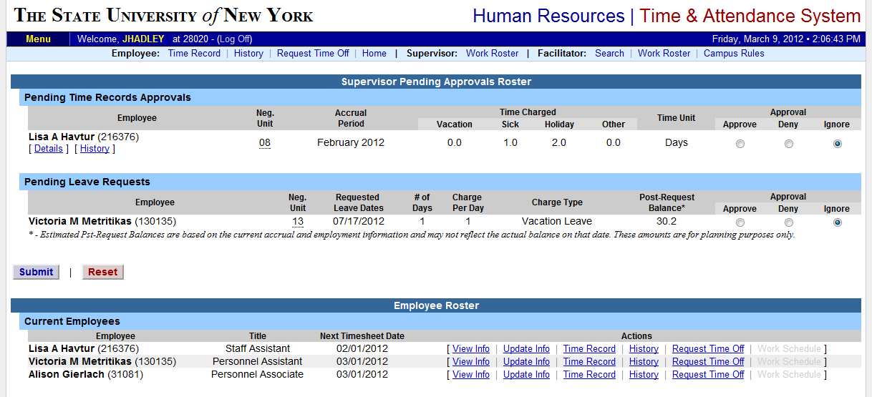
selection to view and approve the electronic record status of direct reports.
Supervisors will have a “Work Roster”
Enter Here
SUBMIT when COMPLETE
Employee List – Contact HR for any corrections.
For PENDING TIME APPROVALS OR LEAVE REQUESTS – Supervisors should select an action: APPROVE, DENY, OR IGNORE. THEN SUBMIT.

Slide 4
Questions?
Martin Deane – AVP Materials Management x-3199
Marty.Deane@Downstate.edu

