Slide 1

SUNY Downstate
Health Sciences University
Lawson Budget & Planning Manual
FY 2021-22

Slide 2

Table of Contents
Page
Login
Contacts
Introduction
SUNY Downstate Budget Process
LBP Main Screen
8. Open Accounting Unit
10. Financial Tab and Workforce Tab
11. Preparing Plan View for FY 21-22-Budget
14. My Plan View
Accounting Units (AU’s)
Financial Tab
Accounts View
Posting Accounts
Workforce Tab
Setting Up Workforce Tab
Workforce Detail Account Lines
Using the Navigation Path
Review Accounting Units (AU’s)
View Preloaded Budget
View PS Summary Information
Salary Projection for FY 21-22-Budget
Review Current Positions in the AU
Workforce FTE/Headcount Column
Modify Existing Employee Record
To Designate Employee Salary Distribution to Different AU/Add a Missing, Vacant or New Approved, Funded Position
Adding Missing Positions and New Position Requests
Financial Tab
OTPS
Adding and Editing Account Detail Lines
36. Appendix
37. Reports
38 Copying Data to Excel
40. Exporting Data to Excel
43. Lawson vs. State Terminology
44. Income Fund Reimbursable (IFR) Accounts Budgets
45. Income Fund Reimbursable (IFR) Account Budgets
46. Establishing a Budget Allocation for IFR AU’s (Academics Only)
47. Entering Consultant Contracts in Object Code 5813
Separate AU’s for Physicians (Hospital Only)
Union Codes for New Hires and Employee Status Changes
FY 21/22 -- Budget Highlights and Important Notes
51. Workforce Planning
Window 10 Upgrade
60. Budget Submission

Slide 3
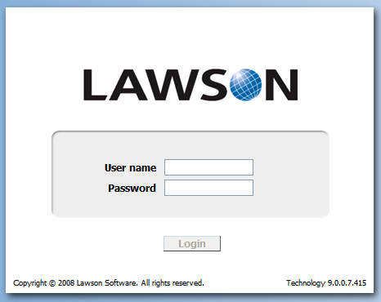
Login
Login Link can be found on Downstate Web Page:
Click Administration > Finance Division > Links >Downstate Health Sciences University Links >
Lawson Budget & Planning System (LBP) - Production database.
Enter your user name and password (same as PC log-in).
Remote Access: To access LBP remotely, you must be connected to your DMC desktop using VPN access. For VPN access, please email the IT help desk: helpdesk@downstate.edu and request to be provided with VPN access.
Use Internet Explorer browser.
(To change from Microsoft Edge-see pgs 53-59)
MAC Users: if you need access to a computer for budget preparation, please send an e-mail to BudgetHelp@downstate.edu.

Slide 4
Contacts
Budgeting Help: During the budgeting process if you have questions or need assistance, please send an e-mail:
  Academic and Shared Services BudgetHelp@downstate.edu
  Hospital non-Shared Services Sharad.Kumar@downstate.edu
  Academic-College of Medicine and School of Graduate Studies only:
  Report Salary / Payroll distribution discrepancies to:
  Ross.Clinchy@downstate.edu
  Elizabeth.Smith@downstate.edu

Slide 5
Introduction
USE THE “21/22-BUDGET” DATABASE TO ENTER DATA.
The three main steps for budget preparation:
Personal Services –Review Workforce tab to ensure all personnel associated to that AU are listed
Contractual OTPS-Financial tab (Detail Lines) ensure all contracts are entered correctly. Will be used for annual encumbrances.
Other OTPS
When you have completed your posting and budget, please review your input and click on the SAVE icon to save your work

Slide 6
SUNY Downstate Budget Process
Ensure all your Accounting Units (AU) are listed
Check Workforce tab to ensure all your employees are listed
Review/adjust employee salary AU distribution. Add any missing components.
Vacant positions approved by Executive Cost Containment Committee (“EC3”) are included (Academic & Shared Svcs)
New Requests not yet approved by EC3 –add to dep’t VACANT AU’s
OTPS details and PS (non-workforce) data-Enter into Finance tab
Enter budget detail lines (mandatory for existing contracts)

Slide 7
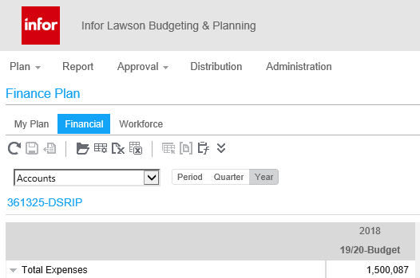
LBP Main Screen

Slide 8
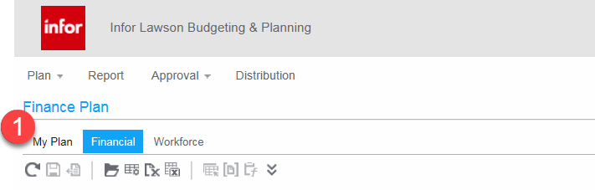
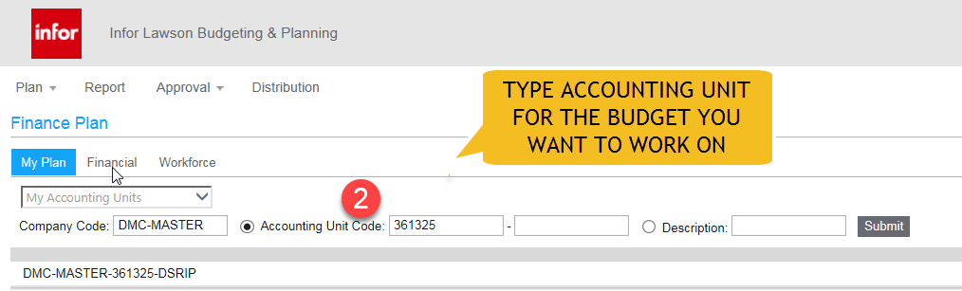
Open Accounting Unit (AU)
There are two ways to open an Accounting Unit (AU)
The First Way to Open an Accounting Unit (AU)
STEPS TO OPEN AN AU
Click on MY PLAN button (1)
Type in AU for the Budget you
want to work on (2)
Click on AU here to open the Budget you want to work on
CLICK ON AU HERE TO OPEN BUDGET
3
(3)

Slide 9
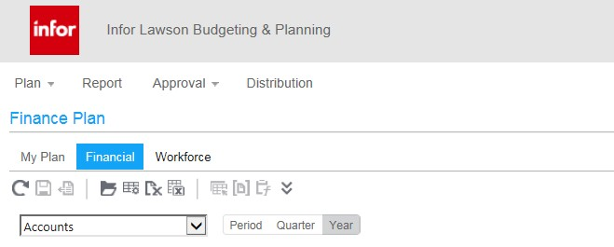
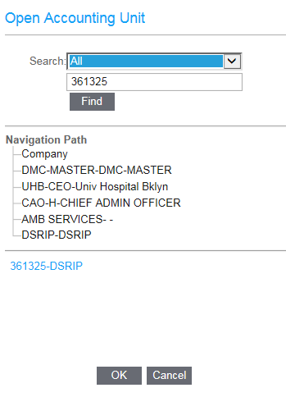
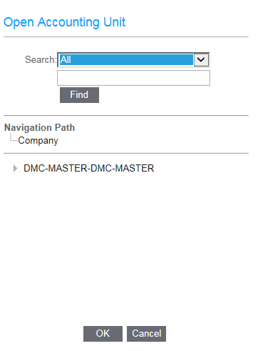
Second Way to Open An Accounting Unit (AU)
Click on the
icon to open Accounting unit (AU) directly as well.
Type in AU and Click on Find.
Click OK once the AU appears.

Slide 10
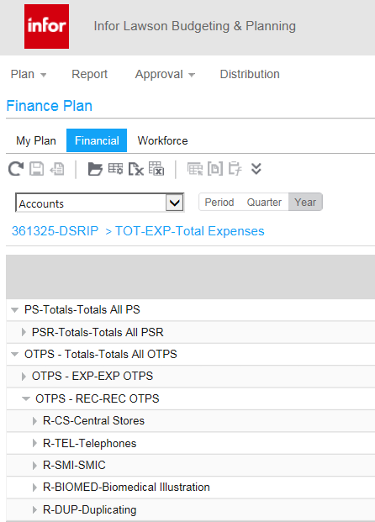
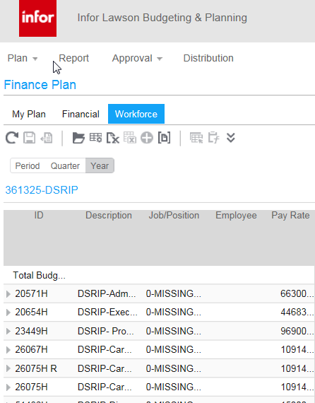
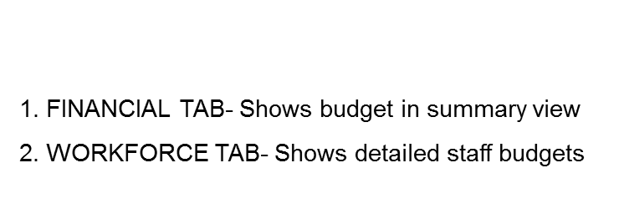

Financial Tab View
Screens to Complete Budget
There are two tabs to work from when completing your
budget: the FINANCIAL tab and the WORKFORCE tab.
WORKFORCE TAB VIEW
11

Slide 11
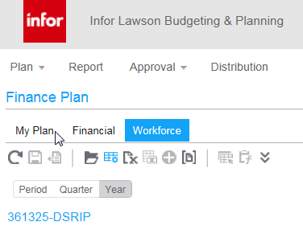
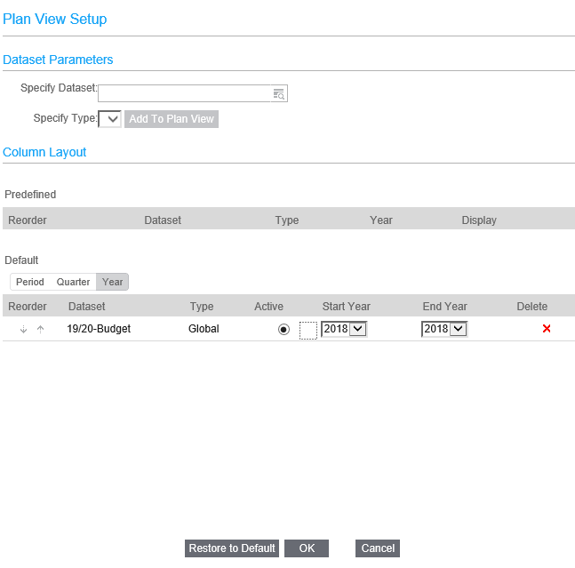
Preparing Plan View for
FY 21-22 Budget Dataset
1
3
2
3
STEPS TO OPEN UP BUDGET
Click on PLAN button (1)
Click on RESTORE TO DEFAULT (2)
Click ON SPECIFY DATASET (3)
2

Slide 12
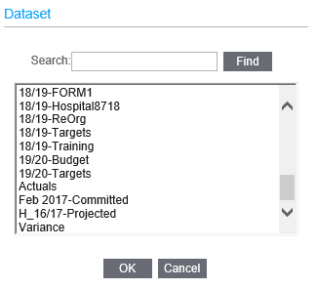
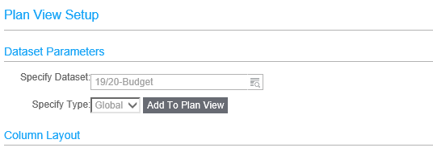
Preparing Plan View for FY 21-22
Budget Dataset
4
6
5
SCROLL DOWN to select budget (4)
Click OK (5)
Click ADD TO PLAN VIEW (6)

Slide 13
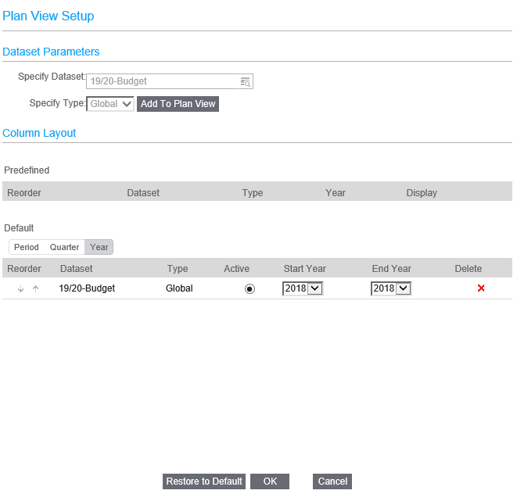
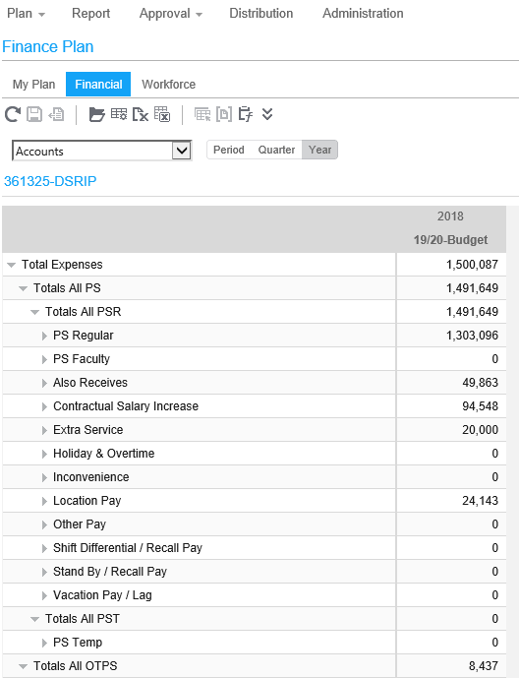
Preparing Plan View for FY 21-22
Budget Dataset
Click ACTIVE Button (7)
Click OK (8)
Budget Plan View
7
8
The following datasets are available in the system for your use:
20-21 Budget - Adjusted
21-22 Budget - preloaded budget dataset (for data entry)
Note: To access prior year datasets: Click Plan, select the dataset from the drop down menu & Click on Add To Plan View.

Slide 14
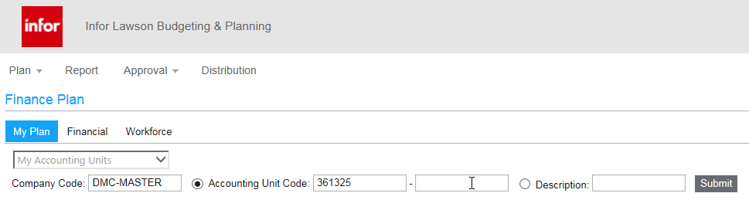
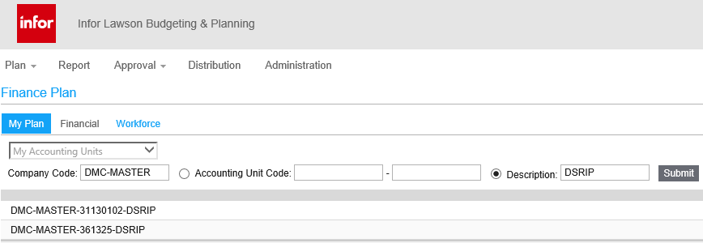
My Plan View
Once you log in, AND SELECTED THE PLAN VIEW, you will see the My Plan View for your department.
  The My Plan View provides rows of expenditure accounts and columns (known in LBP as “Datasets”) with information that will assist you in preparing your budget.
  Here you will be able to type in the Accounting Unit (AU) or the Description to open up the Budget you want to enter
  Or you can just hit SUBMIT button for all Accounting Units (AU) that you have access to.
Accounting Unit (AU)
Enter name of AU you here
if you do not know the AU

Slide 15
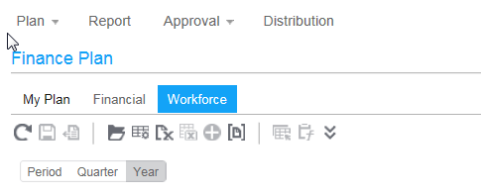
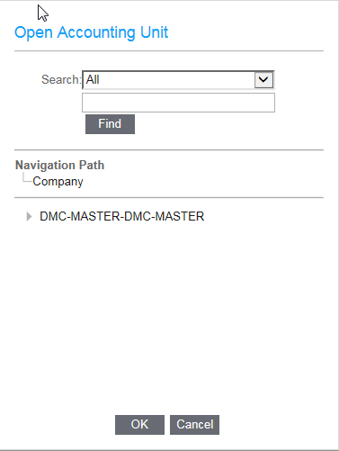
Accounting Unit (AU’s)
Budgets are always updated at the posting AU level (yellow boxes indicate data entry field).
Expand or drill down into the AU to the posting AU (lowest level).
Click on the plus “
” sign to the left of each summary AU to expand to the next level. You are at
the posting level when there are no more “+” signs to expand.
Note: If you are assigned only to posting level AU’s, you will not see the AU summary hierarchy.
DO NOT ENTER AGENCY EXPENSES INTO THE WORKFORCE TAB DIRECTLY OR IT WILL BE REMOVED.
Click on to open drop down box for AU
.
Click on
sign to expand to posting AU

Slide 16
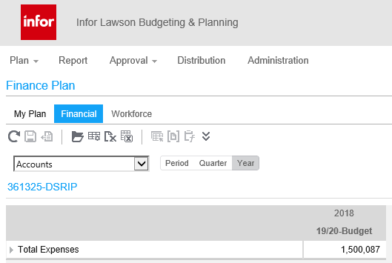
Financial Tab
The Financial tab is where you will enter:
  OTPS (Other Than Personal Service) budget requests.
  PS (Personal Service) non-workforce, lump-sum amounts at a non- employee level (e.g., overtime, standby, etc).
    Note: Detailed calculations for employee related costs are computed in the Workforce tab. The resulting summary amounts from the Workforce tab are reflected in the Financial tab at the account level.
The screen below shows the Financial tab is active. Note the light blue color of the active tab.

Slide 17
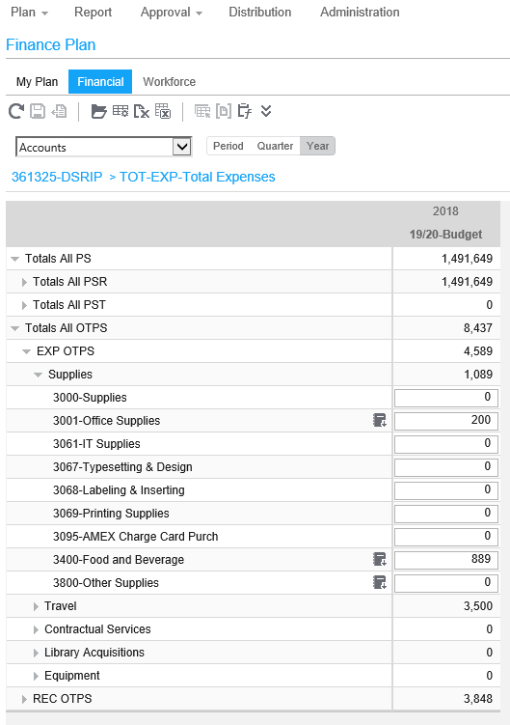
Accounts View
Shows the roll-up of expenditure categories. Drill down to lower level accounts by clicking the ( ) symbol on left of summary accounts.
When viewing data at a summary AU level, the account view shows total
data values for that summary AU. You cannot edit the data at these levels.
When viewing data at the posting AU level you can edit and update your budget.
Summary Accounts
Posting Accounts

Slide 18
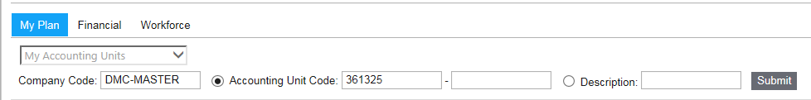
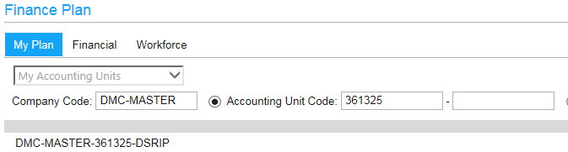
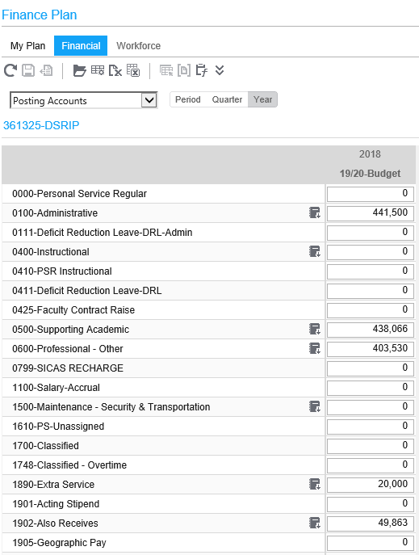
Posting Accounts
Enter the AU for the Budget you want to work on
Click Submit
The AU will appear and then click the link to open AU
Alternately the Posting Accounts view will automatically appear
– It will list all of the posting accounts for that AU.

Slide 19
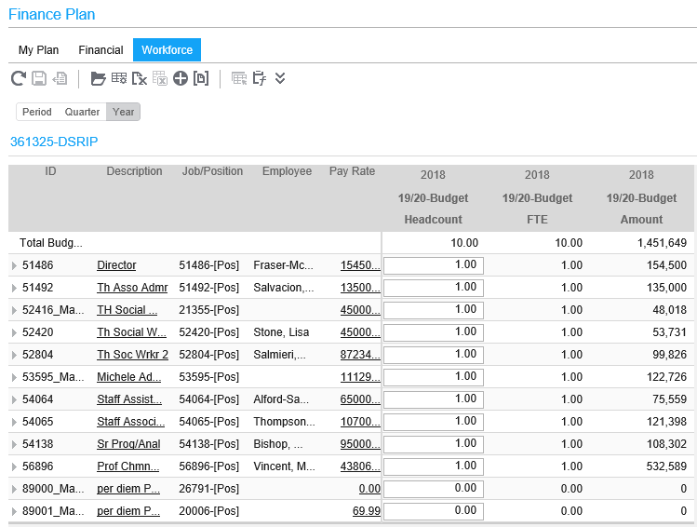
Workforce Tab
1. For entering new and changing current PS salary component $ amounts
Lists all positions and employees in your Posting AU
Please verify all employees in the Posting AU’s that are in your area
If you are missing, existing employees that are on the current payroll, then you can add
them here
The FY 21-22 Budget dataset has been pre-populated with projected PS budgets for each AU. These preloaded numbers can be edited
Click on the ID number to drill down to employee details.
Preloaded
Budget amounts

Slide 20
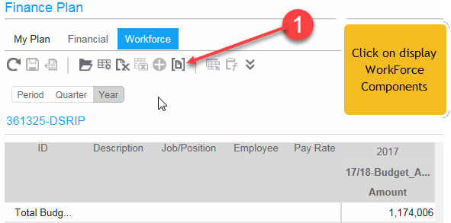
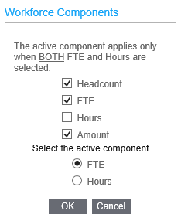
Setting Up the Workforce Tab
HOW TO SET-UP THE WORKFORCE TAB
2
Go to Finance Plan:
1. Click on display Workforce Components (1) When in Workforce Components:
Select Headcount, FTE and Amount, then Click OK
2. Select Headcount, FTE and Amount, then Click OK (2)

Slide 21
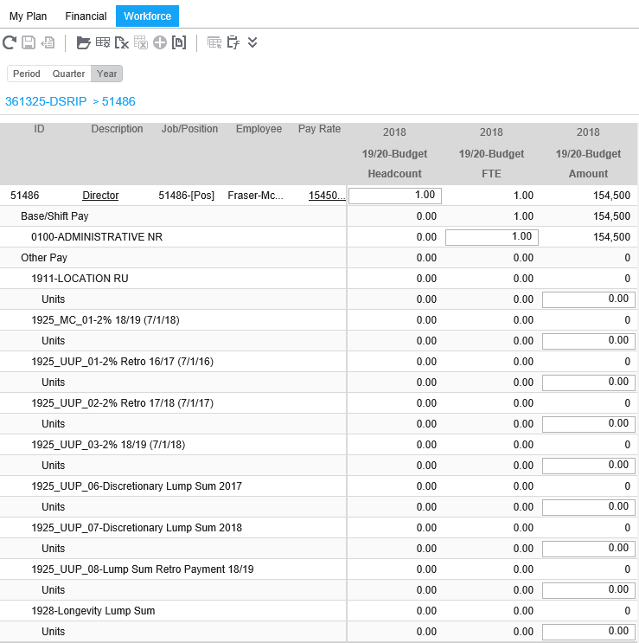
Workforce Detail Account Lines
Workforce detail lines appear when you click on a Workforce budget ID # (equivalent to “line #”)
Each detail line represents a unique pay code. Numbers are entered into the yellow input fields to create a Workforce budget.
Do not make any changes to the Pay Rate. You MUST have prior approval from Administration and a salary review from Human Resources, prior to making such a change. Please submit a copy of any salary review from Human Resources when completing your budget.
Enter Headcount detail in this field.
Enter FTE detail in this field.
Click to see AU distribution and employee details and modify budget.
Enter detailed fixed amounts for items such as Location Pay, Also Receives, etc.,

Slide 22
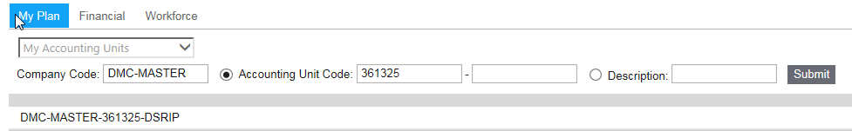
Using the Navigation Path
The Navigation Path, also referred to as Breadcrumbs, appears at the top of the screen.
– Path used to get to where you currently are in the plan view.
To create a breadcrumb:
  Open an AU from My Plan -> Open Accounting Unit,
    (Note: if AU’s are grayed out, it means that you have not been assigned access to view these AU’s).
  Select or type in an AU to be your starting point and click OK.
  The name of the AU appears in the navigation path.
  In the My Accounting Units view, click on each AU level from the top summary to the posting level,
5. NOTE: Please note just click with the mouse to navigate between screens
1
4
2
3

Slide 23
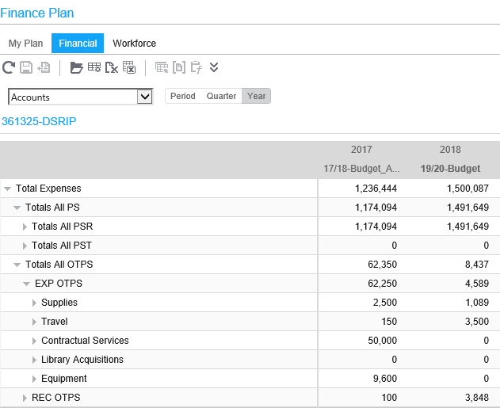

Review Accounting Units (AU’s)
In the My Plan View (see page 16), select Accounting Units (AU’s) from the drop-down box. You will see the AUs that you have been assigned to.
Note: You may see AU’s on the screen that are grayed out if you have not been assigned to these AU’s. They appear so you can see where your AU’s roll up in the organization hierarchy.
View Preloaded Budget and Target Amounts
Review the preloaded FY 21-22 Projected Budget amounts.
In Financial tab - View Targets data at Summary Level AU’s for Fund Within Division.
Target amounts appear only if you are assigned to all of the AU’s for a fund within a division.
Targets appear for Fund/Division for State (3R), Hospital (7H) and Dorm (4R) Funds.
Note: Targets are subject to change.
Preloaded Target Dataset
Preloaded Budget Dataset

Slide 24
View Preloaded Salary Budget
Review the amounts the preloaded FY 21-22 Budget dataset
Preloaded Budget dataset

Slide 25
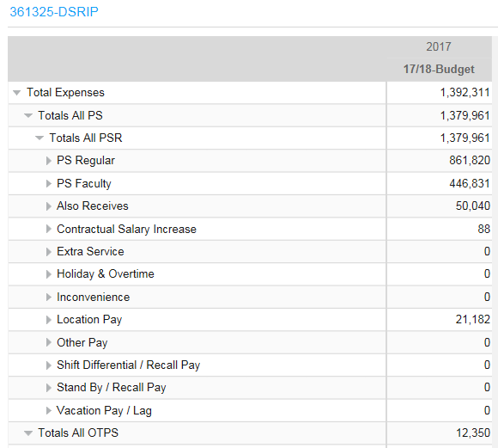

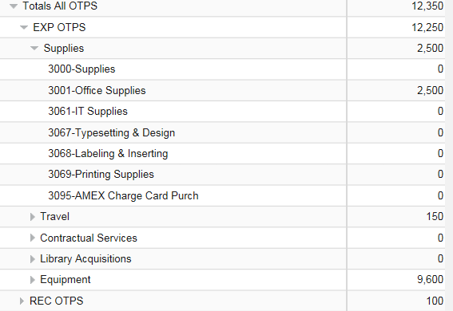
View PS Summary Information
Click on the Financial tab.
Select Accounts from the Accounts/Accounting Unit drop menu field.
View salary information by expense type (accounts/object code).
Drill down by clicking on the ( ) symbol until lowest detail account is displayed.
OTPS Detail Accounts
PS Summary Accounts

Slide 26
Salary Projection for FY 21-22-Budget
Projection for the FY21-22-Budget is based on Payroll (PR) 21 (the 2/3/2021 paycheck). See tables below for categories included/excluded in the projection:
INCLUDED:
EXCLUDED:
OBJECT | DESCRIPTION
0100 to 1899 | BASE SALARY
1902 | ALSO RECEIVES
1905 | GEOGRAPHIC
1908 | INCONVENIENCE PAY
1909 | INTERN IN RESIDENCE
1911 | LOCATION
1921 | PRE-SHIFT BRIEFING
1922 | SHIFT EVENING
1928 | LONGEVITY
2698 | OTHER-GRADUATE STUDENT
2699 OTHER-STUDENTS FB EX
Overtime | 1948
Holiday Pay | 1947
Vacation Payoff | 1918
Overtime meals | 1985
Also Receives (Temp Svc) | 2052
Geographic (Temp Svc) 2055
Location (Temp Svc) | 2061
Supporting Academic* | 2100
Adjunct** | 2400
Teaching Assistants | 2483
Extra Service | 2499
Student Assistants | 2600
* 2100 / 2400 are projected with $1 as a placeholder for hourly employees, and should be adjusted as necessary.
These items should be budgeted at the AU level in the Financial tab.
20/21 UUP-DSI and Equity Increases are included in Projection. Other Contractual increases are not included. No action required.

Slide 27
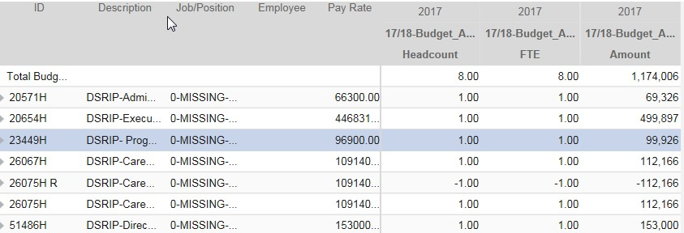

Review Current Positions in the AU
Click on the Workforce tab.
Open Plan -> Accounting Unit. Select a posting AU.
  Scrutinize all positions to determine if salary / distribution is correct.
  Determine if positions are needed or should be eliminated if possible.
Select an employee record to work on by clicking on a Workforce budget ID.
  Determine if the position is correctly charged to the AU and required for FY 21-22
  If this Position/Line does not belong in this AU:
    Contact: (Hospital) Sharad.Kumar@downstate.edu
    Contact: (Academics & Shared Services) BudgetHelp@downstate.edu
    Contact: (COM & Grad School) Ross.Clinchy@downstate.edu
    Elizabeth.Smith@downstate.edu
    For budget purposes, change budgeted amounts and FTE/Headcount to zero.
Note: The system has been preloaded with a projected budget for Personal Services,
based on Payroll PR 21 (2/3/21)
FTE
Distribution Amounts
Workforce Budget ID
Base Salary/budget amount verification required

Slide 28
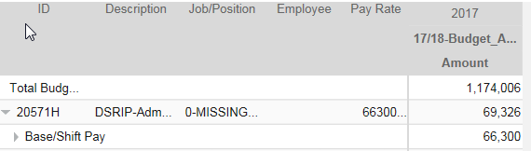

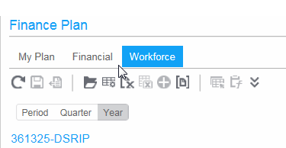
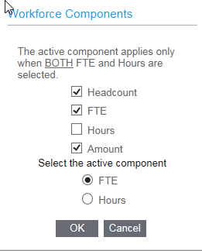
Workforce FTE/Headcount Column
Note: The first time you log into LBP, the FTE/Headcount column may not appear in your Workforce view.
To see the FTE detail column:
Click on the Display WF Components button
Click on the box to the left of FTE and Headcount and a check mark will appear
Click OK

Slide 29

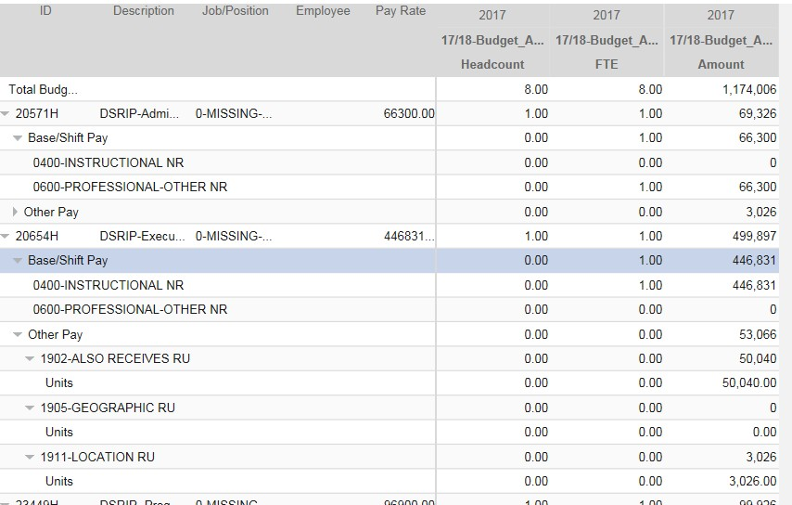

Modify Existing Employee Record
If salary rate is incorrect or not properly distributed to AU’s and salary components:
  Change number in FTE/Headcount field to desired percentage for that AU.
  Change Unit amounts for non-base salary pay codes, (e.g., Location Pay, Also Receives, etc.).
  Change end date of position (i.e.; retirement or resignation) using the Modify Workforce Budget screen.
To modify an employee record.
  If a position is no longer needed, change the Pay Rate, FTE, Headcount and Unit amounts for that employee to zero. Very Important - Do not delete the position. Make sure all salary components are zeroed-out, (e.g., Location Pay, Also Receives, etc.).
Note: If required pay code is missing for position, for the Hospital, contact BudgetHelp@downstate.edu
Click to open Workforce budget screen
FTE Fields for base salary pay
codes
Unit amounts for non-base salary pay codes

Slide 30
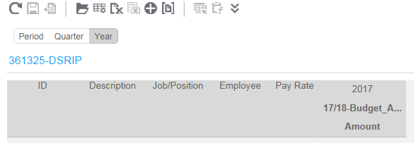
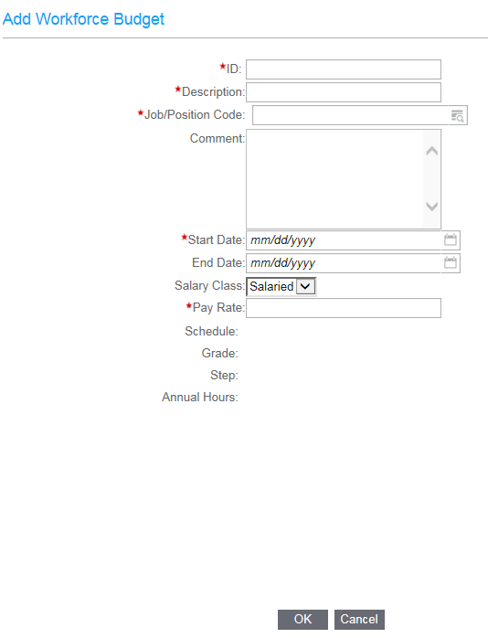

To Designate Employee Salary Distribution to Different AU / Add a Missing, Vacant or New, Approved Funded Position
•
From the Financial tab, select the posting AU to work on.
Select the Workforce tab and click on the Add
1
•
Budget Icon The Add Workforce Budget
input screen will appear. 1
.
•
•
Enter data into Add Workforce Budget fields
Click OK
Add Workforce Budget fields (A red asterisk = required field):
•
ID - Same as the UHB Line number. (for a new line number use the format: “NEW-sequence #-Posting AU”. Example: “NEW#H321370”)
Description - Position title. If existing position, can put in employee name.
Job/Position Code - Click the Find button. Select Position Code. If existing position, same as line number. For additions, select from “Generic codes”.
Comment: This is a freeform text field (1) If employee is allocated between multiple AU’s, enter the % breakdown by AU for that employee. (2) If modifying an employee record, indicate what was changed, example “changed FTE from .5 to zero”
Start Date - Expected start date.
End Date – Leave blank or enter an expected end date.
Pay Rate - Total annual base salary.
(Note: For part time employees use actual salary paid, not annualized rate)
•
•
•
•
•
•

Slide 31
Adding Missing Positions and New Position Requests
Use the Generic Position codes shown below to enter missing positions or requests for new Positions:
MISSING- Add missing positions in appropriate AU(s) using “0-MISSING” code
VACANT -
  Academic & Shared Svc-EC3 approved positions were loaded to department AU’s. If missing, use “0-VACANT” code to enter in the department’s AU
  Hospital Non-Shared Services-add approved positions from list provided by Hospital Finance Dep’t. Use “0-VACANT” code to add to department AU’s
NEW - Non-Hospital NEW (not yet approved) requests, use special VACANT “VAC”) AUs at departmental or divisional level (with the exception of the COM and SGS) to add new position requests . Use “0-NEW-UNFUNDED” code
0-MISSING Existing position missing from list
0-VACANT APPROVED Add approved vacancy
0-VACANT-FUNDED Replace existing position within budget
0-NEW-UNFUNDED New Position Request - not yet approved

Slide 32
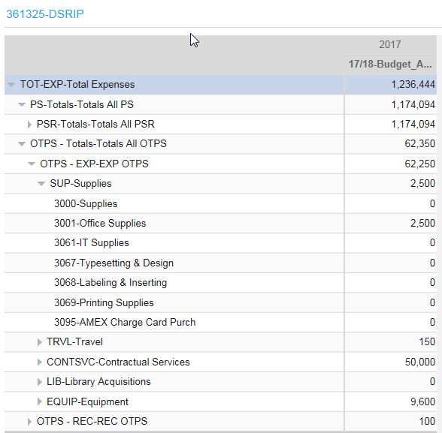
Financial Tab
•
To View OTPS (Other than Personal Service) Summary Information
Click Financial tab.
In the Financial view, click on a summary account to review.
Summary Account “OTPS – Totals” is the total of all OTPS accounts.
Drill down to see details.
•
Entering a Budget (OTPS and PS non-workforce, lump-sum adjustments, such as overtime, standby, etc.)
After selecting your posting AU, the screen will show Accounts in the Financial tab view. Budgets may only be entered at the posting AU level.
Edit or add amounts to FY 21-22 Budget. Input desired dollar amounts in the fields highlighted in yellow.
PS non-workforce, lump-sum adjustments can be made by changing the amount in the yellow box, or at the detail lines level, but adjustments made in the Financial tab will not show up in the Workforce tab.
Enter amounts in yellow highlighted fields
OTPS Total

Slide 33
OTPS
OTPS should be entered into LBP with as much detail as possible
Vendor info or item details must be included for budgeted expense of $10K or more, including contract # where applicable
Existing contracts-detail lines have been preloaded. Budget amount must be added.
Consulting contracts-Use Object Code 5813 – Consultants (see reference list, pg 47)
Temp Agency Staff requests- Use Object 5842-Manpower Svcs in Finance Tab.
  Use detail lines to enter FTE’s and Titles.
  Temp Staff Agency expenses entered in Workforce tab will be removed.
OTPS expenses should be entered in the appropriate category, and not as a lump sum miscellaneous amount
  (e.g., Supplies, Contracts, Travel) in specific object code (e.g., 3001, 4240, 5003, 5842, 7200)
HOSPITAL NON-SHARED SERVICES ONLY - Do not budget for any equipment item for more than $5,000. Capital budgeting is being done separately.

Slide 34


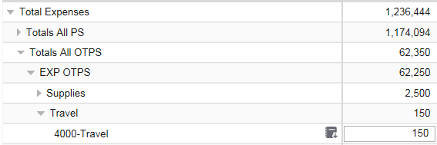
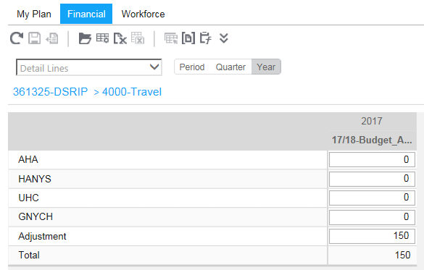
Adding and Editing Account Detail Lines
Detail lines are used to breakdown / describe the amounts entered in a posting account. For example, you should list contracts, suppliers or equipment type.
For contracts, please review the list provided to you by the Budget Office, enter/modify the information where appropriate and if any contracts are missing, please see the next page for instructions.
To add and edit detail account line data:
  Click on a posting account.
  Click the Icon box and select Detail Lines.
  The Change Line Items window will open

Slide 35
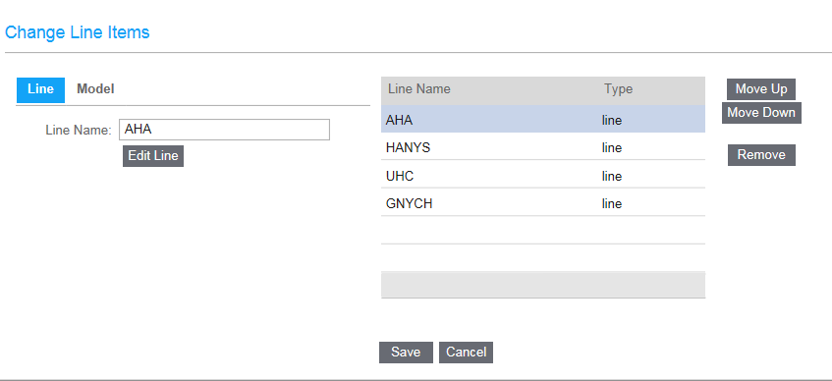
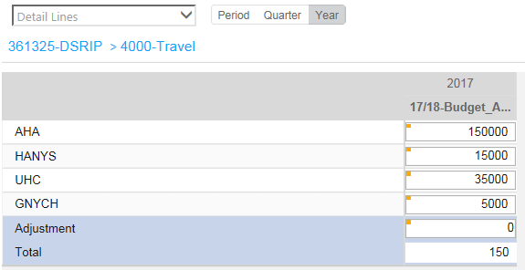
Adding and Editing Account Detail Lines (continued)
•
From the Change Line Items window: Click the Add Line box and type a description in the Line Name Field.
Note: For contracts missing, please enter the following description format: “Contract#-Contractor/ Vendor-Contract Description”.
Click to re-order line items
Click to remove line items
•
Add a line for each budgeted item and click Apply to move the item to the left box. (You will not be adding dollar amounts on this screen.)
•
Hit OK and you will now see the screen to enter line item amounts. Enter amounts in the yellow fields.
•
Hit the Save button in the upper right hand corner of the screen to save changes.
Note: The Adjustment line will show the difference between the total of the detail lines entered and the amount that appears in the
Financial tab view for that posting account.

Slide 36
APPENDIX

Slide 37
Reports
There are two ways to obtain reports of your budgets from Lawson
Budgeting and Planning (LBP):
Copying Data to Excel, or
Exporting Data to Excel.

Slide 38
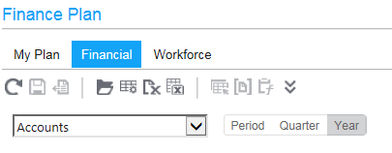
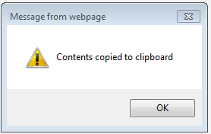
Copying Data to Excel
The following is a quick and easy way to copy contents of the plan view to Excel for review and to produce a hard copy of the budget.
1.
While in the Financial tab, choose Copy to Excel
The contents are copied to the clipboard
Click OK
2.
3.

Slide 39
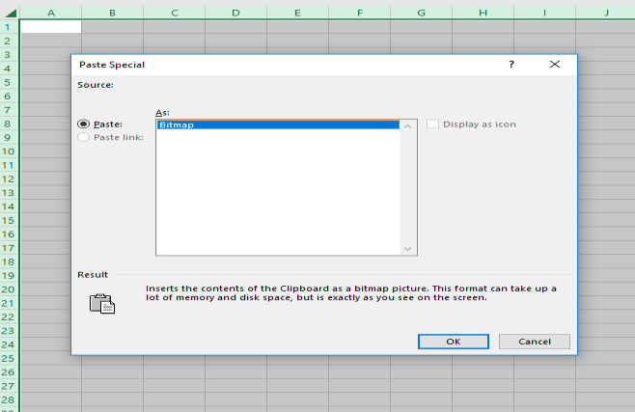
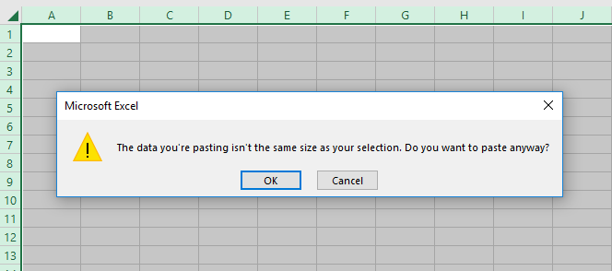
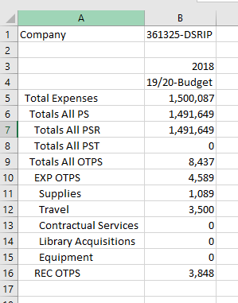
Copying Data to Excel
Open a file in Excel and Click OK to paste
Format worksheet as desired

Slide 40

Exporting Data to Excel
The following is a way to export contents directly into Excel for review and to produce a hard copy of the budget.
1.
While in the Financial tab, choose export to Excel
A screen will appear for you to select the perimeters
Click Next
2.
3.

Slide 41



Exporting Data to Excel
Exporting Data to Excel
The screen with your selections will appear
Assign options from list under available
Once you have assigned all attributes click Finish
An Internet Browser will open giving you the option to open

Slide 42

Exporting Data to Excel
Displayed here is the file containing information selected. You can click on the various tabs at the bottom to drill down into the material.

Slide 43
Lawson vs. State Terminology
Account vs. Accounting Unit (AU)
“Accounting Unit” or “AU” in Lawson = State “Account”.
“Account” in Lawson = State “Object Code”.
•
Summary Accounting Unit (AU) - Alpha-numeric names representing a total of a group of AU’s. Examples:
VP1 - VP – ADMINISTRATION
AA - Affirmative Action 7H-CEO - CEO
–
The AU hierarchy flow is as follows:
VP Area -> Division -> Fund within division -> Posting level AU.
– Fund roll-up AU’s- First 2 positions represents the fund as follows:
0R - General IFR 3R - State Purpose 4R - Dormitory
5R - Hospital IFR 7H - Hospital
•
Posting Accounting Unit (AU)
6 digit number representing the AU level where budget data can be edited.
Lowest level in the AU hierarchy.
Examples: “361325” DSRIP” “321358 Patient Accounts”
•
Summary Account - Non-numeric names representing a total of a group of accounts.
Examples:
PS - Personal Service
CONTSVC - Contractual Services SUP - Supplies
•
Posting Account - 4 digit number representing the account level where budget data can be edited.
Examples:
5003-Conference/Training Services
5006-Memberships

Slide 44
Income Fund Reimbursable (IFR) Accounts Budgets
IFR accounts are accounts that are used for depositing revenue. SUNY requires “appropriation” authority to disburse collected revenue. Spending authority for this revenue is provided on an annual basis by the State Legislature and the Governor in the Enacted Budget. As part of the annual budget making process, the state carefully scrutinizes SUNY’s requested levels of appropriation, and System Administration relies on the campus information to substantiate requested year-to-year changes. It is therefore necessary to prepare a budget allocation request for spending IFR Revenue.
Although an account may have a cash balance, the allocation is also required in order to spend. The cash balance is carried over from year to year, but a new budget request for allocation needs to be entered in LBP annually.

Slide 45
Income Fund Reimbursable (IFR) Accounts Budgets
Please input in LBP the FY 21-22 planned expenses for each IFR in as much detail as possible to assist us in understanding the plan for spending in the coming year. In order to establish a budget allocation for an IFR AU, the projected cash balance for next fiscal year needs to be determined
First, the projected net revenue for the balance of the current Fiscal Year 20/21 should be calculated. Take into consideration any additional revenue or expenses that will be incurred for the remaining portion of the year
Next, the projected revenue for FY 21-22 should be estimated based on known factors such as grants, affiliation contracts or other type revenue streams.
Total projected cash available will become the Target (Maximum Allocation) that can be requested for each IFR.

Slide 46
Establishing a Budget Allocation for IFR AU’s
(this worksheet is designed to assist in calculating the projected cash balance)
Guidelines to assist in determination of required allocation (budget):
1. Determine net available funding for operations for the upcoming fiscal year for the AU
Projected Adjusted* Beginning Cash Balance as of 7/1/21 *(includes prior year cash balance less disbursements and encumbrances) | $ | -
Plus: Projected Revenue for FY 21-22 |  |  | -
Less: Projected Fringe Benefit Expense (Fringe benefit rates vary. Please contact Sergio Maffettone at ext.2790, if unsure of the fringe benefit rate that applies) |  |  | -
Less: Maintenance Overhead Expense (if applicable) |  |  | -
Less: Administrative Overhead Expense (if applicable) |  |  | -
Net Available Funding for FY 21-22 | $ | -
2. Requested allocation should include the following estimated costs (limited to the net funding available)
•The actual fiscal condition of the IFR will be determined by the cash balance in the account.
•The ability to spend the cash balance will be determined by and limited to the allocation in the
Projected Fiscal Year Personal Service Expense (including all salary adjustments for estimated contractual increases) | $ | -
Projected OTPS Expense | $ | -
account. If revenue is available to support additional expenses, a request can be made to increase the allocation.

Slide 47
CONSULTANTS – BUDGET IN OBJECT CODE 5813
State Finance Law requires that each Fiscal Year the Office of State Comptroller (OSC) report all contracts for consulting services that were issued by State agencies
Therefore, we are requesting that any consulting contract be posted to Object Code “5813-Consultants” in the FY20/21-Budget. Below are the types of consulting contracts that need to be reported:
Analysis
Research
Training
Data Processing
Computer Programming
Engineering
Environmental Health Services
Mental Health Services
Accounting
Auditing
Paralegal
Legal
Similar Services

Slide 48
Physicians AU’s based on the Specialty – UHB
Budgeting Hospital
Only
The Hospital has separate AU’s for Physicians by their major Specialties based on the College of Medicine structure.
All the FTE’s with Physicians titles have been moved to the new AU’s from their original home
AU’s.
Zero out any FTE left in the original home AU’s in error. Please inform
Sharad.Kumar@downstate.edu or Darrel.MacArthur@downstate.edu of this error.
Zero out any also receives or any other salary component left in the original home AU’s in error.
All the physician’s AU are under Darrel MacArthur. He can be reached at
Darrel.MacArthur@downstate.edu in case you have any questions.
Below is the list of AU’s being used for physicians.
AU | AU Description
351353 | PHYSICIANS - DERMATOLOGY
351389 | PHYSICIANS - EMERGENCY MEDICINE
351359 | PHYSICIANS - PATHOLOGY
351362 | PHYSICIANS - ANESTHESIOLOGY
351369 | PHYSICIANS - FAMILY PRACTICE
351399 | PHYSICIANS - MEDICINE
351372 | PHYSICIANS - NEUROLOGY
351373 | PHYSICIANS - OBS/GYN
351374 | PHYSICIANS - OPHTHALMOLOGY
351379 | PHYSICIANS - PEDIATRICS
351382 | PHYSICIANS - PSYCHIATRY
351314 | PHYSICIANS - RADIOLOGY
351383 | PHYSICIANS - RADIATION THERAPEUTIC
351384 | PHYSICIANS - REHAB MEDICINE AND ORTHOPEDIC
351385 | PHYSICIANS - OTOLARYNGOLOGY
351386 | PHYSICIANS - SURGERY
351387 | PHYSICIANS - NEUROSURGERY
351388 | PHYSICIANS - UROLOGY

Slide 49
Union Codes For New Hires And Employee Status Changes
For informational purposes, below are the bargaining units to calculate
any PS information
Negotiating Unit |  | Union Long Name |  | Union Short Name
02, 03, 04 | Civil Service Employee Association, Inc., Local 1000, AFSCME, AFL-CIO |  |  | CSEA
05 | Public Employees Federation, AFL-CIO |  |  | PEF
08 | United University Professions |  |  | UUP
13 | Management Confidential |  |  | MC
28 | Communications Workers of America/Graduate Student Employees Union, Local 1104 |  |  | CWA/GSEU
21 | NYS Correctional Officers and Police Benevolent Association, Inc. |  |  | NYSCOPBA
31 | The Police Benevolent Association of New York State, Inc. |  |  | PBANYS

Slide 50
FY 21/22-Budget Highlights and Important Notes
Use Internet Explorer to access LBP
Prepare your Plan View Setup for FY 21/22-Budget database
Only Object code “5813-Consultants” should be used for CONSULTANT CONTRACTS
Union Salary increases were NOT preloaded in the Workforce tab. Funds will be held centrally to address the increases once there is a directive to move forward with them. No action is required
For Academic and Shared Services areas - VACANT AU’s should be used for new requests to fill Vacant positions or other new salary actions. For Hospital non-Shared services, only approved vacancies should be input to department AU’s (list to be provided by Hospital Budget dep’t)
AU’s used for Procurement Card charges must be budgeted in respective objects (i.e. Supplies)
IFR‘s must be budgeted if expenses are planned for 21/22, not to exceed projected cash balance
Contract detail lines have been preloaded. Budget amounts must be entered on these detail lines. This will enable Contracts dep’t to encumber the contracts without requisition submittal.
For Budget Presentations, a narrative at divisional level will be requested.
Department’s Table of Organization are requested only if updates required
(Not required for Hospital)
Budget submission due April 16, 2021

Slide 51
Workforce Planning
Workforce Planning is a core function of human resource management. It relates to the systematic identification and analysis of what an organization is going to need in terms of the size, type, experience, knowledge, and skills of its workforce to achieve its objectives. It is a process used to generate the data to inform the organization of the current, transition and future impact of the environment of the organization
Each area should be looking at their workforce both operationally and strategically:
Operational workforce planning: usually covers the next 12-18 months and should align with the timeframe of the business planning cycle. It is the process and systems applied to gathering, analyzing and reporting on workforce planning strategy
Strategic workforce planning: usually covers a 3-5 year forecast period, aligned to business needs and outcomes. It focuses on identifying the workforce implications, current, transition and future of business strategic objects and includes scenario planning

Slide 52
Workforce Planning
The following is a list of the most common components of a workforce plan:
Forecasting and assessment | Estimates, for example, of the internal/external supply and demand; labor costs; organizational growth rates; and revenue sources.
Succession planning | Designating, for example, the progression plan for key positions.
Leadership development | Designating high-potential employees; coaching; mentoring; rotating people into different projects.
Recruiting | Estimating needs for head count, positions, location, timing, and more.
Retention | Forecasting turnover rates; identifying who is at risk and how to keep them.
Redeployment | Deciding who is eligible for redeployment, and from where to where.
Contingent workforce | Designating the percentage of employees who will be contingent, and in what positions.
Potential retirements | Figuring out who is eligible, when they are eligible, who will replace them, and what alternative work arrangements are available that could prevent a retirement problem.
Performance feedback | Instituting opportunities to set expectations, assess individual and organizational success, and putting together development plans (both individual and collective).
Career path | Career counseling for employees to help them move up.
Backfills | Designating key-position backups.
Environmental forecast | Forecasts of industry and environmental trends, as well as a competitor assessment.
Identifying job and competency needs | Doing a skills-and-interest inventory.
Metrics | Identifying metrics to determine the effectiveness of workforce planning.
Forecasting
assessment
and Estimates, for example, of the internal/external supply and demand; labor
costs; organizational growth rates; and revenue sources.
Succession
Leadership
planning Designating, for example, the progression plan for key positions.
development Designating high-potential employees; coaching; mentoring; rotating
people into different projects.
Recruiting
Estimating needs for head count, positions, location, timing, and more.
Retention
Redeploym
Forecasting turnover rates; identifying who is at risk and how to keep
them.
ent Deciding who is eligible for redeployment, and from where to where.
Contingent
Potential re
workforce Designating the percentage of employees who will be contingent, and in what positions.
tirements Figuring out who is eligible, when they are eligible, who will replace them, and what alternative work arrangements are available that could prevent a retirement problem.
Performanc
Career path
e feedback Instituting opportunities to set expectations, assess individual and organizational success, and putting together development plans (both individual and collective).
Career counseling for employees to help them move up.
Backfills
Environmen
Designating key-position backups.
tal forecast
Forecasts of industry and environmental trends, as well as a competitor
assessment.
Identifying competenc Metrics
job and Doing a skills-and-interest inventory.
y needs
Identifying metrics to determine the effectiveness of workforce planning.
55

Slide 53

Window 10 Upgrade
Window 10 Upgrade
Microsoft Edge is set as default browser on Windows 10 workstations. Lawson LBP requires Internet Explorer 11(IE) to be used. To get Internet Explorer:
Open IE on Windows 10 workstation
Change default browser on Windows 10 workstation
Confirm IE is used
To open Internet Explorer on Windows 10 workstation,
Click on the Search icon at the left lower corner on the desktop

Slide 54

Window 10 Upgrade
Window 10 Upgrade
Type “Internet Explorer”” in the search field shown at the bottom, and click on the Internet Explorer in the “Best Match” session shown at the top to open IE

Slide 55

Window 10 Upgrade
Window 10 Upgrade
To pin the IE icon on the taskbar for easy access in the future, RIGHT click on the IE icon on the taskbar while IE is open, and click on “Pin to taskbar”. The IE icon will be pinned on the taskbar and a single left click on it will open IE

Slide 56
Window 10 Upgrade
Window 10 Upgrade
To confirm the default browser or change the default browser to Internet Explorer(IE),
Click on the Search icon at the left lower corner on the desktop

Slide 57

Window 10 Upgrade
Window 10 Upgrade
Type “Default Apps” in the search field shown at the bottom, and click on the Default apps in the “Best Match” session shown at the top.

Slide 58

Window 10 Upgrade
Window 10 Upgrade
In the window opened, click on “Microsoft Edge” under “Web browser”.
Note: It might show other browsers, like Chrome, instead of “Microsoft Edge” if the default browser had been changed
Click on “Internet Explorer” from the list. The default browser has been changed to IE. The change takes effect immediately and no reboot is necessary. From this point on, IE will be used if you click on a link in an email or a Word file

Slide 59

Window 10 Upgrade
Window 10 Upgrade
To confirm if IE is used,
click on the wheel symbol at the right upper corner of the browser window. If you see “About Internet Explore”, IE is used.
If you do not see the wheel icon in the browser window, you are likely using other browsers
To change the default browser back to other browser, Chrome for example, you can repeat the same process

Slide 60
Budget Submission
Completed budgets must be submitted to the Budget Departments by
April 16, 2021
After this date, the budget will be locked to modification

